Slide 1
What’s new @IBM ?
Laurent Vanel
Laurent.vanel@fr.ibm.com
High Performance Infrastructure Specialist

Slide 2
The world’s view of high-performance computing has evolved
The “Old View” of HPC
The value of an HPC system is measured by FLOPS and TOP500 rank
The Objective is to Make an Algorithm Run Faster
HPC is a Special Category of Computing
HPC Looks Only at the Cluster/Server
Storage is an Afterthought
The IBM View of HPC
Value is Measured by Application Performance
The Objective is to make a workflow optimized
HPC is another form of Analytics
Influx of Large Data demands consideration of Data Management and Storage in HPC: We Must Look Beyond the Server. Performance and data availability are imperative
What Matters
Balanced system design
Scalable, heterogeneous, data centric
Software defined infrastructure
Access data, apply compute, operate workflows
Organic & Collaborative innovation
Eg: OpenCAPI, Co-design, Centers of Innovation
Programming Ease of Use
Application portability with OpenMP
NVLink, Unified Virtual Memory, Page Migration Engine
Notes:
2

Slide 3
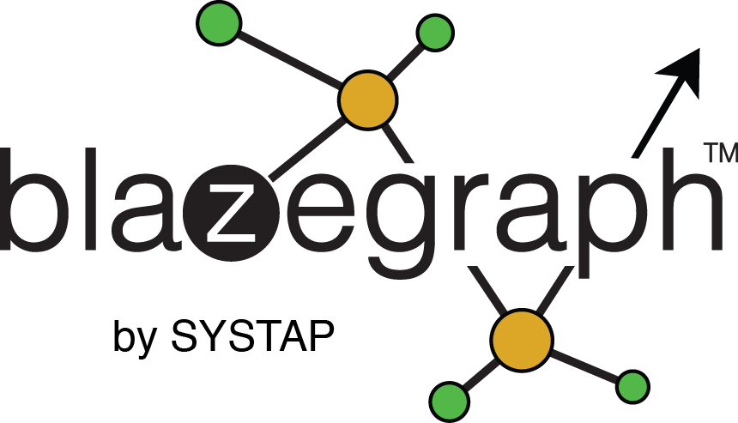
We are investing for in new fields for Innovation
Accelerated and Open Source Data Bases
Accelerated DB: Kinetica, Blazegraph, others
Top R&D Applications
ML/DL
Custom Caffe- CPU/GPU NVLink Optimized
OSDB: EnterpriseDB, MongoDB, Redis, Neo4J, Cassandra
Gaussian , Ansys Fluent,
GROMACS, NAMD,
VMD, WRF, VASP,
OpenFOAM, LS Dyna,
AMBER, NCBI – BLAST,
NWChem GAMESS,
Quantum ESPRESSO
LAMMPS, CHARMM
CP2K, LQCD, QMCPack
MILC, Chroma, QPACE
COSMO, Abinit, COMSOL,
CPMD, GTC, HOMME
HYCOM
PowerAI ML/DL Software Distro (link)
Built for Deployment Speed & with Real Performance Optimization
Caffe, Torch, Theano, DIGITS
Caffe, Torch, Theano, DIGITS, TensorFlow, DL4J, more on POWER
Python, OpenBLAS and other dependencies

Slide 4
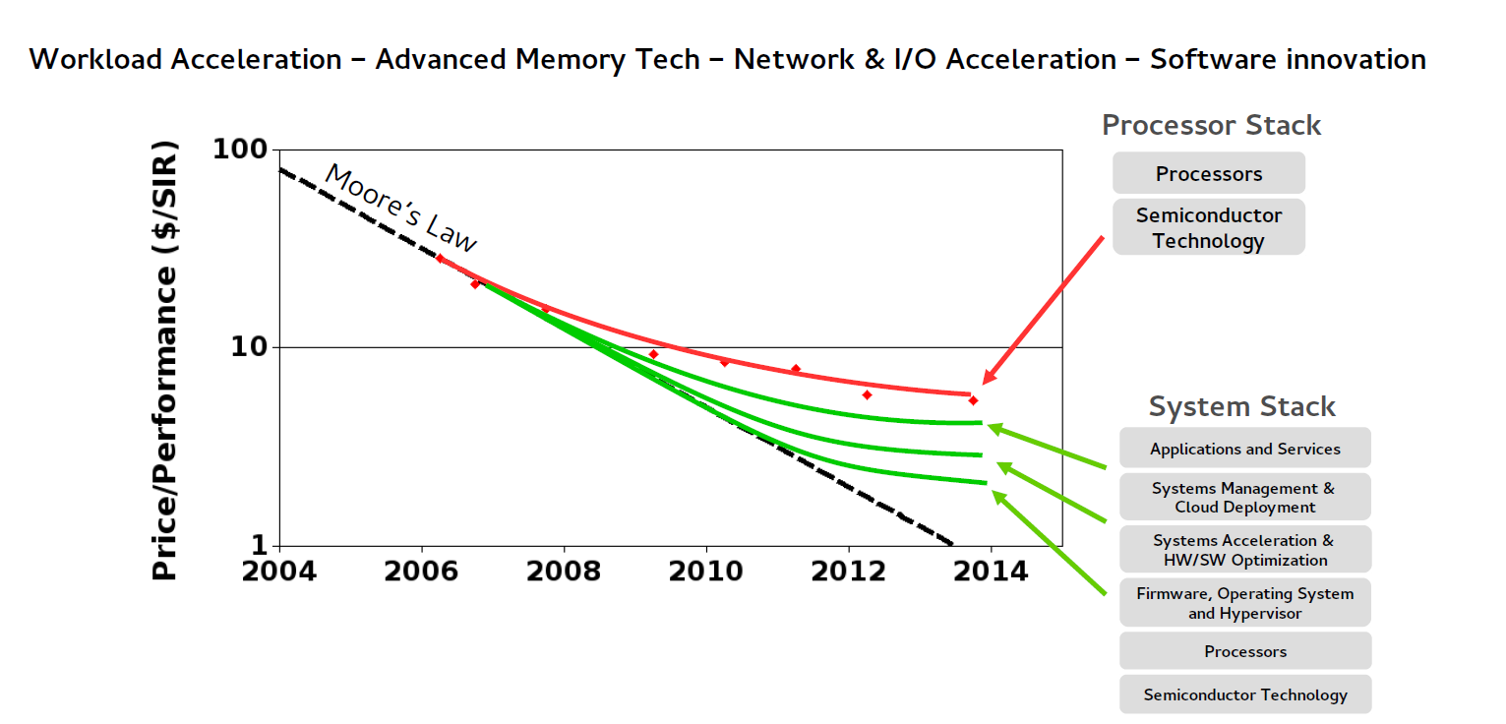
End of Moore’s law requires a different approach for systems design

Slide 5
OpenPOWER Community Growing Fast
Fast Growing Membership
275+ members
26 countries
2300+ ISVs developing Linux on Power
87 OpenPOWER ready servers
60+ technologies & 180+ innovations revealed
Ecosystem & Innovation
Google & Rackspace announce POWER9 OpenPOWER OpenCompute design
Tencent, China Mobile validate Power strategy
100+ Linux on Power clients, Major HPC supercomputers announced
End user traction

Slide 6
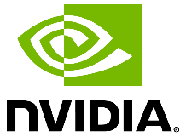
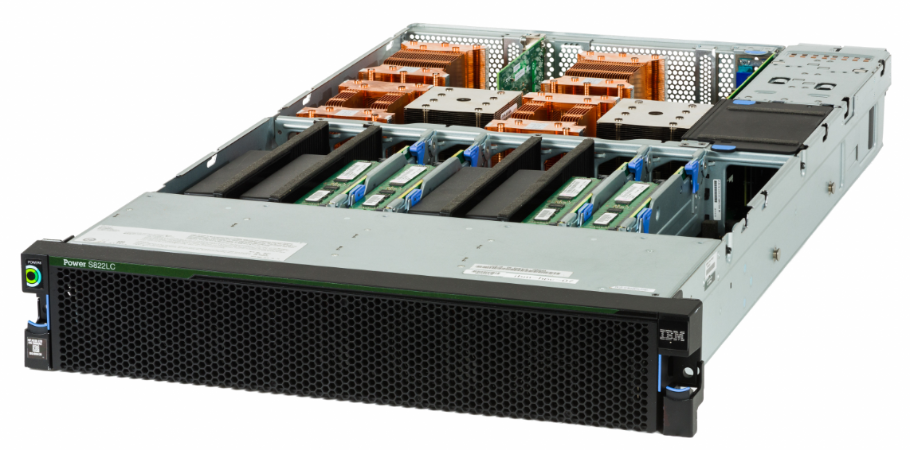
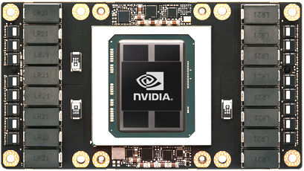
OpenPOWER Innovation in the Design
Power Systems S822LC for High Performance Computing (aka Minsky)
NVIDIA: Tesla P100 GPU Accelerator with NVLink (GPU↔GPU & GPU↔CPU)
Ubuntu by Canonical: Launch OS supporting NVLink and Page Migration Engine
Wistron: Platform co-design
Mellanox: InfiniBand/Ethernet Connectivity in and out of server
HGST: Optional NVMe Adapters
Broadcom: Optional PCIe Adapters
QLogic: Optional Fiber Channel PCIe
Samsung: 2.5” SSDs
Hynix, Samsung, Micron: DDR4
IBM: POWER8 CPU with NVLink
Tesla P100
With NVLink

Slide 7
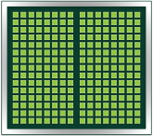
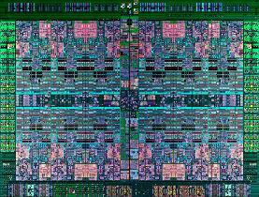
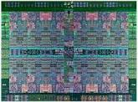
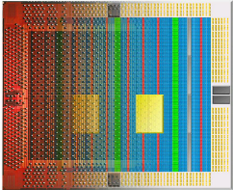
Differentiated Acceleration - CAPI and NVLink – 2016 offering
CAPI-attached Accelerators
NVIDIA Tesla GPU with NVLink
POWER8
40 +40 GB/s
Coherence Bus
Graphics Memory
Graphics Memory
CAPP
40 + 40 GB/s
40 + 40 GB/s
System Memory
POWER8
with NVLink
New Ecosystems with CAPI
Partners innovate, add value, gain revenue together w/IBM
Technical and programming ease: virtual addressing, cache coherence
Accelerator is hardware peer
PSL
Future, Innovative Systems with NVLink
Faster GPU-GPU communication
Breaks down barriers between CPU-GPU
New system architectures
FPGA or ASIC
Notes:
IBM IOD 2011
12/19/2016
12/19/2016 3:45 PM
7

Slide 8
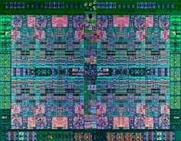
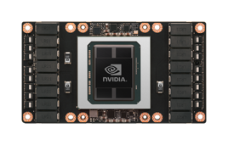
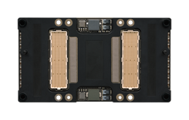
Collaborative Innovation between IBM and NVIDIA: POWER8 with NVLink
Casting NVLink into Silicon
IBM: transistors and I/O to NVLink on CPU
NVIDIA: deep interface into GPU (NVLink)
2+ years in the making
2.5X the bandwidth from CPU:GPU, built into the chip
Embedded
NVLink™
Built for Developer Goals
Think less about architecture in code
Break apart my problem less
Spend less time optimizing
Write simpler code
with NVLink™
Don’t overthink your hardware
Don’t waste time writing for data movement
Easily unleash the parallelism of your GPU

Slide 9
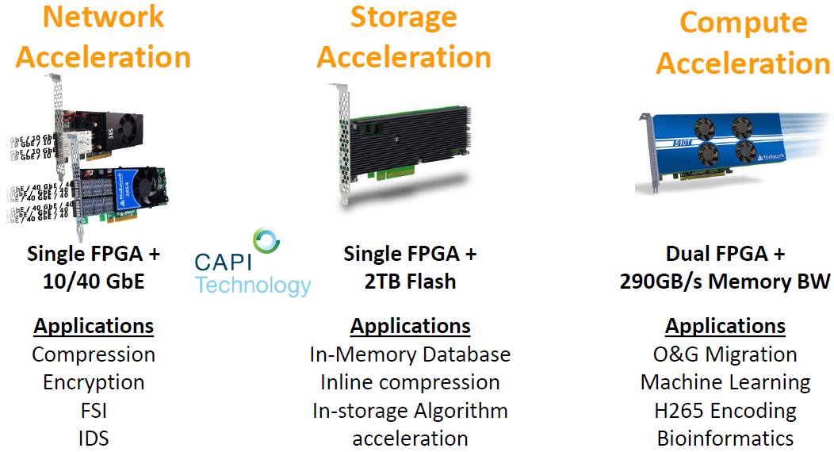
Accelerator cards announced at OpenPOWER Summit in April
Nallatech team explaining CAPI Flash card: https://www.youtube.com/watch?v=1n_ceKkCRuk

Slide 10
OpenCAPI to address two major technology trends
Two major technology trends will heavily impact the industry
Hardware acceleration will become commonplace as microprocessor technology and design continues to deliver far less than the historical rate of cost/performance improvement per generation
New advanced memory technologies will change the economics of computing
Existing system interfaces are insufficient to address these disruptive forces
Traditional I/O architecture results in very high CPU overhead when applications communicate with I/O or Accelerator devices at the necessary performance levels
Systems must be able to integrate multiple memory technologies with different access methods and performance attributes
October 14th : OpenCAPI Consortium announced
Initial members include : AMD, Dell EMC, Google, HPE, IBM, Mellanox, Micron, NVIDIA, Xilinx
OpenCAPI Announced as a standalone organization and welcome other CPUs architecture
Increased Bandwidth performance with 25 gbps signaling for bandwith over 100 GBPS
http://www.opencapi.org

Slide 11
OpenCAPI Performance Advantage
CAPI Feature | Benefit
PCI-E Device Driver replaced with hardware interlocks | Higher Performance
Total ~13µs for data prep
FFT Performance
Typical I/O Model Flow:
25
20
15
10
5
0
22.8
DD Call
Copy or Pin
Source Data
MMIO Notify
Accelerator
Acceleration
Poll / Interrupt
Completion
Copy or Unpin
Result Data
Ret. From DD
Completion
300 Instructions
10,000 Instructions
Application
Dependent, but
Equal to below
3,000 Instructions
1,000 Instructions
10.7
1,000 Instructions
GFLOPS
7.9µs
4.9µs
4.8
Flow with a Coherent Model:
Total 0.36µs
SW 1 Thread
FPGA
CAPI
Shared Mem.
Notify Accelerator
Acceleration
Shared Memory
Completion
Source: “Accelerating arithmetic kernels with coherent attached FPGA coprocessors”, Heiner Giefers et al, DATE proceedings, 2015
400 Instructions
Application
Dependent, but
Equal to above
100 Instructions
0.3µs
0.06µs
40X Faster

Slide 12
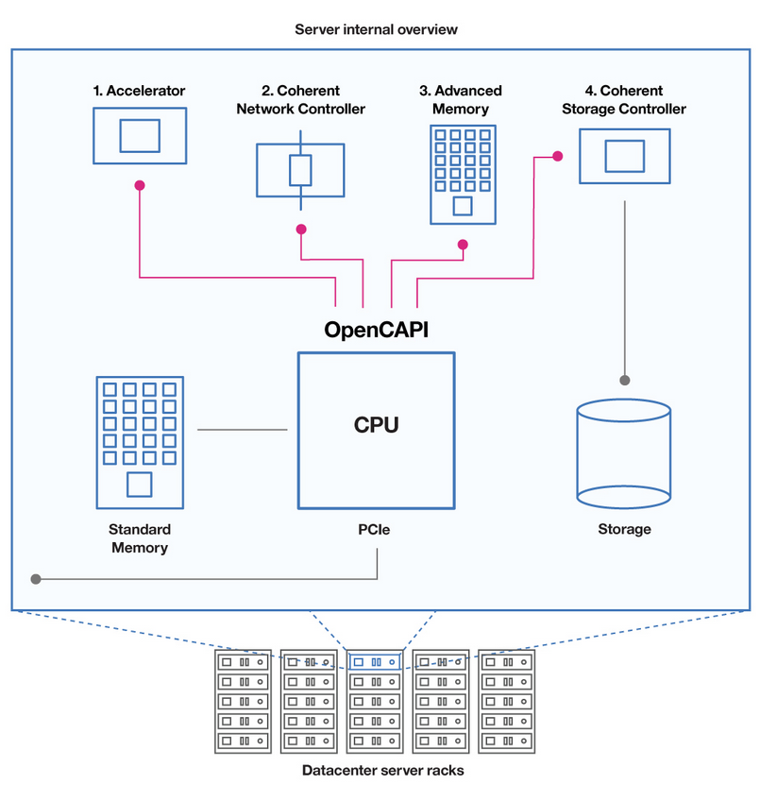
OpenCapi Use cases
1. Accelerators : The performance, virtual addressing and coherence capabilities allow FPGA and ASIC accelerators to behave as if they were integrated into a custom microprocessor.
2. Coherent Network Controller : OpenCAPI provides the bandwidth that will be needed to support rapidly increasing network speeds Newtork Controllers based on virtual addressing can eliminate software overhead without the programming complexity usually associated with user-level newtorking protocols.
3. Advanced Memory : OpenCAPI allows system designers to take full advantage of emerging memory technologies to change the economics of the datacenters
4. Coherent Storage Controller: OpenCAPI allows storage controllers to bypass kernel software overhead, enabling extreme IOPS performance without wasting valuable CPU cycles.

Slide 13
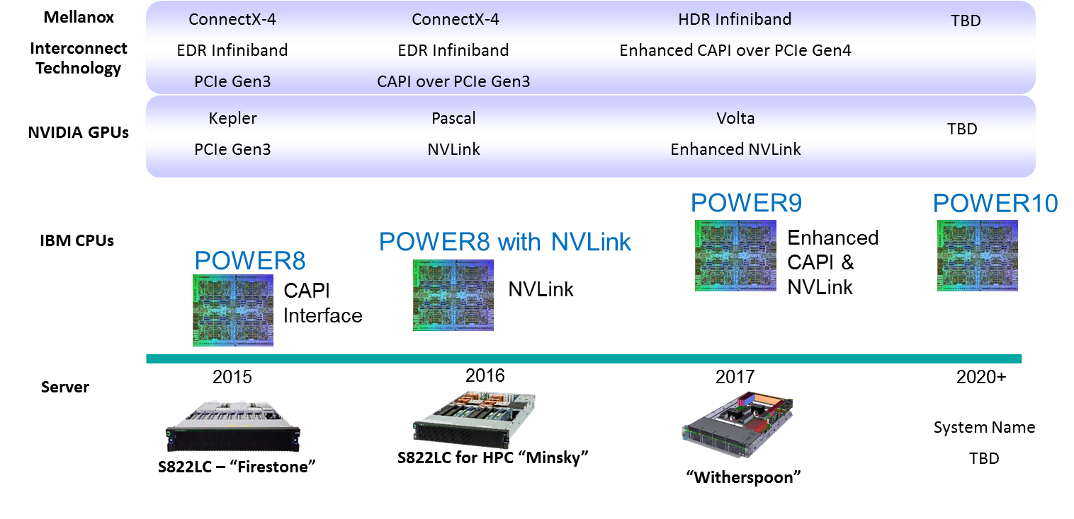
IBM Power Accelerated Computing Roadmap

