Slide 1
GMAP Winter School 2022 Mapping Mars: Aram Chaos

Slide 2
Mapping Mars: an example from Aram Chaos
Monica Pondrelli, Angelo Pio Rossi, Erica Luzzi,
Luca Penasa, Riccardo Pozzobon, Beatrice Baschetti,
Ilaria di Pietro, Silvia Bertoli, Cristian Carli,
Giacomo Nodjoumi, Javier Eduardo Suarez Valencia,
Pierre-Antoine Tesson

Slide 3
What do we do?
Attempt to perform collectively (in groups / individually) a geologic/geomorphic map of a chaotic terrain on Mars.
Content CC-BY-ND
Imagery: please see sources

Slide 4
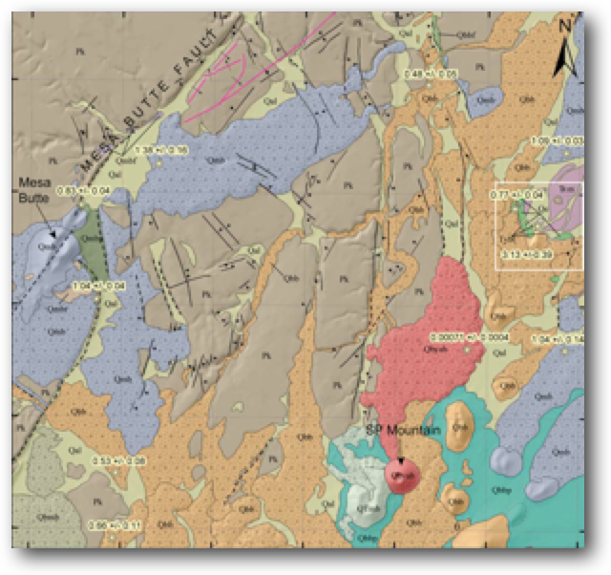
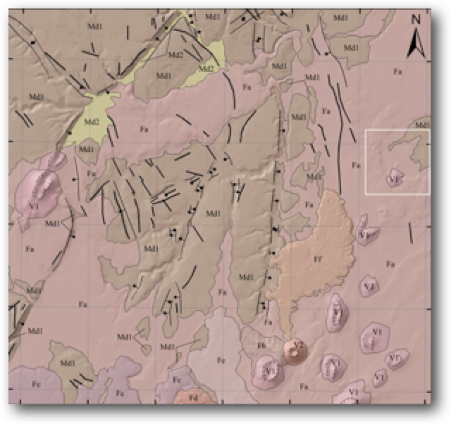
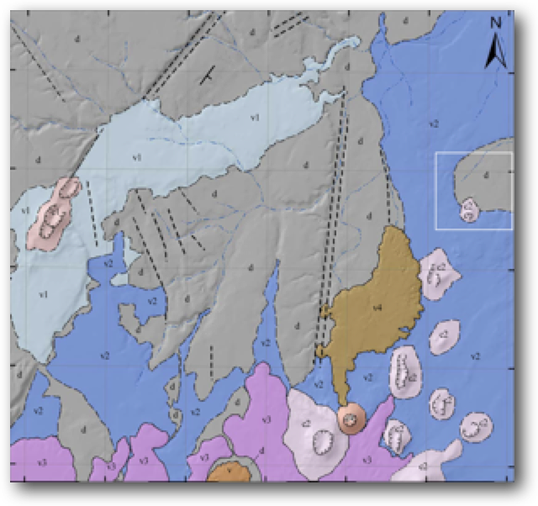
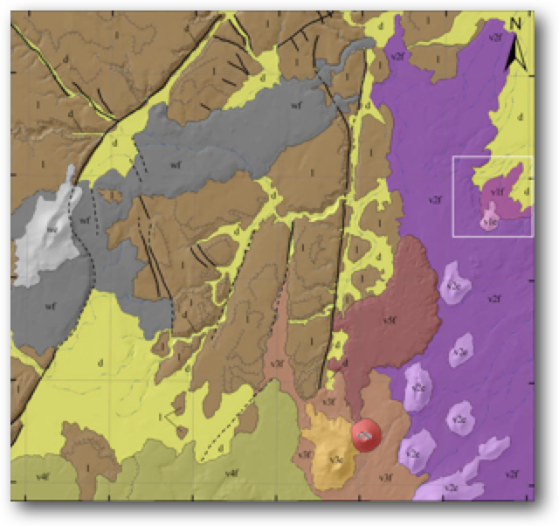
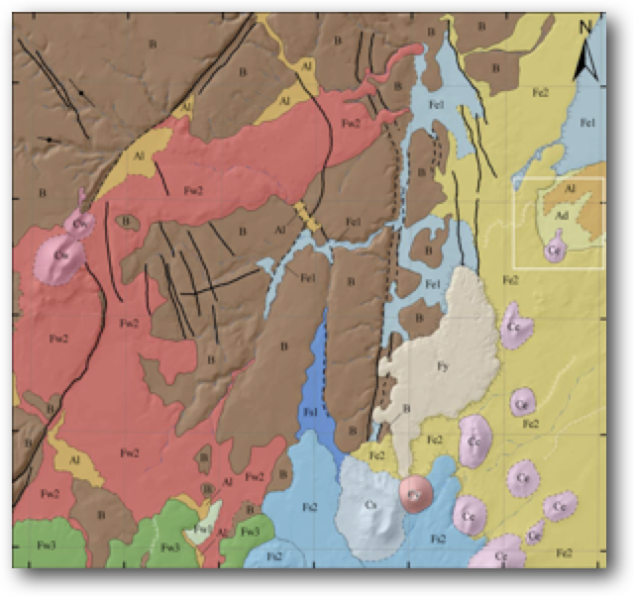
No truth without ground truth (and still we need to start from somewhere)
Source: modified fromTanaka et al. (2007)
Content CC-BY-ND
Imagery: please see sources

Slide 5
Structure of the day (1)
11:00 - 11:30 Welcome and description of the practical activity, Plenary go-through the group subdivision
11:30 – 12:30 Unit definition/description and Mapping
12:30 – 14:00 Lunch
Content CC-BY-ND
Imagery: please see sources

Slide 6
Structure of the day (1)
14:00 - 14:30 Science Seminar
Erica Luzzi: The origin of chaotic terrains
14:30 – 16:00 Mapping
16:00 – 16:30 Coffee break
16:30 – 17:30 Mapping
17:30 – 18:30 Presentation and discussion
Content CC-BY-ND
Imagery: please see sources

Slide 7
Instructors
Angelo Pio Rossi
Monica Pondrelli (flying)
Riccardo Pozzobon
Erica Luzzi
Giacomo Nodjoumi
Luca Penasa (flying, data/GIS/mappy issues)
Ilaria Di Pietro
Silvia Bertoli
Javier Eduardo Suarez Valencia
Pierre-Antoine Tesson
Content CC-BY-ND
Imagery: please see sources

Slide 8
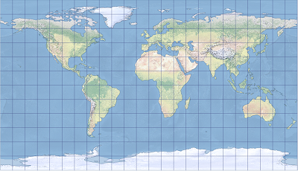
Coordinate Reference System
Equidistant cylindrical
Reference body: MOLA truncated sphere A=B=C=3396000
Central Longitude: 0
Central Latitude: 0
Content CC-BY-ND
Imagery: please see sources

Slide 9
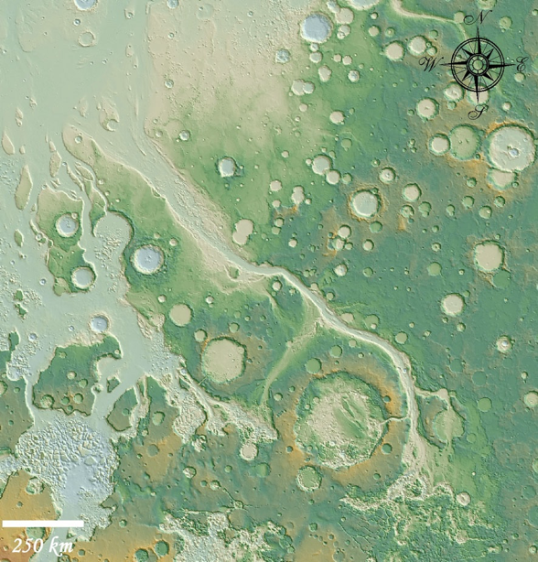
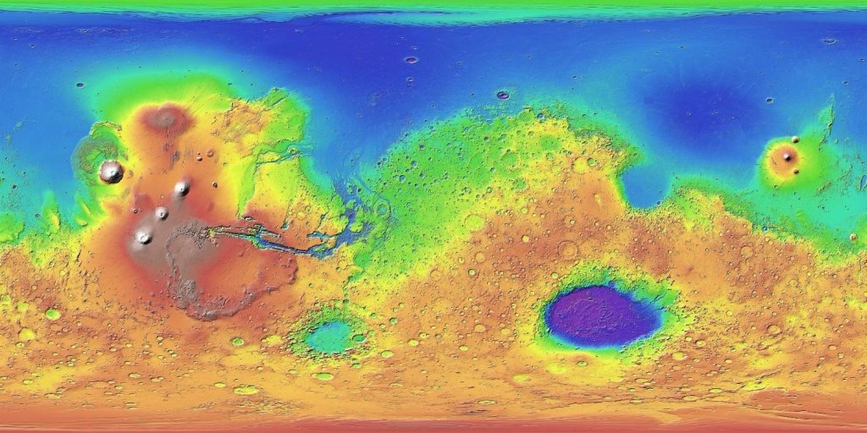
Aram Chaos: Regional Context
Mapping Area
After Pacifici et al., 2009
Content CC-BY-ND
Imagery: please see sources

Slide 10
Geological context
Source: Tanaka et al. (2014)
Content CC-BY-ND
Imagery: please see sources

Slide 11
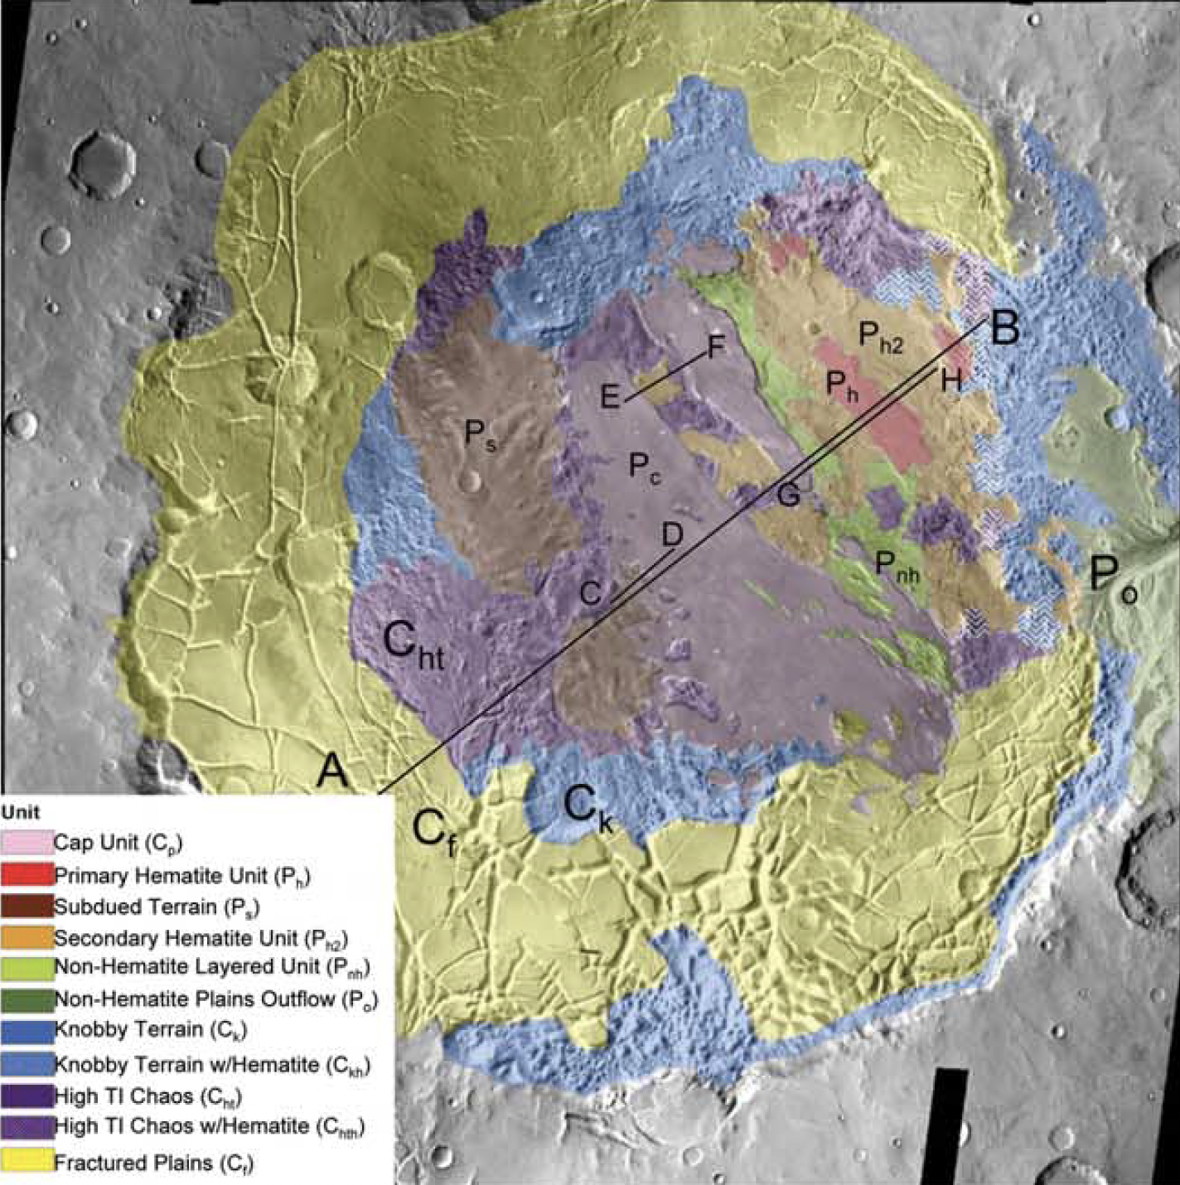
Existing map
Source: Glotch and Christensen (2005)
Content CC-BY-ND
Imagery: please see sources

Slide 12
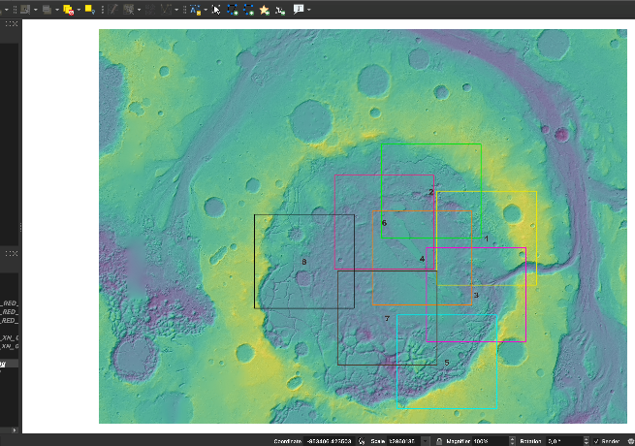
Project and Tiles
Content CC-BY-ND
Imagery: please see sources

Slide 13
Groups
GROUP1 – Instructor: Angelo Pio Rossi
Davide Boccato
F. Niebl
Nabamita Chaudhuri
Martine Irog
Prateek Tripathi
Elia Genghini
Giacomo Melchiori
Mauro Spagnuolo
Thomas Gusmeo
Dariusz Marciniak
Marc Canale
Cumhur BABAOĞLU
Christiana Kpakpo
Valeriya Rychagova
Magdalena Laban
Ma. Angela Lourdes Lequiron
GROUP2 – Instructor: Riccardo Pozzobon
Diogo Quirino
Giuseppina De Felice Proia
Francesco Giancristofaro
Emma Losantos Guillén
Roger Stabbins
Thibaut Pons
Francesco Gallo
Graham Driver
Vipul Bhadani
Marco Moro
Elettra Mariani
Osip Kokin
Namitha Rose Baby
Caz Wright
Mara Mantegazza
Federico Mansilla Nuñez
Content CC-BY-ND
Imagery: please see sources

Slide 14
Groups
GROUP3 – Instructor: Erica Luzzi
Vidhya Ganesh Rangarajan
Sanju Khatri
Bartosz Pieterek
Mariam Hegazy
Valerio Filice
Davide Demartini
Marco Maio
Isik Su Yazici
Jasmine Bayron
Stefano Scurani
Sophie Benaroya
Fatima Ezzahra BOUCHNEB
Hector-Andreas Stavrakakis
Adriana Barbieri
Luca Conci
GROUP4 – Instructor: Giacomo Nodjoumi
Adil Khan
Prabhleen Kaur
Chimira Nicole Andres
Akin Domac
Kailey Busch
Maria Spourita
Girlie Cortez
Devanshi Kacholia
Elena Scacchia
Marco Fraccaro
Carolina Aliano
Maciej Fitt
Alfonso Fiorelli
Laura Patermann
Georgii Kondratenko
Content CC-BY-ND
Imagery: please see sources

Slide 15
Groups
GROUP5 – Instructor: Ilaria Di Pietro
Alfonso Ragazzo
Leonidas Vonopartis
Samidha V Revankar
Laura Parro
Sowkhya Shanbhog
ARPITA SAHA
Le Wang
Susanna Tonoian
Grace Kim
Iván López Ruiz-Labranderas
Cansu Floyd
Ruilin Cheng
Martina Cascone
Fatima Ezzahra JADID
Leslie Hopper
GROUP6 – Instructor: Silvia Bertoli
Siti Nurmaisarah Akmal
Maria Rojas
Katerina Fialova
Shamsheer Pal Singh
Deep Patel
KHALED OMAR
Safoura Tanbakouei
Alistair Blance
Johanna Erika Valdueza
Dan James
Panagiota – Kalliopi Karadima
Alexandra Warren
Angelica Angles
Anatole Deligant
Edoardo D'Onofrio
Content CC-BY-ND
Imagery: please see sources

Slide 16
Groups
GROUP7 – Instructor: Javier Eduardo Suarez Valencia
S. Bharathvaj
Wayne Barnett
Sofia Souto
Giovanni D'Este
Myriam Alqassab
Ana de Dios Cubillas
Grace Fanson
N R Kavin Kumar
PIERLUIGI MANZI
Giovanni Munaretto
Francesco Maio
Abimbola Chris Ogunyele
Ryan Hill
Priscilla Nowajewski
Michael Fuller
GROUP8 – Instructor: Pierre-Antoine Tesson
Jinhao Cai
Nicole Costa
Luca Tardivo
Jun Huang
Deborah Bastoni
Gianluca Frasca
Mariam Mehrez
Edward Baker
Xiangzhao Zeng
Dimitra Argyrou
Filippo Signora
Giorgio Creazzo
Tareq Alkhateb
Alejandro Pertuz Dominguez
Scott Mansfield
Content CC-BY-ND
Imagery: please see sources

Slide 17
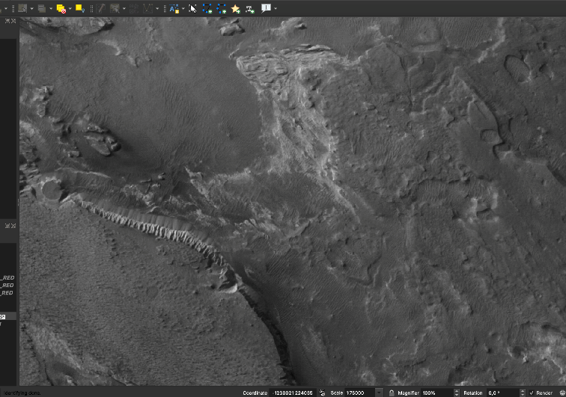
Scale of work 16” Fullscreen QGIS at 1/75k
Content CC-BY-ND
Imagery: please see sources

Slide 18
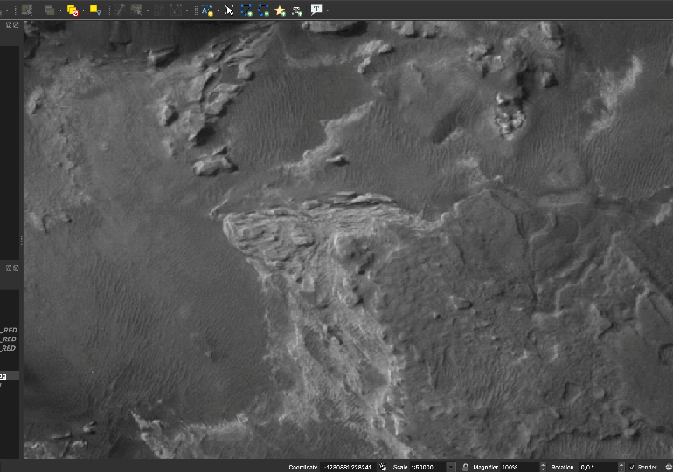
Scale of work 16” Fullscreen QGIS at 1/50k
Content CC-BY-ND
Imagery: please see sources

Slide 19
Units (random order, stratigraphic relations to be reconstructed)
BUT
Feel free to be independent and propose different/new
e.g., Geomorphology vs Geology…
Content CC-BY-ND
Imagery: please see sources

Slide 20
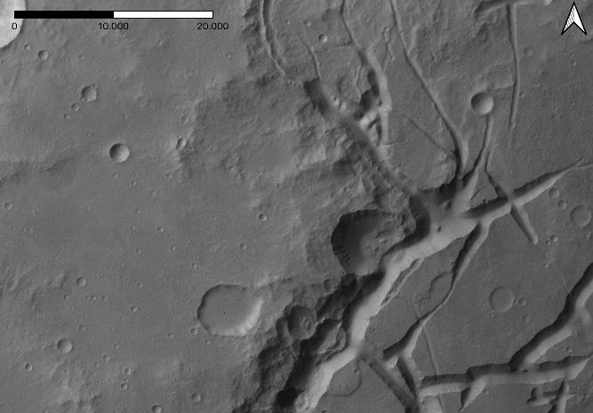
Plateau, mesas of the chaotic terrains, fractures
m
Crater
Fracture
Plateau
Mesa
Content CC-BY-ND
Imagery: please see sources

Slide 21
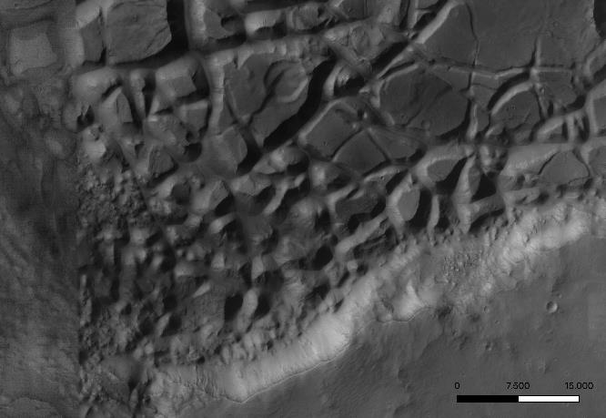
Plateau, mesas/knobs of the chaotic terrains, fractures
Crater
Fracture
Knobs
Mesa
Plateau
m
Content CC-BY-ND
Imagery: please see sources

Slide 22
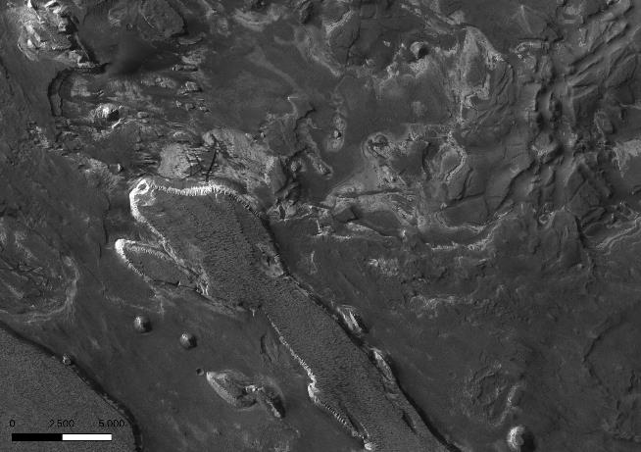
Knobs of the chaotic terrains, Layered deosits, Cap unit
Layered Deposits
Knob
Cap unit
m
Content CC-BY-ND
Imagery: please see sources

Slide 23
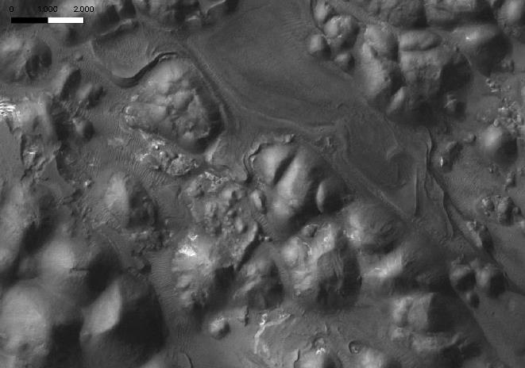
Knob of the chaotic terrains, Layered deosits, Cap unit, Aeolian cover
Knob
m
Cap unit
Layered Deposits
Aeolian cover
Content CC-BY-ND
Imagery: please see sources

Slide 24
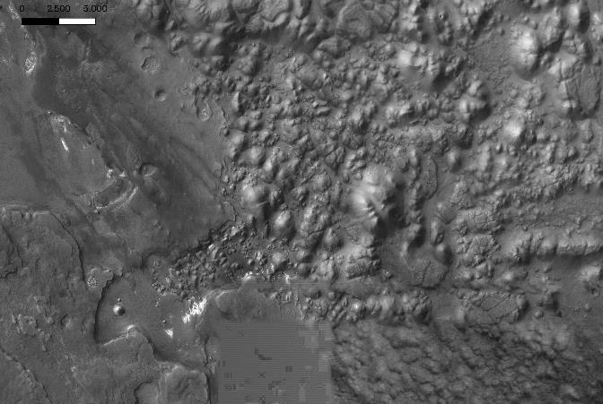
Mesas/knobs of the chaotic terrains, layered deposits, cap unit
m
Knobs
Cap unit
Mesa
Layered Deposits
Content CC-BY-ND
Imagery: please see sources

Slide 25
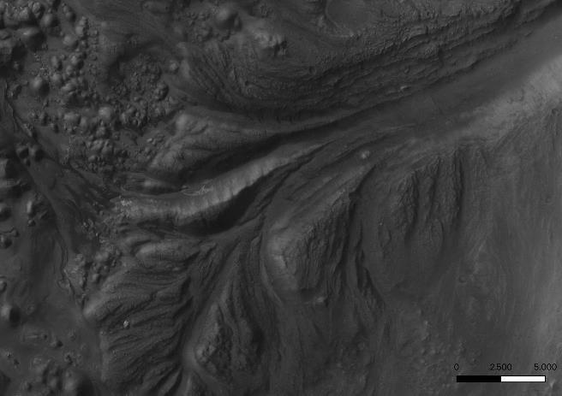
Mounds of the chaotic terrains, cap unit, grooves, outflow channel
Outflow channel
Mounds
Groove
Cap unit
m
Content CC-BY-ND
Imagery: please see sources

Slide 26
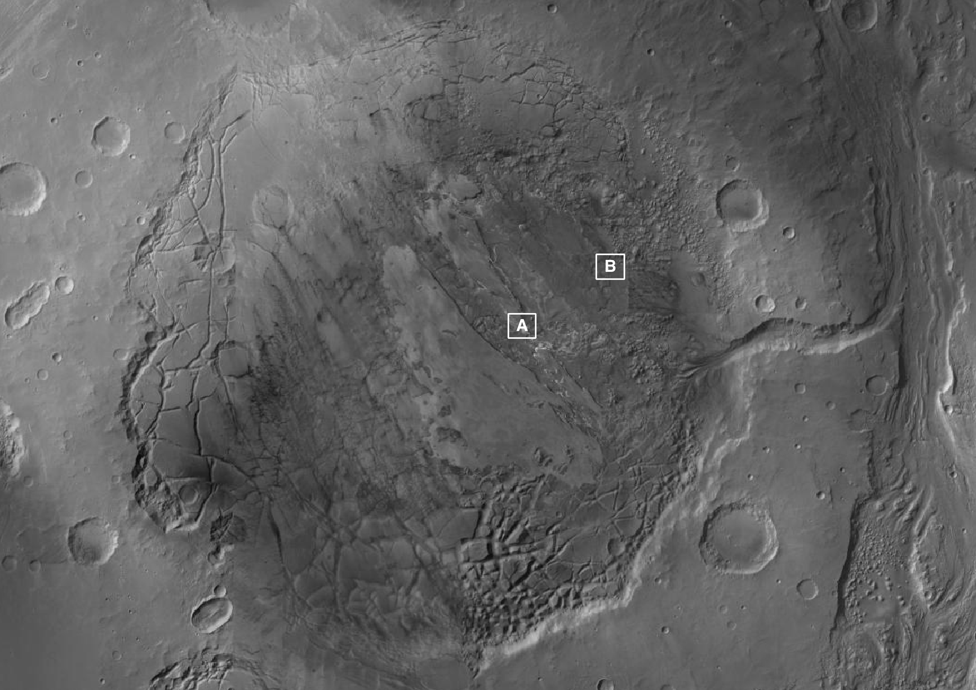
Reference areas for detailed description of some of the units

Slide 27
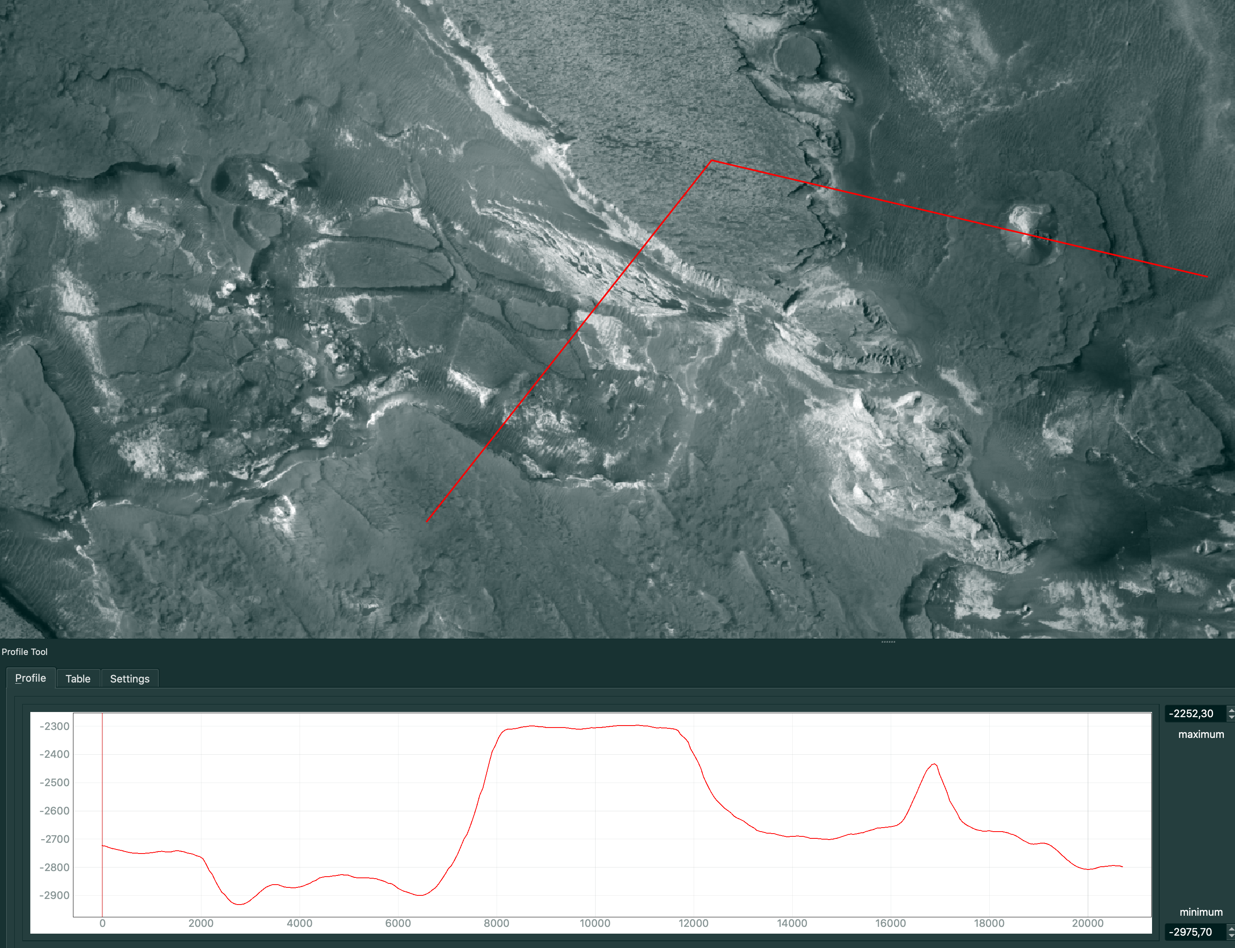
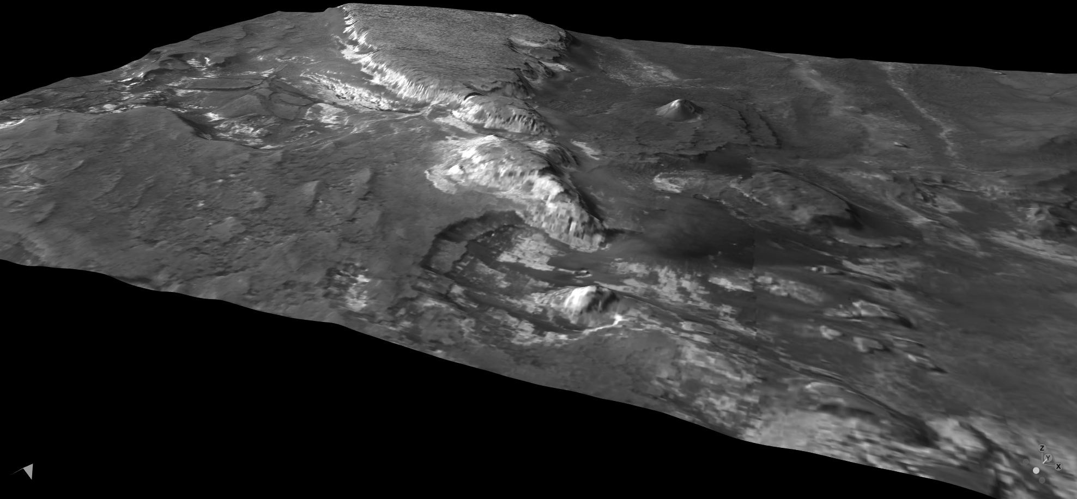
Reference area A
Content CC-BY-ND
Imagery: please see sources

Slide 28
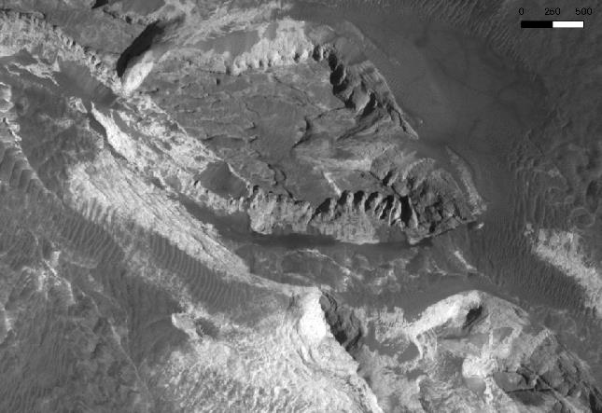
Observations at CTX scale
m
Description, Stratigraphic relations
Content CC-BY-ND
Imagery: please see sources

Slide 29
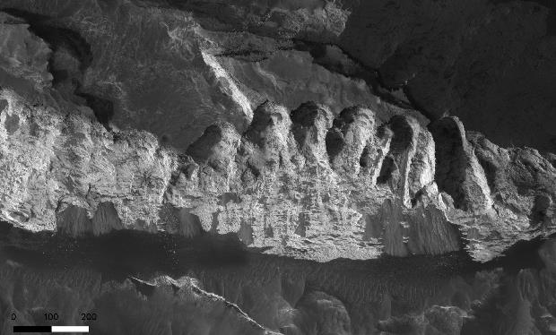
Observations at HiRISE scale
Description, Stratigraphic relations
m
Content CC-BY-ND
Imagery: please see sources

Slide 30
CRISM-based information
TRU (true colour) browse product
HYD (hydrated mineralogy) browse product
FAL (false colour) browse product
Content CC-BY-ND
Imagery: please see sources

Slide 31
CRISM-based information
TRU (true colour) browse product:
Enhanced true colour representation of the scene obtained combining the following three spectral channels across the visible part of the spectrum:
red = R600 (reflectance at 600 nm)
green = R530 (reflectance at 530 nm)
blue = R440 (reflectance at 440 nm)
Content CC-BY-ND
Imagery: please see sources

Slide 32
CRISM-based information
FAL (false colour) browse product:
Enhanced false colour representation of the scene obtained combining the following three spectral channels across the infrared part of the spectrum:
red = R2529 (reflectance at 2529 nm)
green = R1506 (reflectance at 1506 nm)
blue = R1080 (reflectance at 1080 nm)
Content CC-BY-ND
Imagery: please see sources

Slide 33
CRISM-based information
FAL (false colour) browse product:
The RGB combination for the FAL browse products highlights differences between key mineral groups.
Green colours may indicate hydrated material (e.g., clays, carbonates or certain types of sulfates);
Gray/brown colours often indicate basaltic material.
Content CC-BY-ND
Imagery: please see sources

Slide 34
CRISM-based information
HYD (hydrated mineralogy) browse product:
Shows information related to bound water in minerals:
red = SINDEX2 (Detects convexity at 2.29 μm due to 2.1 μm and 2.4 μm absorptions typical of hydrated sulfates)
green = BD2100_2 (Detects 2.1 μm shifted H₂O band depth in monohydrated sulfates)
blue = BD1900_2 (Detects 1.9 μm H₂O band depth)
Content CC-BY-ND
Imagery: please see sources

Slide 35
CRISM-based information
HYD (hydrated mineralogy) browse product:
Polyhydrated sulfates have strong 1.9 μm and 2.4 μm absorption bands, and thus appear magenta.
Monohydrated sulfates have a strong 2.1 μm absorption and a weak 2.4 μm absorption band, and thus appear yellow/green.
Blue colours are indicative of other hydrated minerals (such as clays, hydrated silica, carbonate, or zeolite).
Content CC-BY-ND
Imagery: please see sources

Slide 36
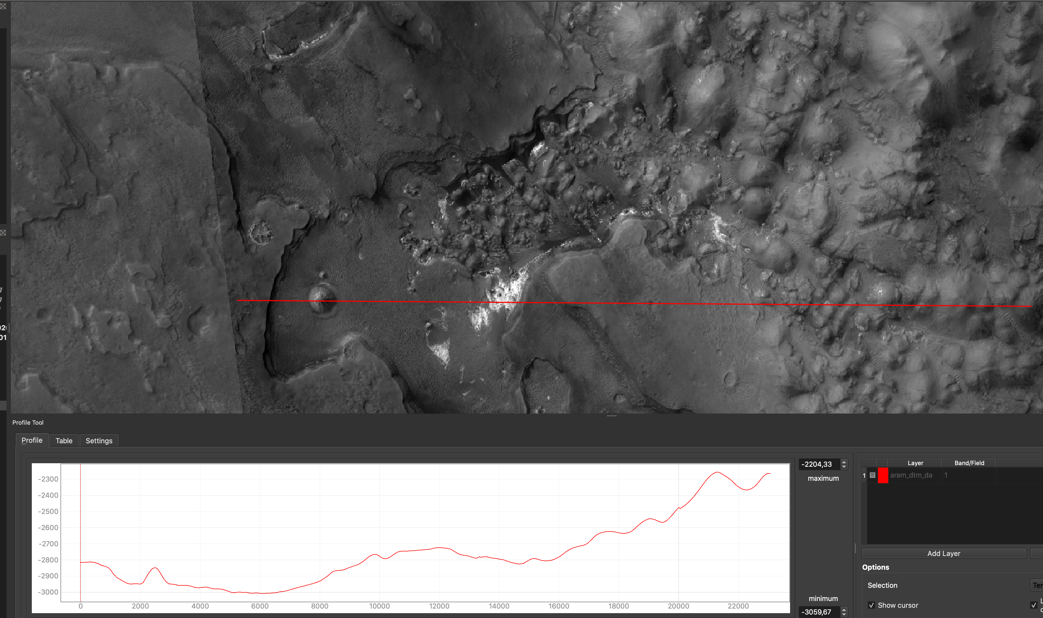
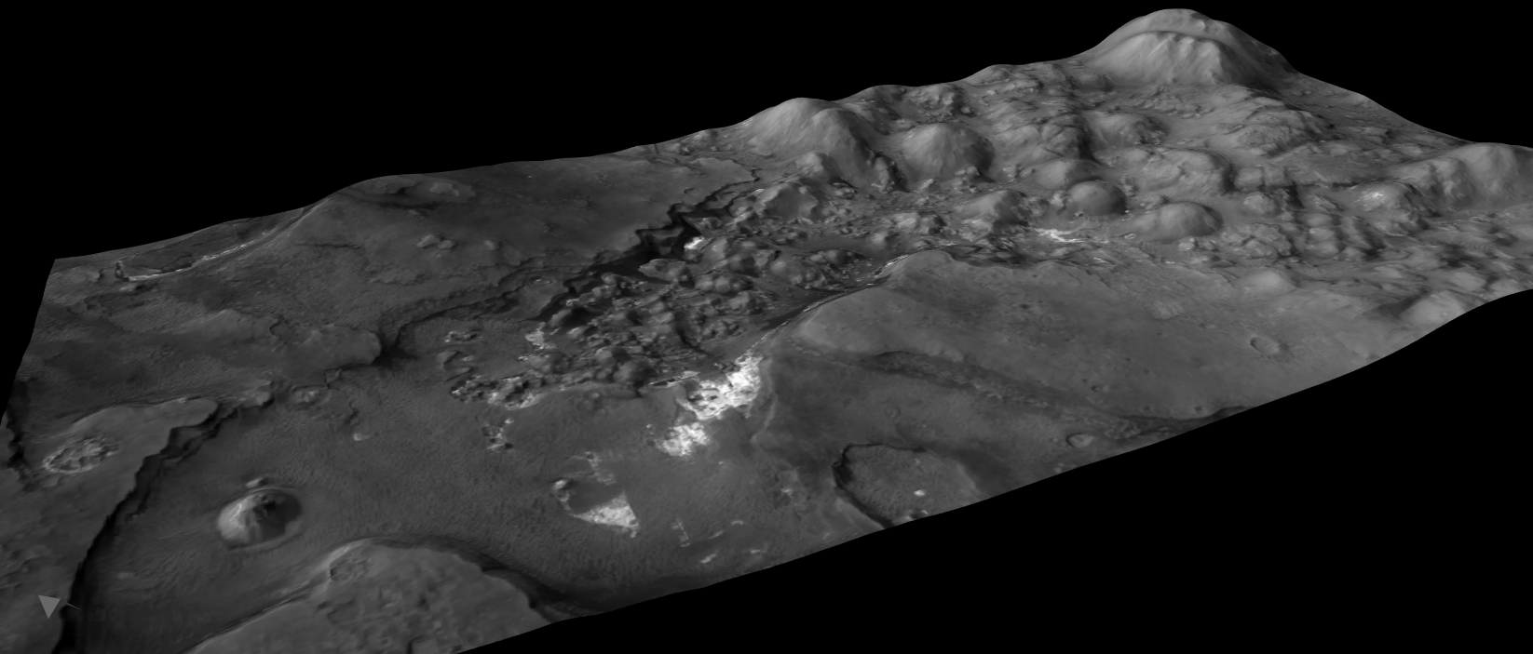
Reference area B
Content CC-BY-ND
Imagery: please see sources

Slide 37
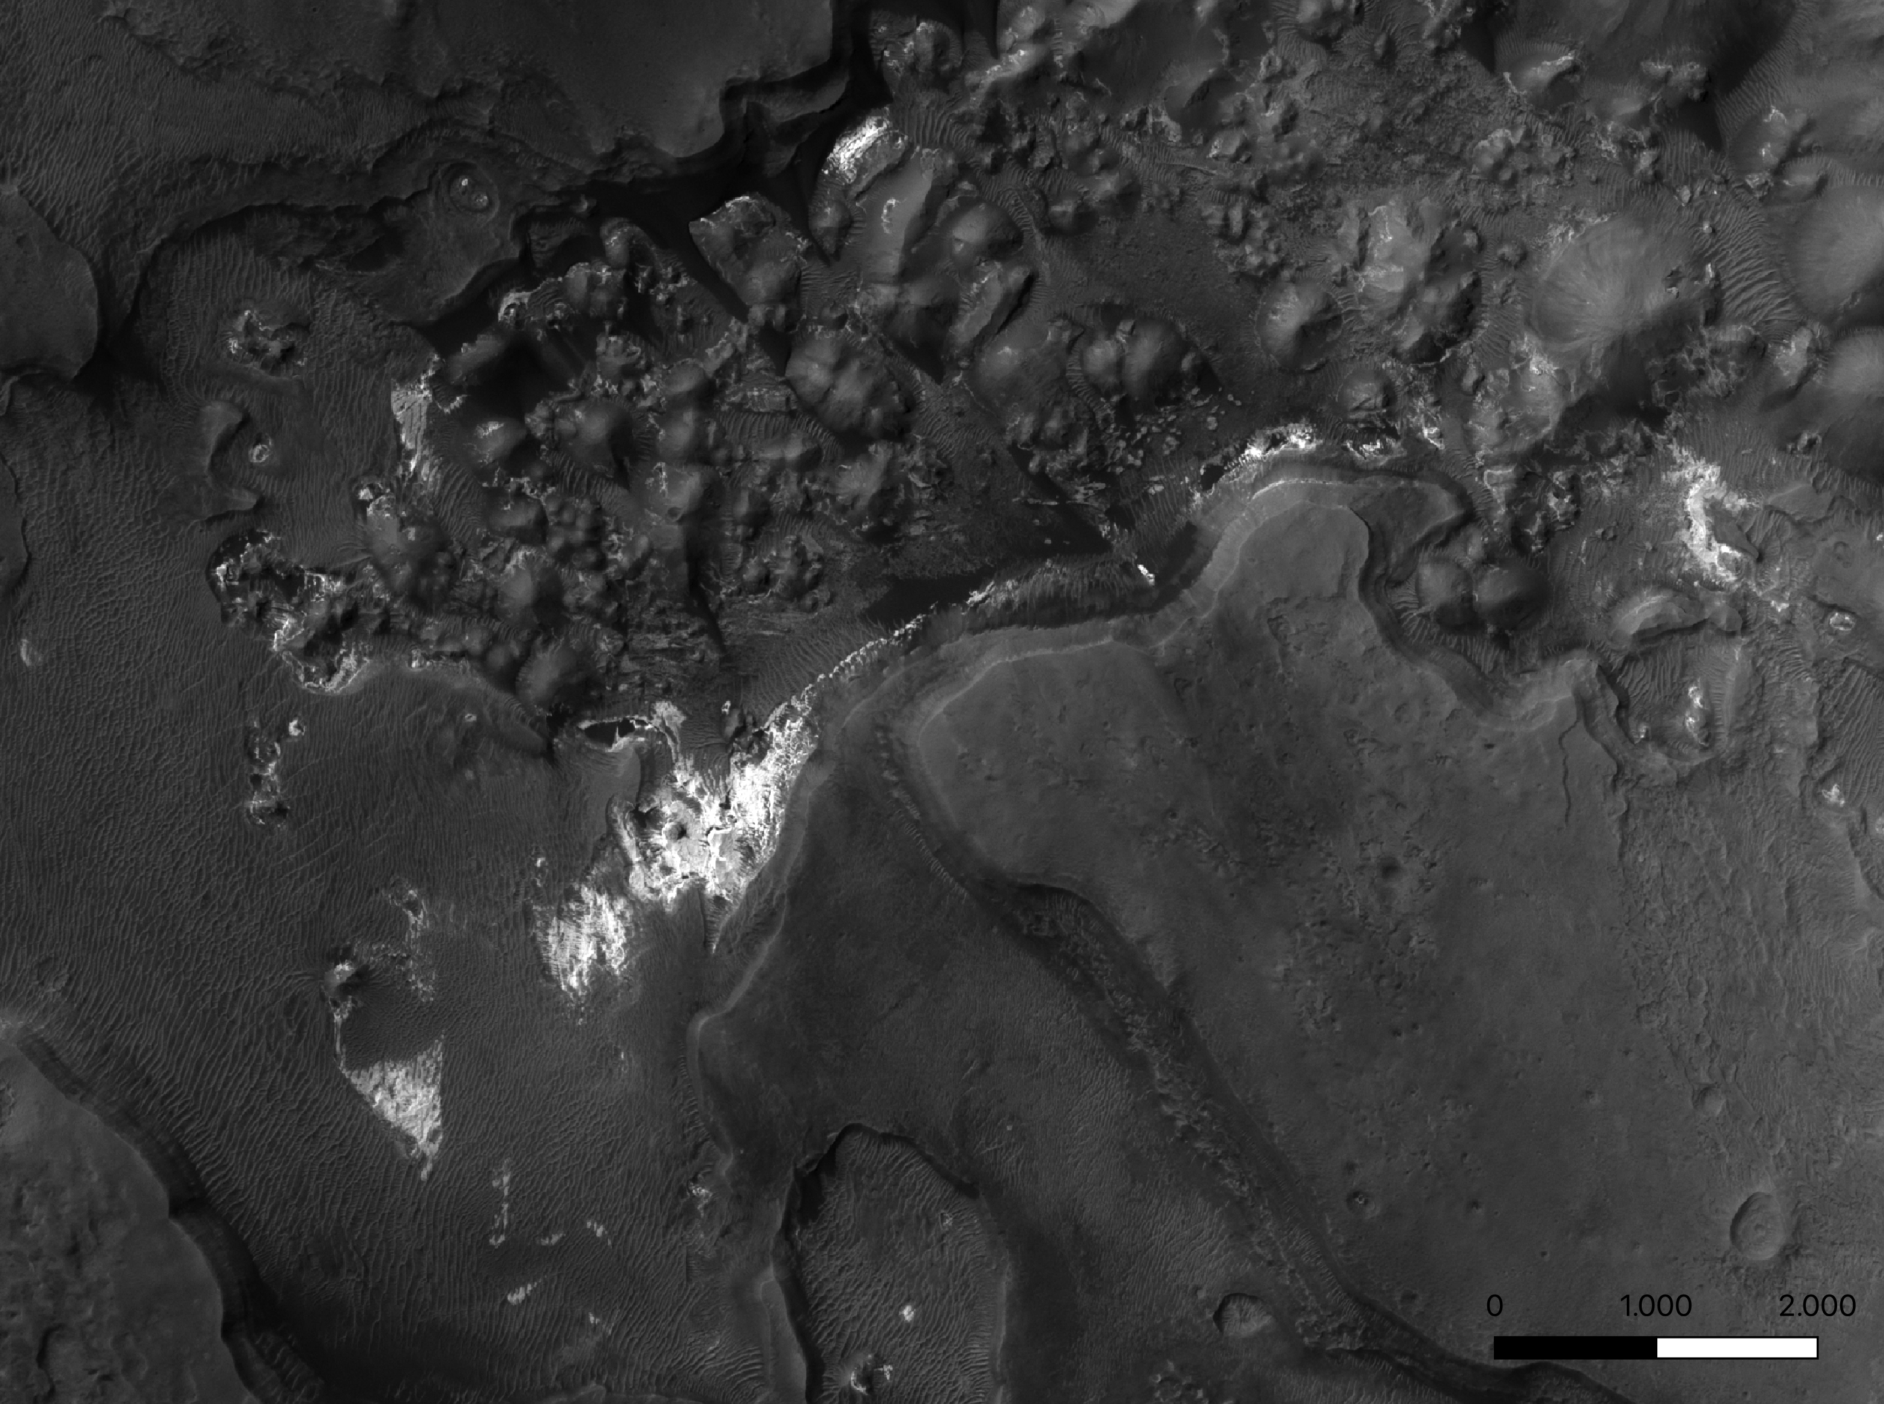
Observations at CTX scale
Description, Stratigraphic relations
Content CC-BY-ND
Imagery: please see sources
m

Slide 38
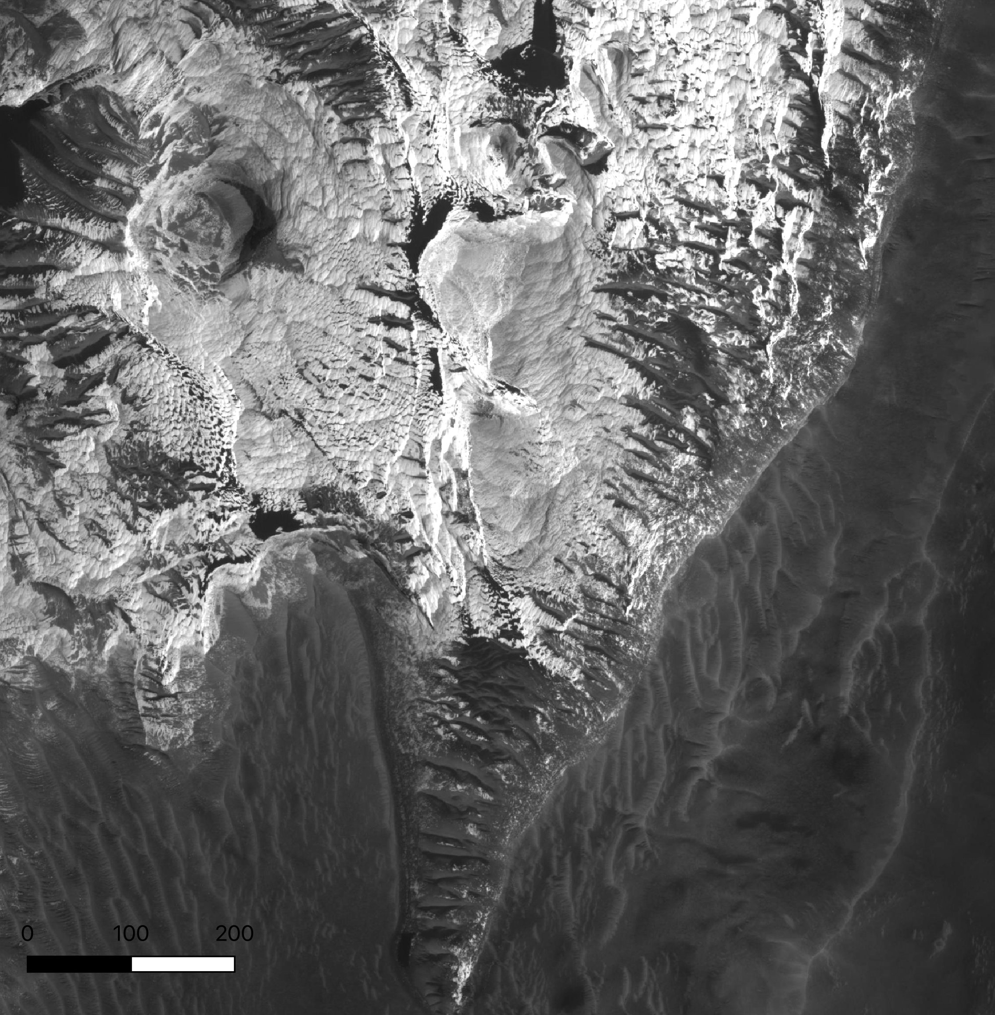
Observations at HiRISE scale
Description, Stratigraphic relations
m
Content CC-BY-ND
Imagery: please see sources

Slide 39
CRISM-based information
TRU (true colour) browse product
HYD (hydrated mineralogy) browse product
FAL (false colour) browse product
Content CC-BY-ND
Imagery: please see sources

Slide 40
CRISM-based information
Same meaning as those in reference area A
TRU (true colour) browse product
HYD (hydrated mineralogy) browse product
FAL (false colour) browse product
Content CC-BY-ND
Imagery: please see sources

Slide 41
Steps
Have a look at the units across all the study area
At all scales BUT remember that you are going to map using HRSC images
List the units you are planning to map
Decide your scale of work
Enjoy mapping

Slide 42
Results
Among each group/tile:
Select one (or maximum two) map(s)
Send the screenshot
Named: tile number
We will try to very roughly merge them and discuss
Later on, even after the school, you will be able to upload your gpkg here:
https://cloud.planmap.eu/index.php/s/eAYXZ4qEie93q6W
Naming convention: mars_firstname_lastname_tile

