Slide 1
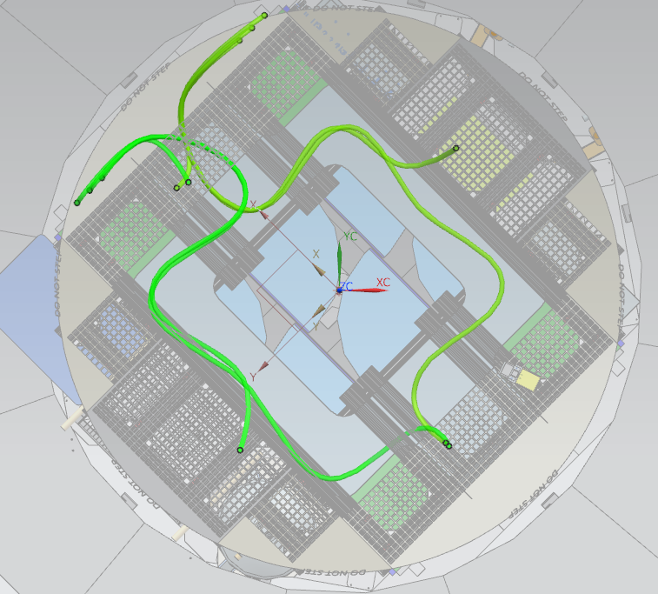
Harness Routing
On this view, ABCD seem to be labels at the level corresponding to the base of the cryostat body, where cable ducts start. But these labels could be located anywhere along the side of the cryostat.
B
B
A
A
C
D
C
D

Slide 2
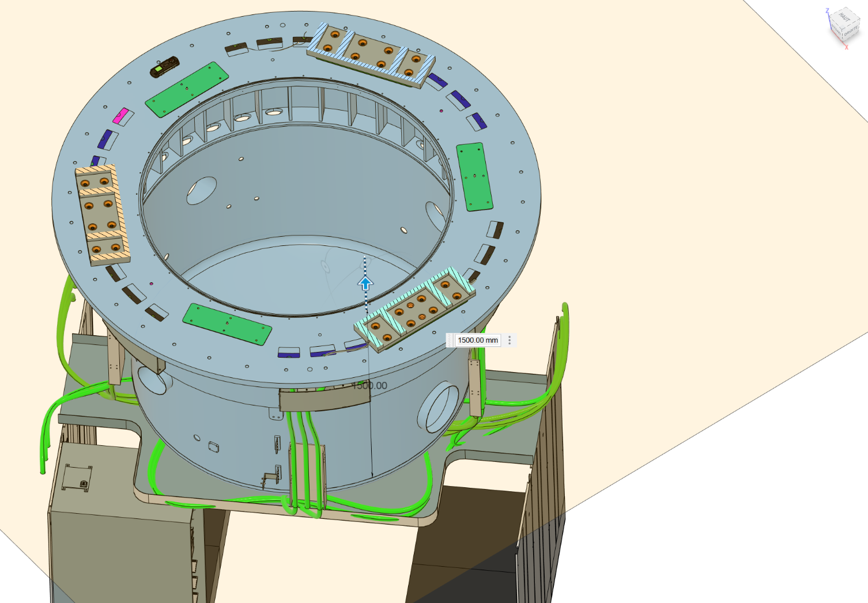
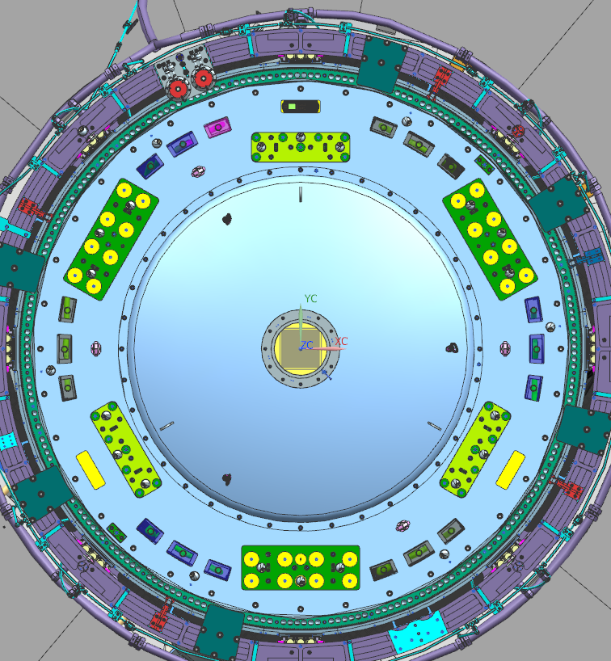
Harness Routing
On this view, the labels A1 A2 B C1 C2 D are at the level of the ring where the feet of SCAO are fixed.
B
B
C1
A1
A1
B
C2
A
A2
D
A2
C1
C
D
D
C2

Slide 3
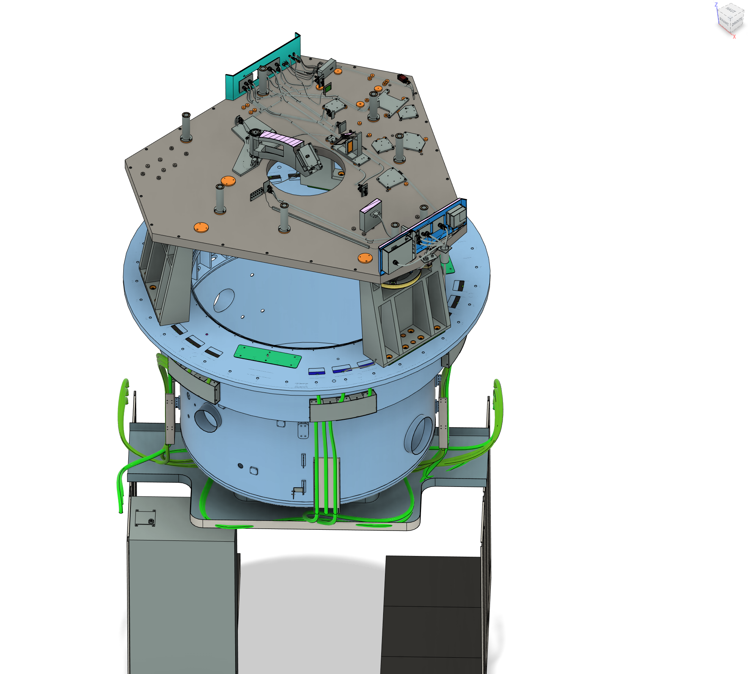
Harness Routing
A1 A2 B C1 C2 D are labels at this level for the top of crystat ring, where SCAO feet starts
Label confusion :
The labels B and D on the top of cryostat ring, where the feet of SCAO starts, use the same letters as the labels B and D on the bottom of cryostat body.
B
C1
A1
B
C2
A2
D
C
A
C
D

Slide 4
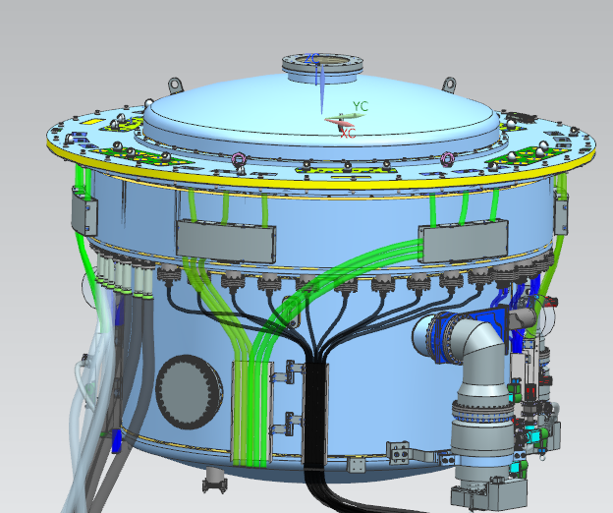
Harness Routing 2021 Cable length as mentioned by Veronika Hörmann
A1: 1600 – 1850mm
A2: 1770 – 2070mm
B: 1520 – 1750mm
C1: 2060 - 2340mm
C2: 1580 – 1800mm
D: 1530 – 1750mm
A → ICS03: ~4900mm
B → ICS03: ~3550mm
C → ICS03: ~1700mm
D → ICS03: ~3200mm
A1
B
B
A
A → ICS04: ~1300mm
B → ICS04: ~3200mm
C → ICS04: ~4800mm
D → ICS04: ~3300mm
A2
C1
D
C
D
C2
A → ICS06: ~900mm
B → ICS06: ~3200mm
C → ICS06: ~4600mm
D → ICS06: ~3300mm

Slide 5
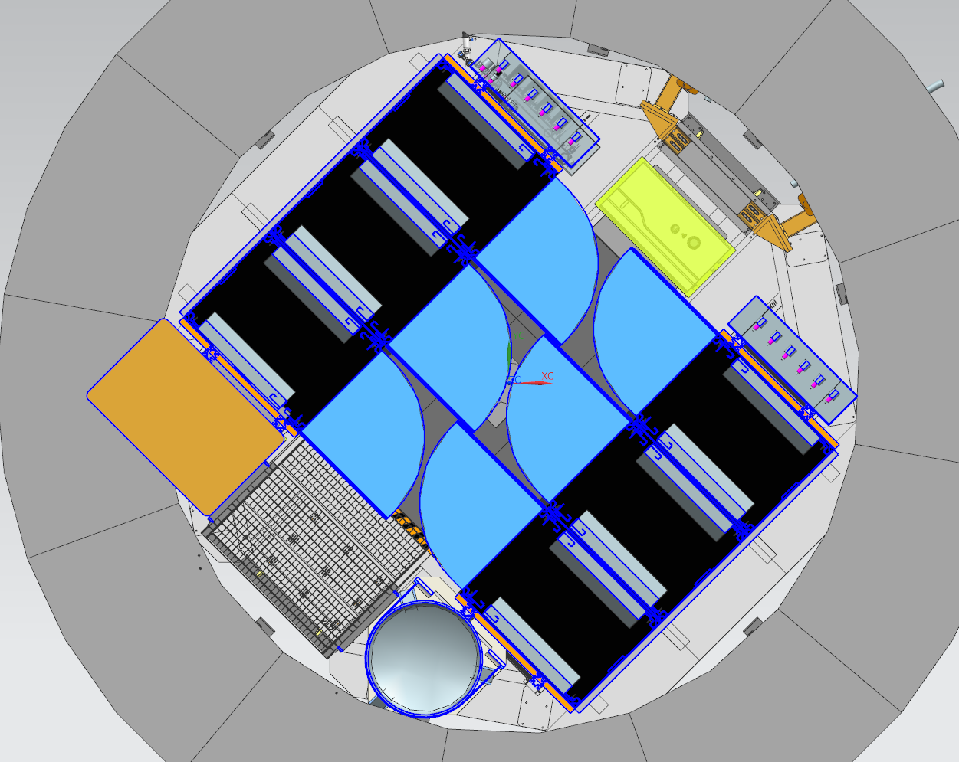
Harness Routing 2021 Cable length as mentioned by Veronika Hörmann
Rough estimate of harness length:
A1 ->
A2 -> SCAO: 5270mm
B -> SCAO: 4950mm
C1 ->
C2 -> SCAO: 6400mm
D -> SCAO?: 5050mm
ICS 04
ICS 06
ICS04 = LOR
ICS06 = SCAO

Slide 6
Harness Routing 2023 Cable length as asked to move ICO06
A1: 1600 – 1850mm
A2: 1770 – 2070mm
B: 1520 – 1750mm
C1: 2060 - 2340mm
C2: 1580 – 1800mm
D: 1530 – 1750mm
A → ICS06: approx. 4000mm
B → ICS06: approx. 2450mm
C → ICS06: approx. 850mm
D → ICS06: approx. 2300mm
A1
B
B
A
A2
C1
D
C
D
C2

Slide 7
Harness Routing 2023 Cable length as asked to move ICO06
Rough estimate of harness length from IC06 to the flanges on the top of Cryostat ring (Not SCAO Panel) :
A1 -> SCAO: 5850mm
A2 -> SCAO: 6050mm
B -> SCAO: 4200mm
C1 -> SCAO: 3050
C2 -> SCAO: 2650
D -> SCAO : 4000
ICS 04
ICS 06
ICS04 = LOR
ICS06 = SCAO

