Slide 1
Teems photonics PIC

Slide 2
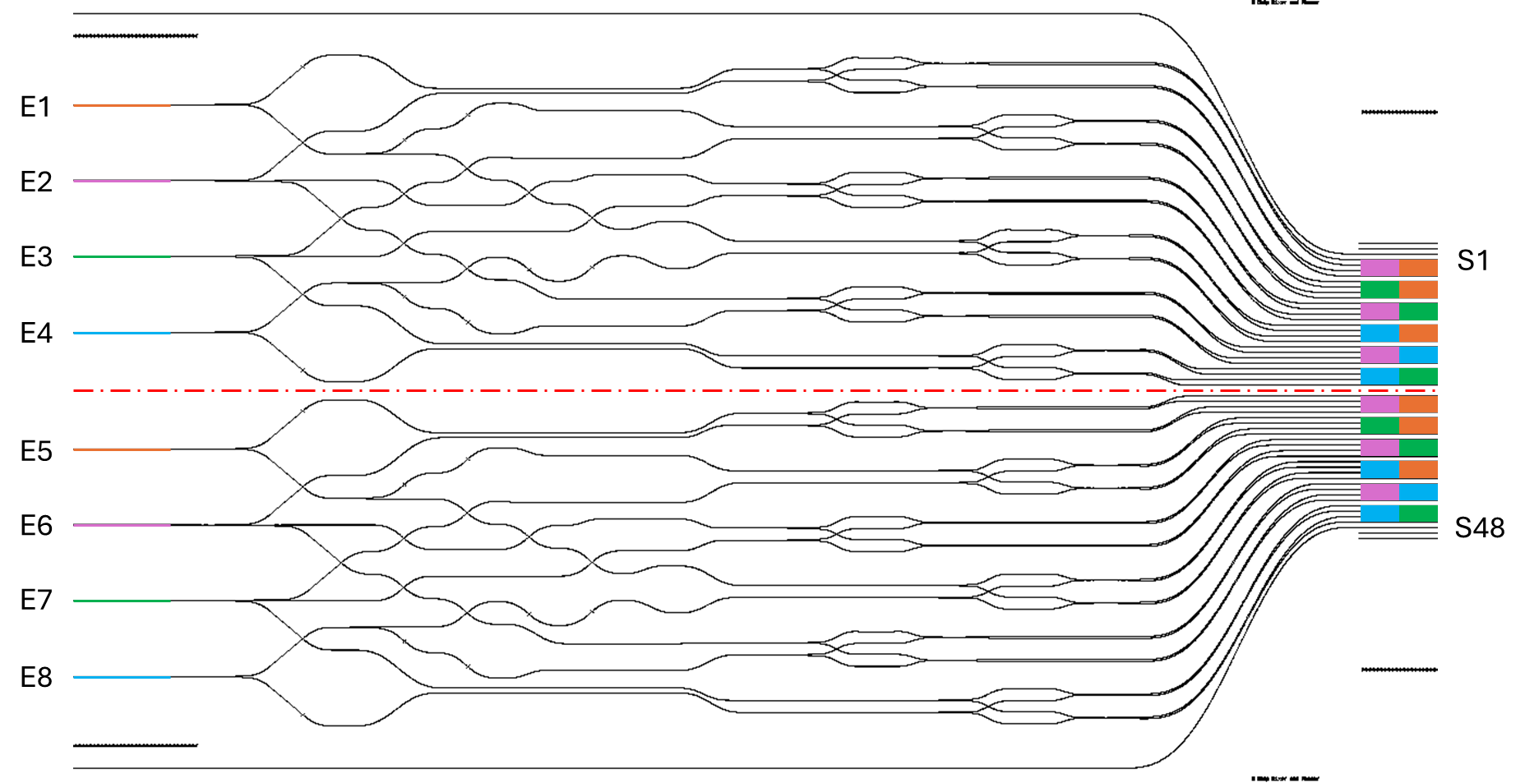
Design of the PIC tested

Slide 3
Design of the PIC tested

Slide 4
Transmission at 1083 nm without protective blade
Transmission at 1310 nm without protective blade
TAP (dBm) : | 2,02
REF (dBm) : | -3,88
REF(mW) : | 0,4093
F/SWG(bas)/F (dBm) | -4,42
Power difference (dB) | -0,54
transmission(%) | 88,30799004
F/SWG(haut)/F (dBm) | -4,42
Power difference (dB) | -0,54
transmission(%) | 88,30799004
TAP (dBm) : | 2,02
REF (dBm) : | 1,57
REF(mW) : | 1,4355
F/SWG(bas)/F (dBm) | 0,06
Power difference (dB) | -1,51
transmission(%) | 70,63175543
F/SWG(haut)/F (dBm) | -1,17
Power difference (dB) | -2,74
transmission(%) | 53,21082593

Slide 5
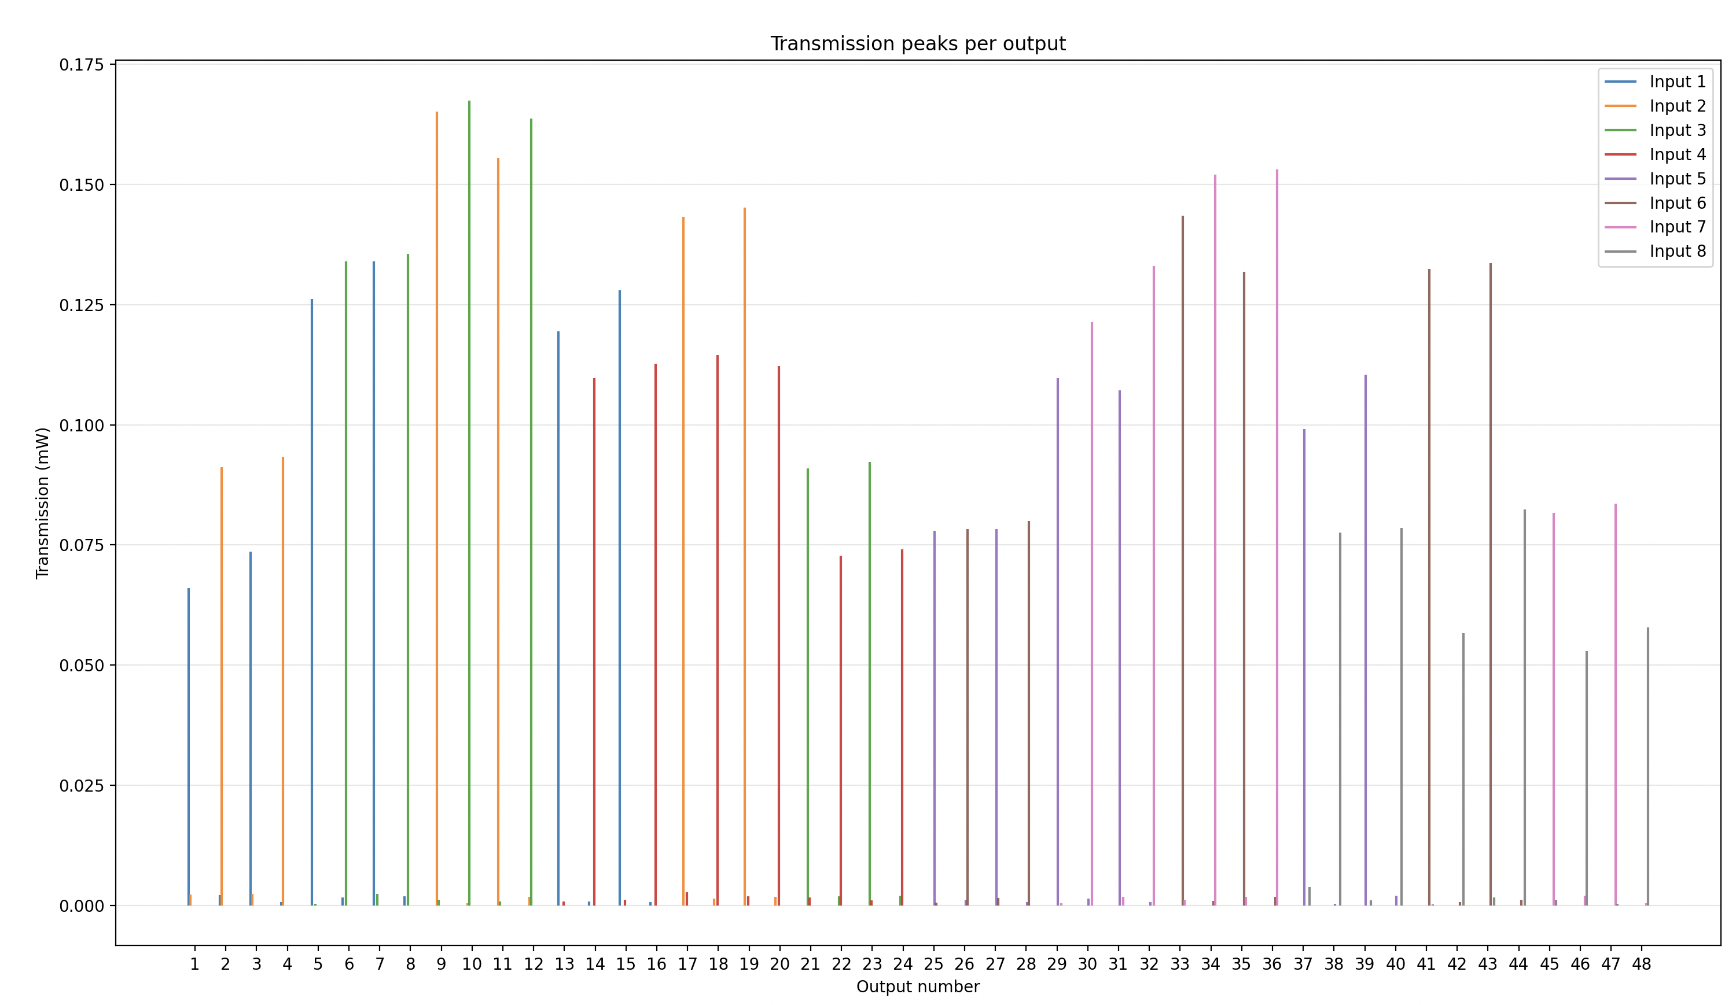

Slide 6
Transmission at 1310 nm with protective blade
Transmission at 1083 nm with protective blade
TAP (dBm) : | 2,02
REF (dBm) : | -3,32
REF(mW) : | 0,4656
F/SWG(bas)/F (dBm) | -4,4
Power difference (dB) | -1,08
transmission(%) | 77,98301105
F/SWG(haut)/F (dBm) | -4
Power difference (dB) | -0,68
transmission(%) | 85,50667129
TAP (dBm) : | 2,03
REF (dBm) : | 1,32
REF(mW) : | 1,3552
F/SWG(bas)/F (dBm) | 0,42
Power difference (dB) | -0,9
transmission(%) | 81,28305162
F/SWG(haut)/F (dBm) | -0,06
Power difference (dB) | -1,38
transmission(%) | 72,77798045

