Slide 1
From Scattering Amplitudes to Classical Observables
David A. Kosower Institut de Physique Théorique, CEA–Saclay
work with Ben Maybee and Donal O’Connell (Edinburgh)
[arXiv:1811.10950] & in progress @ Meudon meeting on Waveforms & Tests of GR,— Feb 4, 2020

Slide 2
New ways of calculating observables relevant to Gravitational Waves

Slide 3
Approaches
Traditional: solve General Relativity perturbatively
Effective Field Theory: use separation of scales to compute better in General Relativity

Slide 4
Approaches
Traditional: solve General Relativity perturbatively
Effective Field Theory: use separation of scales to compute better in General Relativity
An idea: use scattering amplitudes

Slide 5
Scattering Amplitudes
It’s a bound-state classical problem
Why might quantum scattering amplitudes help?
Calculate only what’s needed for physical quantities
No auxiliary Hamiltonians or potentials
Double copy: amplitude calculations in gravity are vastly simplified by the observation that
Gravity $\sim$ (Yang–Mills)²

Slide 6
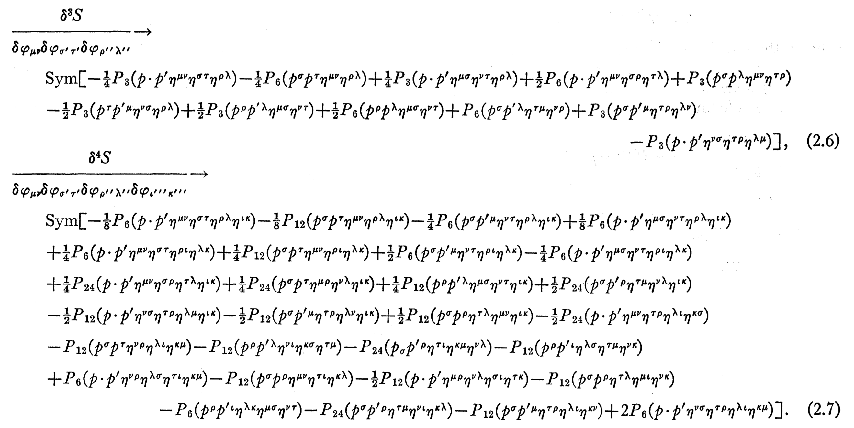
Feynman Vertices
De Witt:
Three-point
Four-point
$⋮$

Slide 7
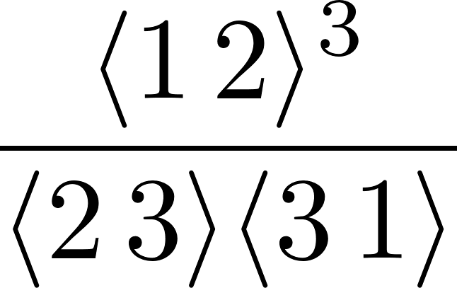
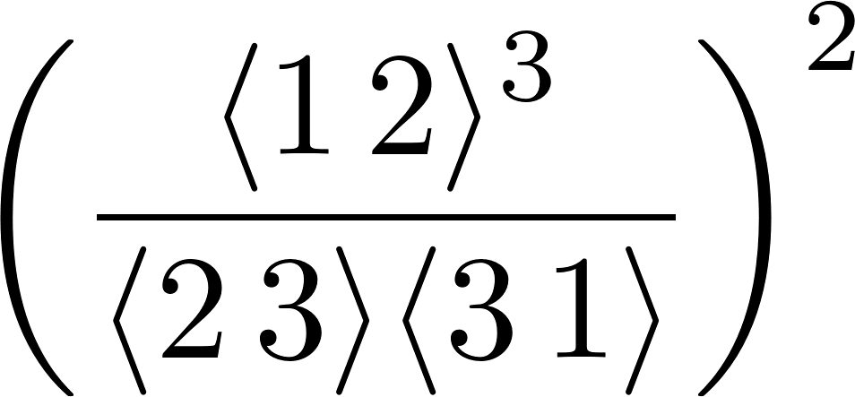
Double-copy reminder
Yang–Mills three-point amplitude
Gravity three-point amplitude
Field-theory equivalent of Kawai–Lewellen–Tye expression for closed-string amplitudes in terms of open-string ones

Slide 8
Direct Path: New Result for Potential
Potential to 3rd post-Minkowski order
Bern, Cheung, Roiban, Shen, Solon, Zeng (2019)

Slide 9
Our Strategy: Take the Scenic Route
Pick well-defined observables in the quantum theory
That are also relevant classically
Express them in terms of scattering amplitudes in the quantum theory
Understand how to take the classical limit efficiently

Slide 10
Set-up
Scatter two massive particles
Look at two observables:
Change in momentum (‘impulse’) of one of them
Momentum radiated during the scattering

Slide 11
Classical Limit
Classical limit requires $ℏ→0$
Need to restore $ℏ$
Dimensional analysis; keep $c=1$
$\left[M\right]≠{\left[L\right]}^{−1}$
$[|p⟩]={[M]}^{−1}$
[Ampl_{n}]$={\left[M\right]}^{4−n}$
$ℏ$ in couplings: $e→e/\sqrt{ℏ}$; $κ→κ/\sqrt{ℏ}$
Distinguish wavenumber from momentum: $\overline{p}=p/ℏ$
Net: n-point, L-loop amplitude in scalar QED scales$\sim ℏ^{1−\frac{n}{2}−L}$
Not the end of the story: compensating factors of $ℏ$ from scaling of momenta

Slide 12
Wave Packets
Point particles: localized positions and momenta
Wavefunction $φ(p)$
Incoming pair plane waves ${\left|p_{1}p_{2}\right\rangle }_{in}$
Initial state
$${\left|ψ\right\rangle }_{in}=∫{\hat{d}}^{4}p_{1}{\hat{d}}^{4}p_{2} {\hat{δ}}^{(+)}\left(p_{1}^{2}−m_{1}^{2}\right){\hat{δ}}^{(+)}\left(p_{2}^{2}−m_{2}^{2}\right) φ\left(p_{1}\right)φ\left(p_{2}\right) \\ ×e^{ib⋅p_{1}/ℏ} {\left|p_{1}p_{2}\right\rangle }_{in}$$
$$=∫dΦ\left(p_{1}\right)dΦ\left(p_{2}\right) φ\left(p_{1}\right)φ\left(p_{2}\right) e^{ib⋅p_{1}/ℏ} {\left|p_{1}p_{2}\right\rangle }_{in}$$
Absorb factors of $2π$
Impact parameter

Slide 13
Momentum
$$\left\langle p_{out,1}^{μ}\right\rangle ={}_{out}^{}{⟨ψ}|P_{1}^{μ}|{ψ⟩}_{out}^{}$$
$={}_{in}^{}{⟨ψ}\left|S^{†}P_{1}^{μ}S\right|{ψ⟩}_{in}$
Insert a complete set of states and rewrite,
Think of $r_{1,2}$ as final-state momenta: connection to scattering amplitudes

Slide 14
Impulse
aka time integral of change in momentum
$$⟨Δp_{1}^{μ}⟩={}_{in}^{}{⟨ψ}\left|S^{†}P_{1}^{μ}S−P_{1}^{μ}\right|{ψ⟩}_{in}$$
Write $S=1+i T$ and use unitarity ${S^{†}S}^{}=1,$
$$\left\langle Δp_{1}^{μ}\right\rangle =\left\langle ψ | i{[P}_{1}^{μ},T\right]\left|ψ\right\rangle +⟨ψ\left|T^{†} \left[P_{1}^{μ},T\right]\right|ψ⟩$$
Expression holds to all orders in perturbation theory

Slide 15
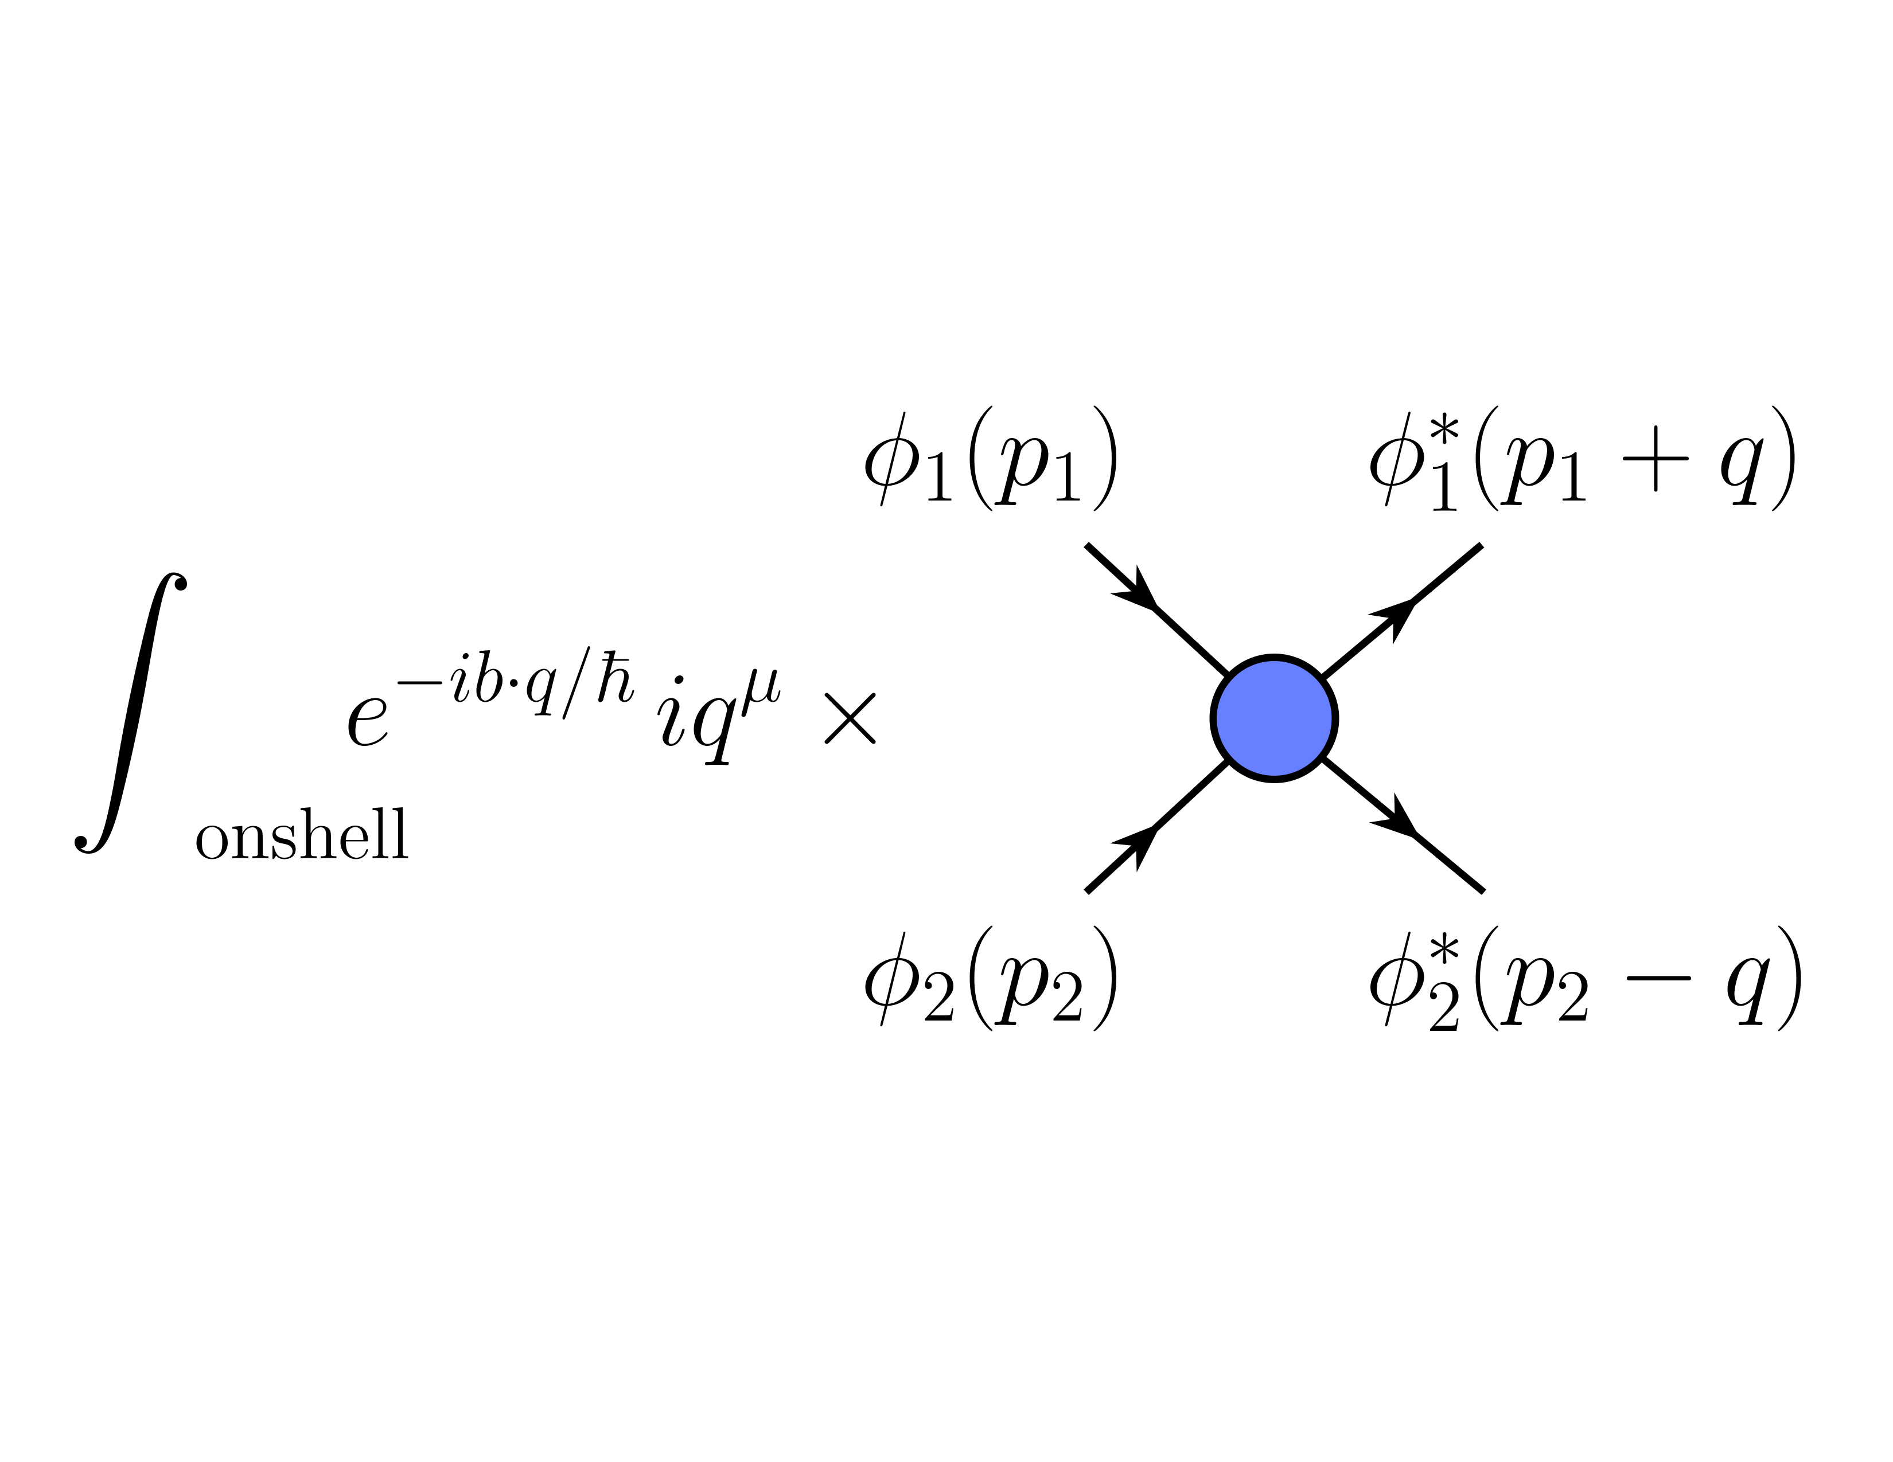
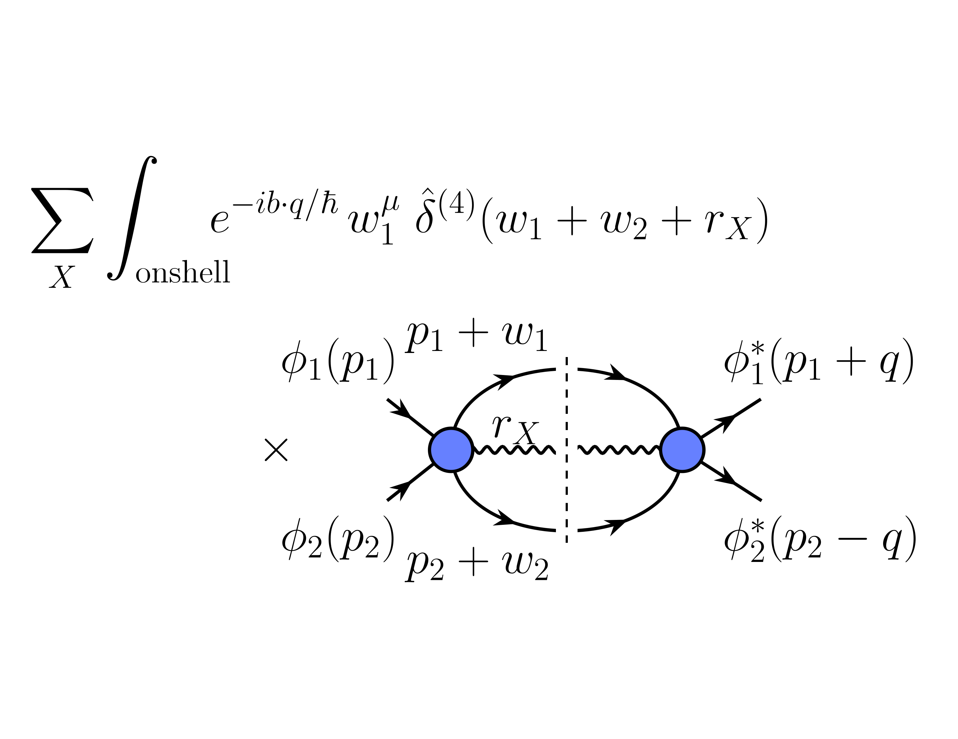
Impulse
$$\left\langle Δp_{1}^{μ}\right\rangle =\left\langle ψ | i{[P}_{1}^{μ},T\right]\left|ψ\right\rangle +⟨ψ\left|T^{†} \left[P_{1}^{μ},T\right]\right|ψ⟩$$
Diagrammatically ($q$ is momentum mismatch, $w$ momentum transfer)
First term is linear in amplitude
+

Slide 16
Classical Limit, part 2
Minimum-uncertainty non-relativistic wavefunction
$$exp\left(−\frac{p^{2}}{{\left(2m^{2}ℓ_{c}^{2}\right)}/{\left(ℓ_{w}^{2}\right)}}\right)$$
$ℓ_{c}$: Compton wavelength
$ℓ_{w}$: Wavefunction spread
Take relativistic wavefunction to be controlled by ${ξ=ℓ}_{c}^{2}/ℓ_{w}^{2}$ as well
Needs four-momentum parameter $u$: four-velocity
Simplest dependence $p⋅u/(mξ)$

Slide 17
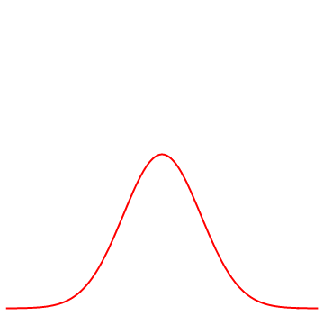
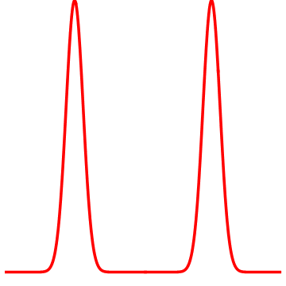
Classical Limit, part 2
Three scales
$ℓ_{c}$: Compton wavelength
$ℓ_{w}$: wavefunction spread
$b$: impact parameter
Particles localized: $ℓ_{c}≪ℓ_{w}$
Well-separated wave packets: $ℓ_{w}≪b$
More careful analysis confirms this ‘Goldilocks’ condition
$$ℓ_{c}≪ℓ_{w}≪b$$
$$b$$

Slide 18
Impulse at LO
O($g^{2}$)
Only first term contributes, with tree-level amplitude

Slide 19
Scalar QED Impulse at LO
2 → 2 amplitude
Impulse (use $p=m u$)
Evaluate the integral
Dilaton Gravity
Pure Gravity

Slide 20
Summary
Dawn of gravitational astronomy: new impetus to theoretical calculations in classical general relativity
Amplitudes and the double copy offer a simpler avenue to such calculations
Formulate observables valid in both quantum and classical theories
Organize formalism to take limit in a simple way
Count $ℏ$s
Momenta for massive particles, wavenumbers for massless
Lots of interesting things to do looking forward

