Slide 1
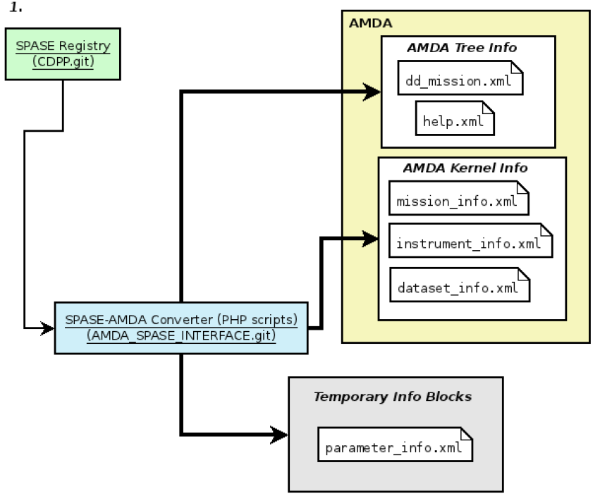
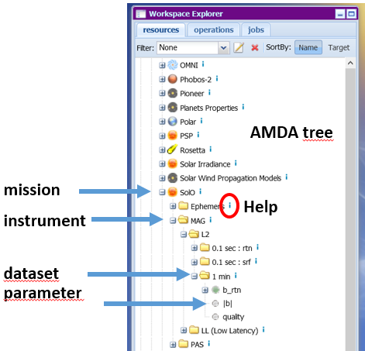
IHDEA #4 – 0ct. 2020
AMDA distributes space physics data for 15 years
Public data from NASA/CDAWeb, NASA/PDS, ESA/PSA, ESA/CSA, ESA/SOAR, … + simulations and models
SPASE is used at all levels of data description
AMDA parameter XML are built from SPASE registry (info) + AMDA specific blocks in 3 fields (Get, Process, Output)
A simulation model extension is available and is now being improved (see next presentation)
SPASE Registry
(CNES.git)
HAPI
AMDA team
V. Génot, E. Budnik, M. Bouchemit, C. Jacquey, N. André

Slide 2
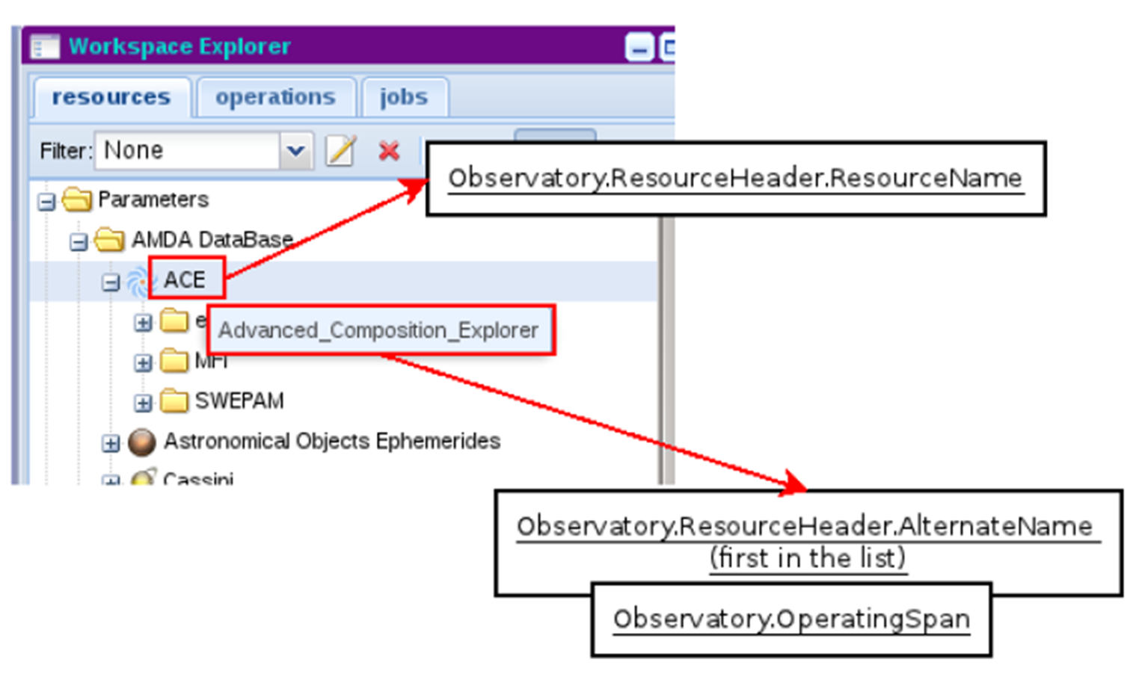
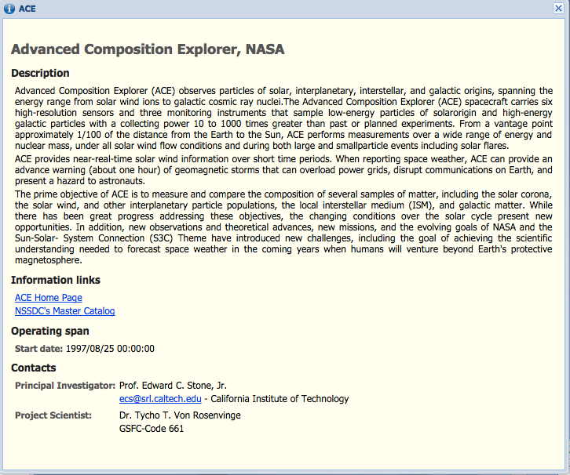
AMDA help from SPASE registry (mission level)
SPASE tags used for the mission level
Here at the mission level
And similarly at the instrument and dataset levels

