Slide 1
IBM Power system – HPC solution
Real-time control for adaptive optics workshop
26-27 January 2016
Guillaume Villette (guillaume.villette@fr.ibm.com)

Slide 2
IBM Power system HPC ecosystem Applications
AGENDA:

Slide 3
Power system – An OpenPOWER initiative
Moore’s law no longer satisfies performance gain
Growing workload demands
Numerous IT consumption models
Mature Open software ecosystem
Open Development
open oftware, open hardware
Rich software ecosystem
Spectrum of power servers
Multiple hardware options
Derivative POWER chips
Collaboration of thought leaders
simultaneous innovation, multiple disciplines
Performance of POWER architecture
amplified capability
Feeds back … resulting in client choice
OpenPOWER is an open development community, using the POWER Architecture to serve the evolving needs of customers.

Slide 4
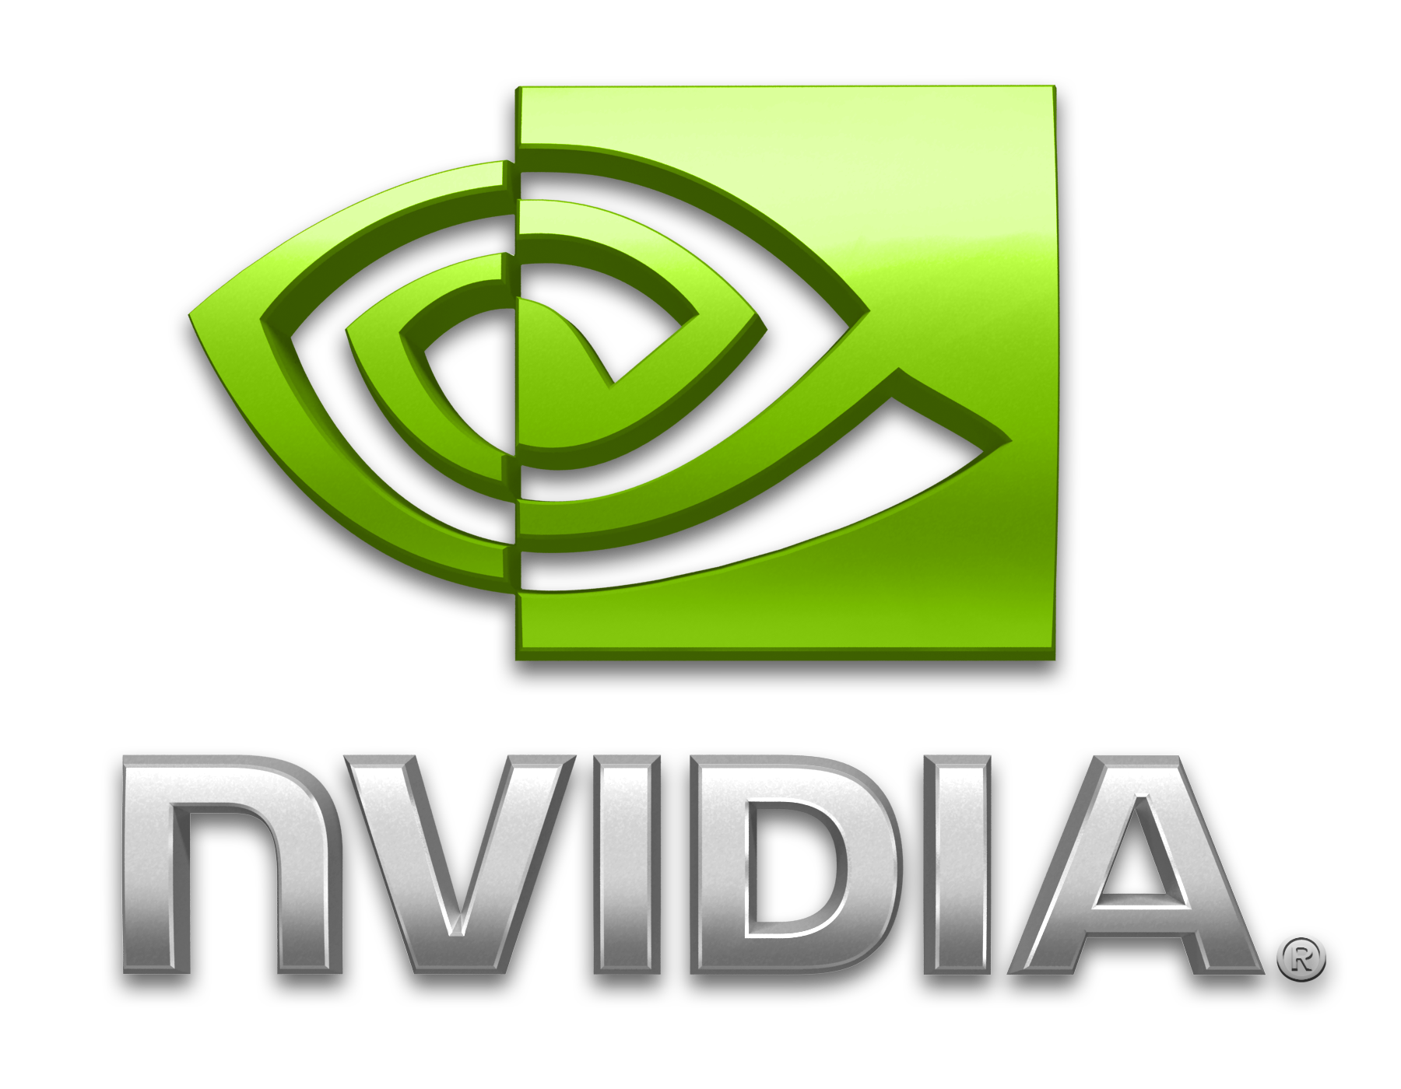
Power system – An OpenPOWER initiative
GPU
Memory
NVLINK
DMI
CAPI/PCIe
FPGA

Slide 5
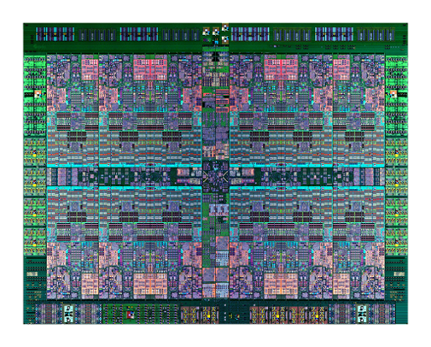
Power8 chip
Cores
10-12 cores (SMT8)
8 dispatch, 10 issue, 16 exec pipe
2X internal data flows/queues
Enhanced prefetching
Core
Core
Core
Core
Core
Core
SMP Links
Accelerators
L2
L2
L2
L2
L2
L2
8M L3
Region
L3 Cache & Chip Interconnect
Mem. Ctrl.
Mem. Ctrl.
Caches
64K Data cache (L1)
512 KB SRAM L2 / core
96 MB eDRAM shared L3
Up to 128 MB eDRAM L4 (off-chip)
Core
Core
Core
SMP Links
PCIe
Core
Core
Core
L2
L2
L2
L2
L2
L2
Bus Interfaces
Integrated PCIe Gen3
SMP Interconnect
CAPI
Accelerators
Crypto & Random number generator
Transactional Memory & Active memory expansion
Data Move / VM Mobility
Memory
Dual memory Controllers
230 GB/sec Sustained bandwidth
Technology
22nm SOI, eDRAM, 15 ML 650mm2

Slide 6
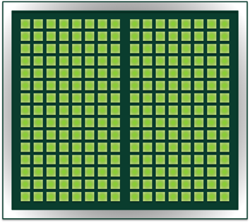
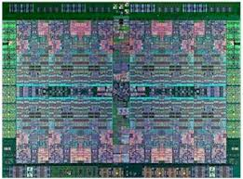
GPU - NVLink
NVIDIA GPU
NVIDIA GPU with NVLink
40+40 GB/s
Graphics Memory
Graphics Memory
Graphics Memory
16+16 GB/s
PCIe x16
40+40 GB/s
40+40 GB/s
80 GB/s
Peak*
System Memory
Power Chip
System Memory
Power Chip
with NVLink
Current GPU Attach
Future NVLink GPU Attachment
“NVLink will help improve GPU-GPU peer-to-peer communications, eliminating the need to transfer data via the PCIe bus. It would also allow one or more GPUs to access the system RAM much quicker. The new protocol will debut in 2016 with Pascal, which was revealed to be NVidia's next GPU architecture.”

Slide 7
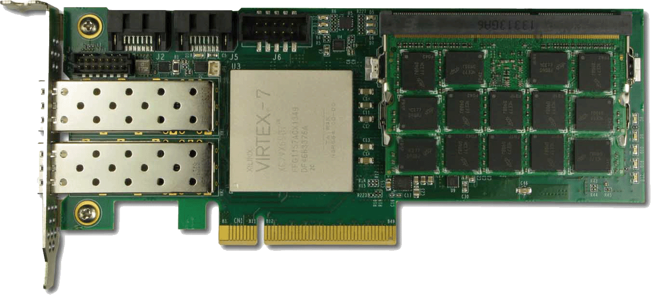
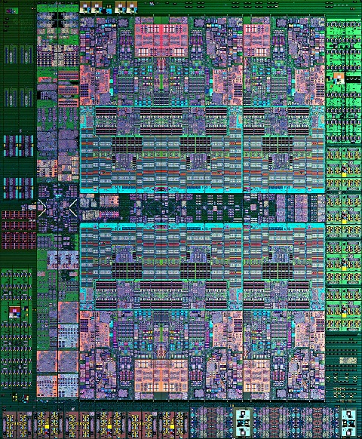
CAPI – Coherent Accelerator Processor Interface
FPGA
AFU
Typical I/O Model Flow:
Total ~13µs for data prep
IBM Supplied PSL
Acceleration
DD Call
Copy or Pin
Source Data
MMIO Notify
Accelerator
Poll / Interrupt
Completion
Copy or Unpin
Result Data
Ret. From DD
Completion
300 Instructions
10,000 Instructions
Application
Dependent, but
Equal to below
3,000 Instructions
1,000 Instructions
1,000 Instructions
7.9µs
4.9µs
PCIe
Flow with a Coherent Model:
Total 0.36µs
CAPP
Acceleration
Shared Mem.
Notify Accelerator
Shared Memory
Completion
Memory (Coherent)
POWER8 Core
400 Instructions
Application
Dependent, but
Equal to above
100 Instructions
0.3µs
0.06µs
OS
App
POWER8 Processor

Slide 8
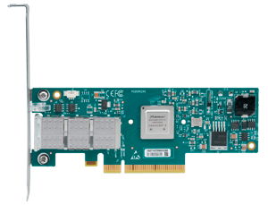
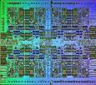
IBM OpenPOWER – Based HPC Roadmap
ESSL/PESSL
MASS
PE
ESSL/PESSL + GPU
MASS
Plateform MPI
ESSL/PESSL + GPU
MASS
Plateform MPI
Libraries
XL
LLVM – OpenMP4 (C)
GCC – OpenACC 1+
XL
LLVM – OpenMP 4.1
GCC – OpenACC 2
PGI – OpenACC 2
XL – OpenMP 5
LLVM – OpenMP 5
GCC – OpenACC
PGI – OpenACC 3
Compilers
Mellanox
Interconnect Technology
Connect-IB
FDR (50Gb/s)
PCIe Gen3
ConnectX-4
EDR (100Gb/s)
CAPI over PCIe Gen3
ConnectX-5
HDR (200Gb/s)
Enhanced CAPI over
PCIe Gen4
NVIDIA GPUs
Tesla
PCIe Gen3
Pascal
NVLink
Volta
Enhanced NVLink
POWER8
POWER8
POWER9
IBM CPUs
OpenPower
CAPI Interface
Enhanced CAPI & NVLink
NVLink
2015
2016
2017

Slide 9
IBM HPC ecosystem - Platform Computing
LSF
RTM
PAC
Resource
Management
IBM Platform Computing
Storage
Spectrum Scale/ ESS
Provisioning
Platform Clustering Manager
xcat

Slide 10
Applications considered
# Applications Application Category | Ported | GPU Enabled | Performance Metrics Avail | In-process | Planned to be ported | Under Consideration
Astrophysics | 2 | 2 | 2 | 0 | 3 | 2
Biological Sciences | 55 | 9 | 4 | 2 | 14 | 15
Chemistry and Physics | 7 | 4 | 3 | 12 | 16 | 37
Computer-aided Engineering (CAE) | 8 | 3 | 3 | 0 | 5 | 4
Deep Learning | 0 | 0 | 0 | 1 | 0 | 3
Defense & Intelligence | 0 | 0 | 0 | 0 | 0 | 0
Digital Content Creation and Distribution (DCC / DCD) | 0 | 0 | 0 | 0 | 0 | 0
Electronic Design Automation (EDA) | 1 | 0 | 1 | 0 | 0 | 0
Financial Modeling | 5 | 2 | 2 | 0 | 0 | 5
Geosciences | 2 | 1 | 1 | 1 | 7 | 13
Weather and Climate | 8 | 1 | 1 | 1 | 5 | 10
Benchmarks | 11 | 6 | 5 | 1 | 5 | 1
Utilities | 15 | 9 | 0 | 4 | 2 | 6

Slide 11
Applications considered
POWER8: Application Performance Advantages over Intel Haswell

Slide 12
Questions? guillaume.villette@fr.ibm.com

