Slide 1
Past, present and future of the Generalized Optical Differentiation Wavefront sensor
Sebastiaan Haffert, Joost Wardenier, Rico Landman and Christoph Keller
Leiden Observatory, Leiden University

Slide 2
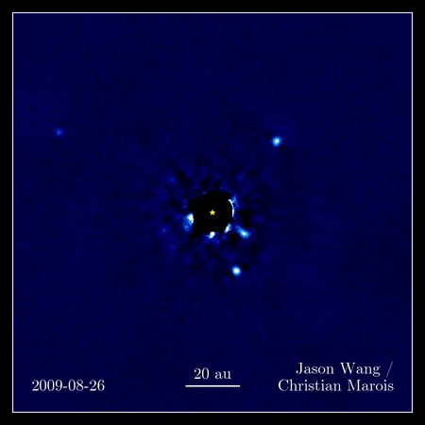

Slide 3
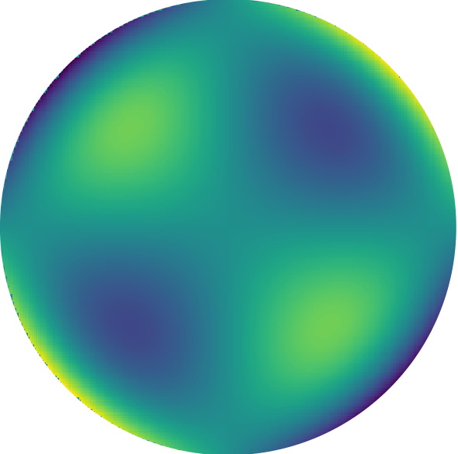
Optical Differentiation Wavefront Sensor
$$\frac{I_{1}−I_{2}}{I_{1}+I_{2}}∝\frac{dW}{dx}$$

Slide 4
Optical Differentiation
Foucault knife-edge test

Slide 5
Response
Response
Input
Input

Slide 6
Response
Response
Input
Input

Slide 7
Response
Response
Input
Input

Slide 8
Hybrid amplitude mask

Slide 9
Hybrid amplitude mask
Response
Input
Generalised optical differentiation wavefront sensor. Haffert 2016

Slide 10
Hybrid amplitude mask
Response
$$β$$
Input
Generalised optical differentiation wavefront sensor. Haffert 2016

Slide 11
Optical Differentiation Wavefront Sensor
$$\frac{I_{1}−I_{2}}{I_{1}+I_{2}}∝\frac{dW}{dx}$$

Slide 13
Leiden EXoplanet Instrument (LEXI)
A path-finder for high-contrast spectroscopy instrumentation
Wavefront sensing
High-resolution spectroscopy
William Herschel Telescope
Adaptive Optics
High-contrast imaging

Slide 14
Leiden EXoplanet Instrument (LEXI)
A path-finder for high-contrast spectroscopy instrumentation
Wavefront sensing
High-resolution spectroscopy
William Herschel Telescope
Adaptive Optics
High-contrast imaging

Slide 15
75 optical elements.
Set-up time of 5 days.

Slide 16
Evolution of LEXI from AO to XAO
Palomar strategy:
Downscale aperture to create an XAO system
William Herschel Telescope
4.2m diameter
LEXI run June 2016
William Herschel Telescope
1.2m off-axis segment
LEXI run December 2017

Slide 17
Why take an off-axis segment?
Better raw-contrast
We can more easily test new coronagraphs
Single-mode fiber injection scales with Strehl
Light gathering power versus coupling efficiency
We lose a factor of 16 in light but we gain Strehl
No central obscuration

Slide 18
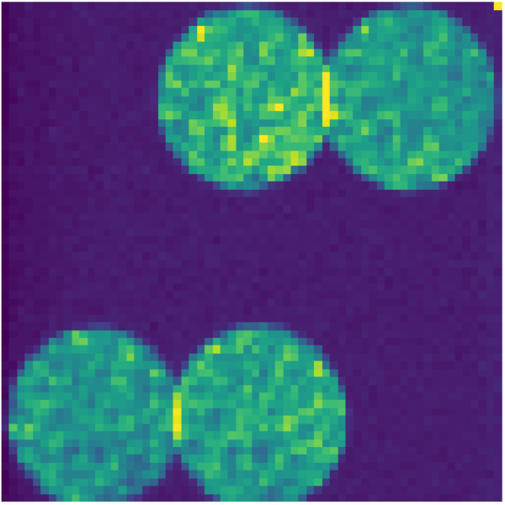
generalised Optical Differentiation wavefront sensor
Shack-Hartmann wavefront sensor
AO speed: 500 Hz
Number of modes: 75-80
Alpao 97-15 DM
AO speed: 800 Hz
Number of modes: 96
Alpao 97-15 DM
Haffert 2016, Haffert et al. (in prep)

Slide 19
Adaptive optics on
Adaptive optics off
50 Hz Imaging in R-band with 10 nm bandwidth

Slide 20
PSF quality improvement

Slide 21
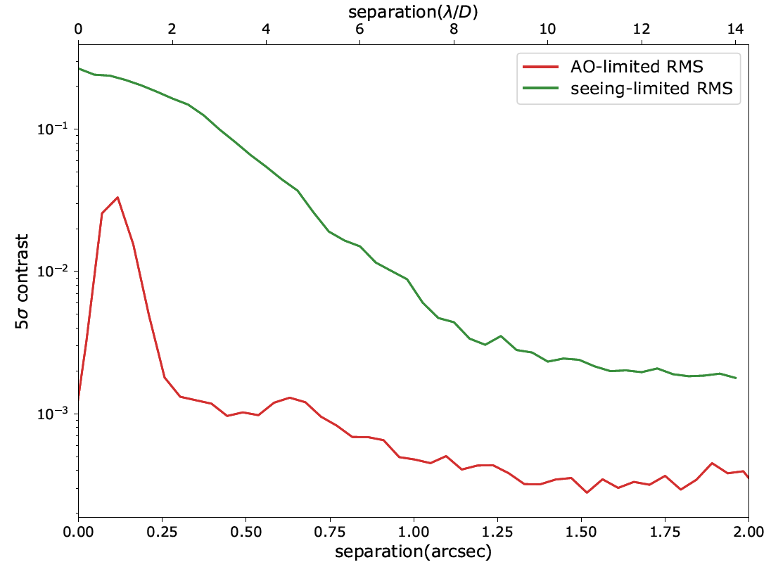

Slide 22
Atmospheric refraction is limiting us

Slide 23
Non-linear effects are important!
For high-contrast imaging we will not operate the WFS around its optimal performance point.
We need to correct for NCPAs
If we go to lower wavelengths, there will be turbulence generated non-linearities
Residual atmospheric dispersion will also cause non-linearities
Important for visible light HCI!

Slide 24
Non-linear wavefront reconstruction
Forward modelling of full system (Frazin et al. 2018)
Optical gain tracking ( M. van Kooten 2016, V. Deo 2018)
Non-linear system identification with neural networks (R. Landman and S. Y. Haffert in prep).

Slide 25
What is a neural network?
$$\left(\overset{⃑}{S},\overset{⃑}{I}\right)$$
Input state
Wavefront
Response
Pupil images

Slide 26
What is a neural network?
Response
$$\left(\overset{⃑}{S},\overset{⃑}{I}\right)$$
Input state
Wavefront
Response
Pupil images

Slide 27
What is a neural network?
Response
$$\left(\overset{⃑}{S},\overset{⃑}{I}\right)$$
Input state
Wavefront
Response
Pupil images
Reconstruction

Slide 28
What is a neural network?

Slide 29
What is a neural network?
Effectively a neural network is just a
“non-linear interaction matrix”

Slide 30
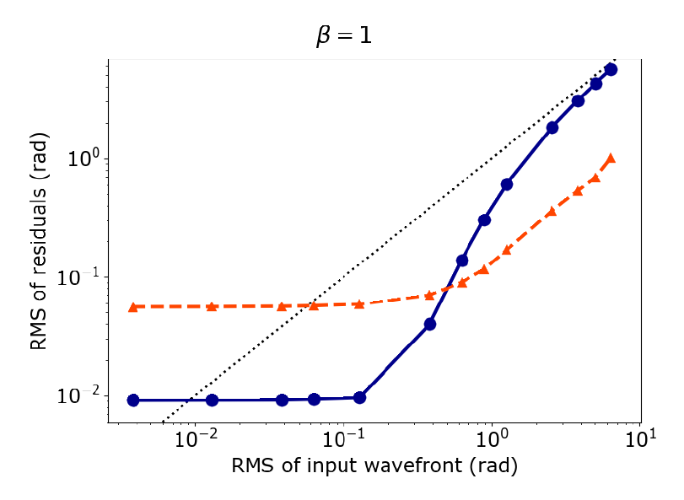
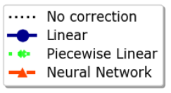
Rooftop wavefront sensor or Pyramid Wavefront sensor
Simulation

Slide 31
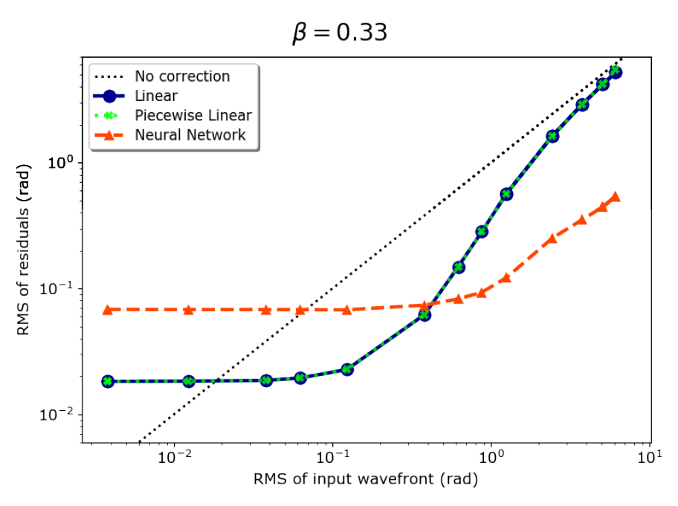
Simulation

Slide 32
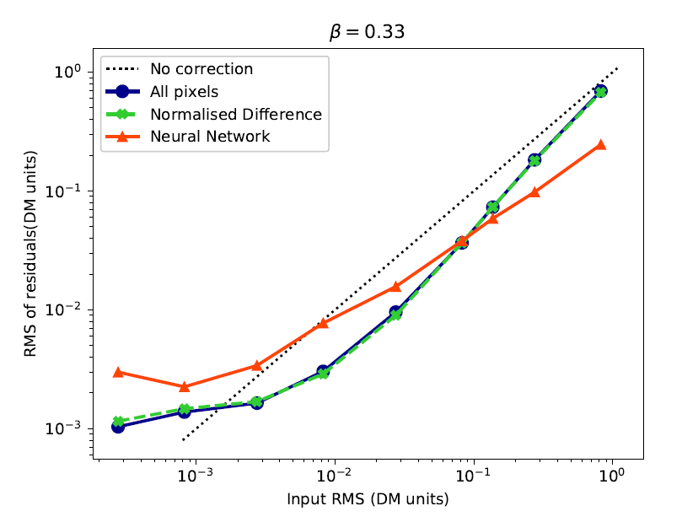
Wavefront reconstruction in lab

Slide 33
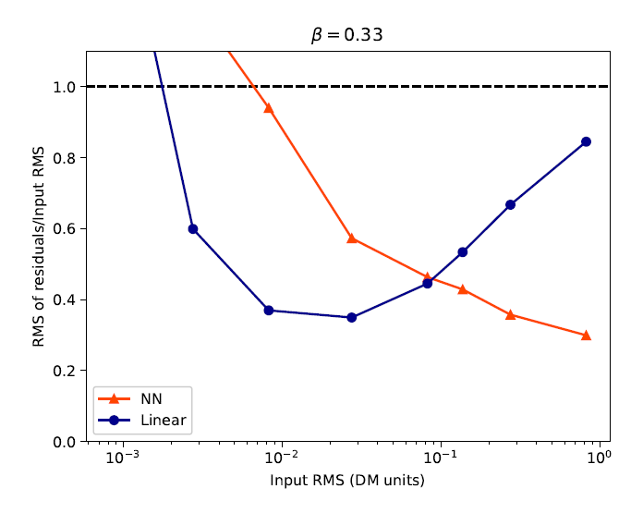

Slide 34
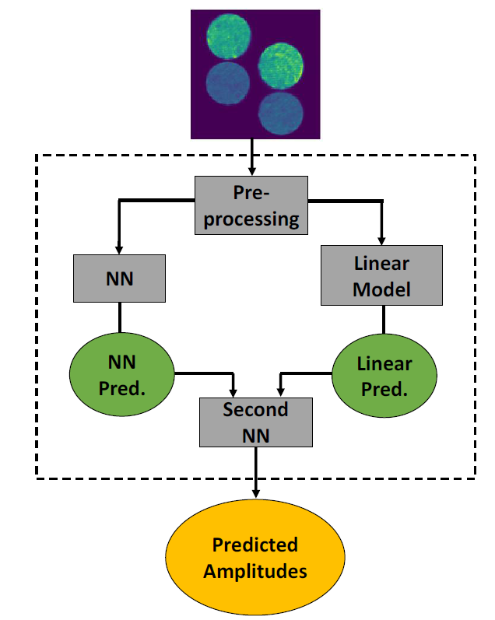

Slide 35
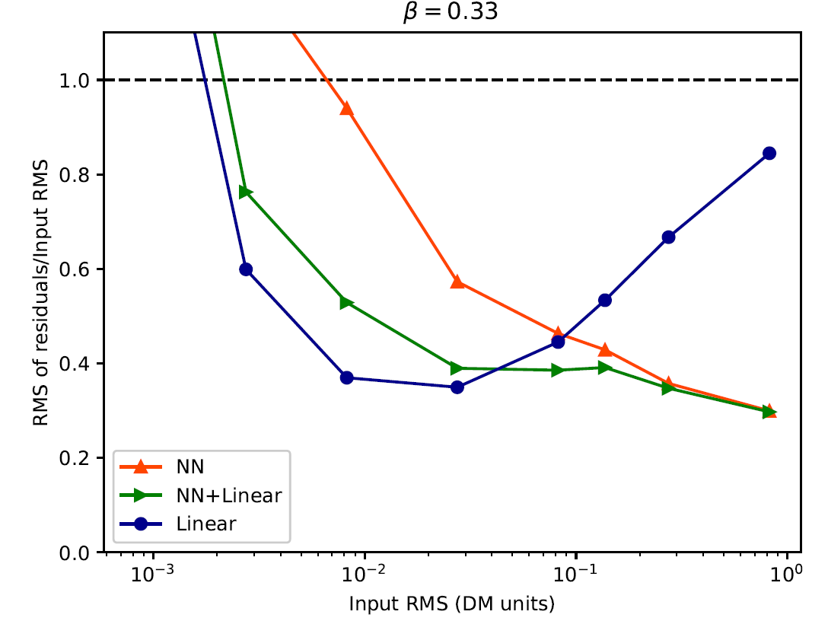
The combined performance

Slide 36
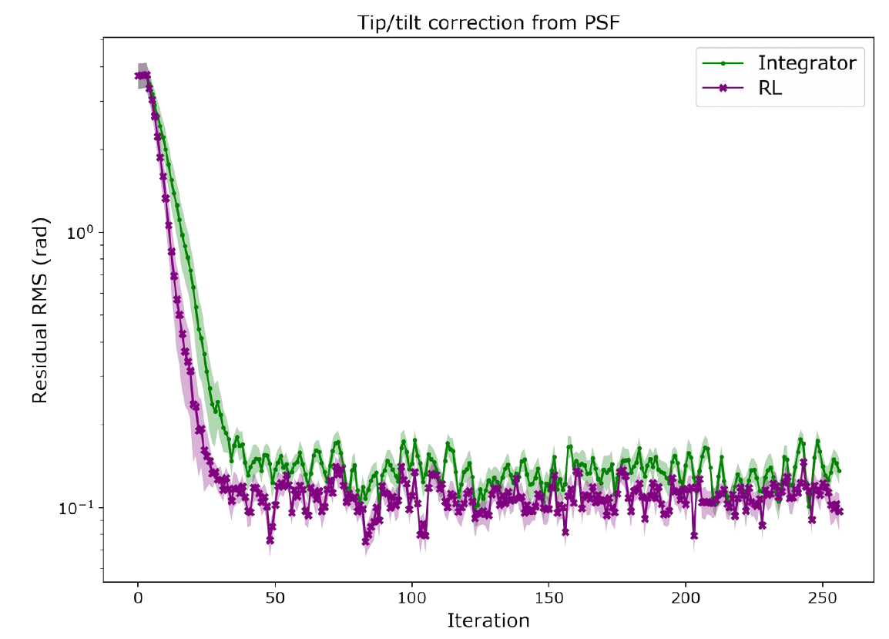
Merge sensing and control with reinforced learning

Slide 37
Predictive control with the g-ODWFS
A Data-Driven Closed-Loop Subspace Identification Approach
Step 1: Check if we can predict the turbulence using subspace identification
This seems to work, we verified it with simulation and on-sky data.
Step 2: Combine the predictor with a spatio-temporal control matrix
This works in simulation.

Slide 38
Conclusion
The g-ODWFS’s first on-sky test has been successful
Neural networks can be used for non-linear wavefront reconstruction
The g-ODWFS performs better in the large aberration regime
What is necessary for future XAO? Sensitivity or NCPA correction?
Merge sensing and control in one problem!
Let the control algorithm learn from its mistakes.

Slide 39
