Slide 1
Estimation, Prediction, and Reconstruction of Atmospheric Turbulence Minimising servo-lag error in SCAO and MCAO applications
Jesse Cranney, Francois Rigaut, Jose De Dona, Visa Korkiakoski

Slide 2
What is the issue?
ALL Wave-front sensors introduce measurement delay into Adaptive Optics systems.
ALL real-time control is based on observations of the past. This is worse in AO thanks to the “2 frame delay”
Non-predictive AO schemes introduce servo-lag error.
Two (non-exclusive) options are available to reduce servo-lag error:
A) Increase Speed of AO loop
B) Improve estimation/prediction of turbulence

Slide 3
Option A) Go Faster
Pros:
Increasing speed directly reduces servo-lag error,
Faster DM updates enables correction for faster temporal dynamics,
Simple control schemes work “good enough” in most cases.
Cons:
Wave-front sensor read-out noise ruins signal-noise ratio.
Computational demand grows inversely with control period. As latency tends to zero, computation demand tends to infinity.

Slide 4
Option B) Improve Prediction
Pros:
Can dramatically reduce (if not completely eliminate) servo-lag error.
Improve measurement utilisation (spatial/temporal sensor fusion).
Allows for the utilisation of more prior knowledge on turbulence (dynamic/statistical properties).
Rich existing literature on linear estimation (e.g. Kalman Filter) and linear control (e.g. LQR).
Cons:
Higher computational demand per command calculation.
Requires some kind of “tuning” or System ID stage.
More challenging to implement.

Slide 5
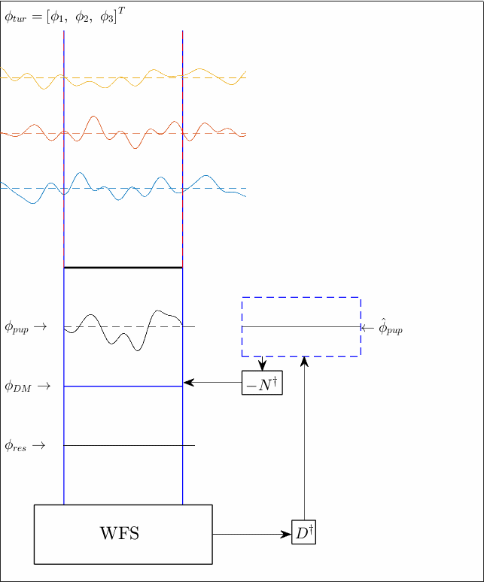
Non-Predictive SCAO
Summary:
Estimate the pupil-plane projected turbulence wave-front.
Use measurements from 1 WFS.
Correct for phase with a single DM conjugated to the pupil/ground layer.

Slide 6
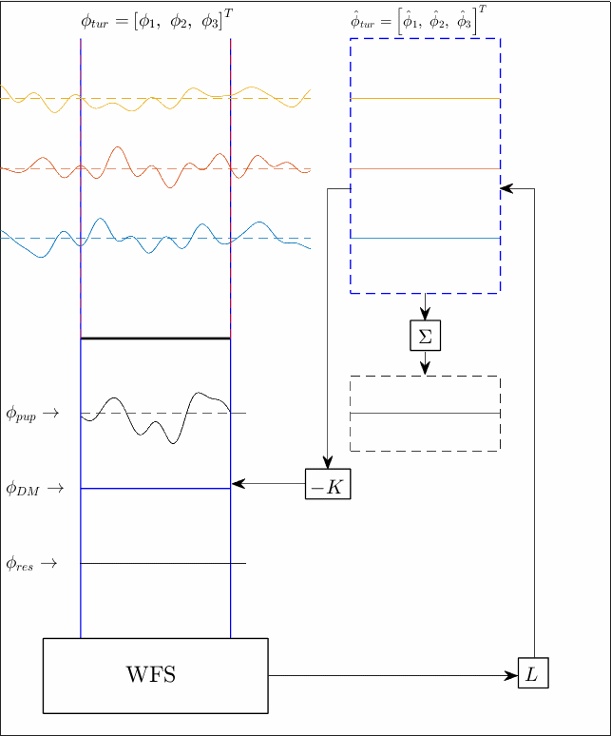
Predictive SCAO
Same physical apparatus as non-predictive scheme, but using knowledge of turbulence dynamics, try to estimate the individual layer phase contribution.
Improves estimate of the pupil wave-front AND allows prediction for the wave-front for multiple frames.

Slide 7
Predictive SCAO (continued)
Depends on knowledge of the layer speeds/directions.
This is directly solvable in SSA (satellite tracking) if the up-to-date CN2 profile is known (along with telescope slew-rate).
This is solvable in general, but requires telemetry to perform system identification algorithms on (no need for CN2 profile in this case).

Slide 8
Non-Predictive vs Predictive

Slide 9
2 Layer Example

Slide 10
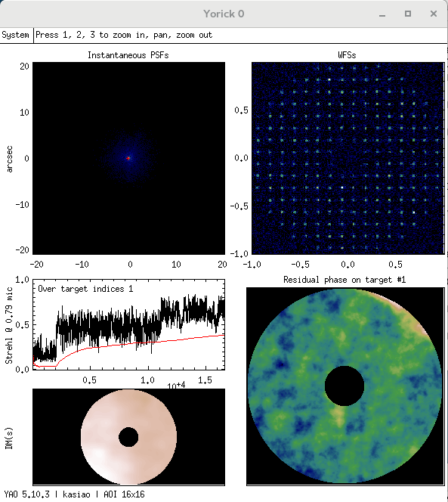
Preliminary Results in YAO
3 layers of turbulence (30,50,70)m/s same direction (SSA).
17x17x3 phase estimates (in RTC),
17x17 DM,
16x16 WFS.
Predictive SCAO
Integrator
No control

Slide 11
Still work to do
Sensitivity Analysis
Stochastic model mismatch:
Distribution of turbulence ($r_{0}, L_{0}$)
WFS noise
NCPA’s
Deterministic model mismatch:
Mismodelled delays,
Mismodelled altitudes,
Mismodelled velocities.

Slide 12
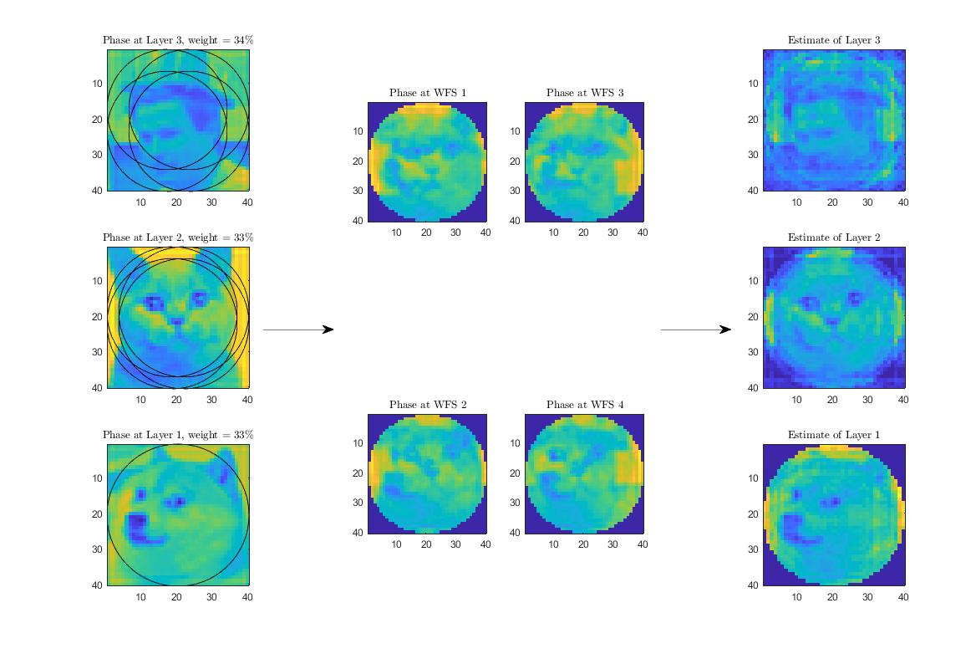
Non-Predictive MCAO
Use geometry of multiple WFS to design a tomographic reconstructor, which takes WFS measurements and produces phase estimates for the atmosphere.
The innovation is integrated in closed loop, and then projected to the altitudes of the DMs (not shown here)

Slide 13
Non-predictive MCAO (continued)

Slide 14
Predictive MCAO
Use ALL the tools we have:
Dynamics of turbulence,
Models of noise (turbulence boiling/WFS noise/aliasing),
Geometry of multiple WFS.
Zonal Predictive MCAO also covers more sky, and allows for convenient handling of spiders/irregularities.
The closed loop system (in a Kalman Filter) takes the form:
$${\hat{φ}}_{k+1}=A_{cl}{\hat{φ}}_{k}+Ls_{k+1} \\ u_{k+1}=−K{\hat{φ}}_{k+1}$$

Slide 15
But at what cost?!
L5
Example case:
4 x 40x40 WFS’s
5 x 40x40 Layers (estimated states in RTC)
3 x 40x40 DM’s
1kHz AO Loop
Online computational demand:
Non-Predictive: ~179 GFLOPS
Predictive: ~204 GFLOPS
L4
L3
L2
L1
PUPIL
DM1
DM2
DM3
WFS4
WFS1
WFS3
WFS2

Slide 16
Boundary Considerations
At some computational cost, we can lift the shift invariance requirement.
Treat border discontinuities as “integrator model” rather than predictive.
Same for spiders and other pupil discontinuities.
Problem. Defining the “weird bits” of the meta-pupils sounds boring and time-consuming.
Solution…

Slide 17
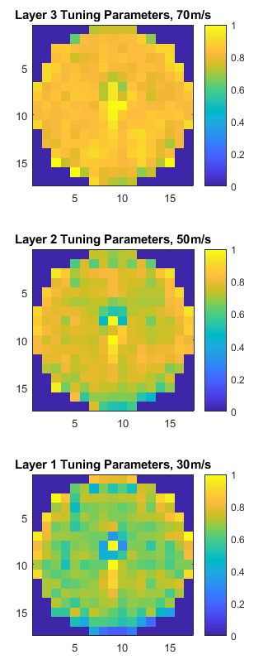
We can generalise it!
What information do we need in order to tune for these irregularities?
Recent telemetry,
“Ideal”/untuned AO model.
Closed form solution.
Constrained Quadratic Problem:
$$\text{min} \left\{\frac{1}{2}x^{T}Hx+x^{T}f\right\} \\ \text{s}\text{.}\text{t}\text{. }Ax≤b$$
$H,f,A,b$ matrices determined directly from phase and turbulence models.

Slide 18
Questions?

