Slide 1
AO Calibration with Pyramid WFS:
Focusing on the Mis-Registrations Identification
Cedric Taïssir Heritier
2nd year PhD Student
ESO: S. Oberti, P. Y. Madec, M. Kasper, C. Verinaud, J. Paufique, M. Le Louan, N. Cerpa, J. Kolb
LAM/ONERA: T. Fusco, B. Neichel, C. Correia, J. F. Sauvage
INAF: S. Esposito, R. Briguglio, G. Agapito, E. Pinna, A. Puglisi

Slide 2
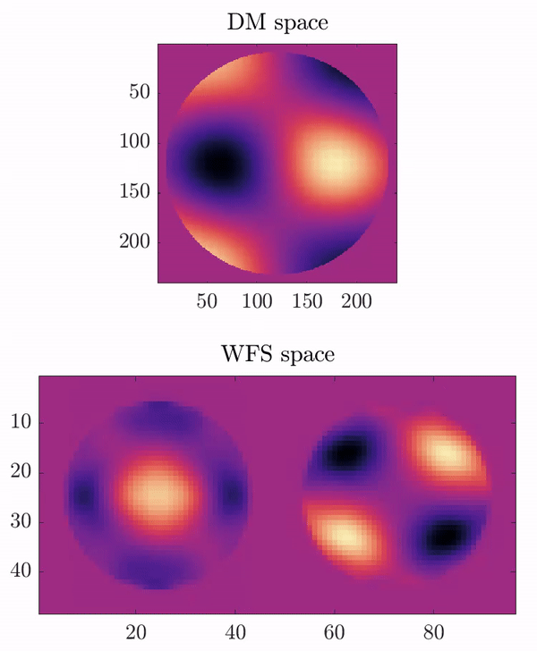
AO Calibration
Interaction Matrix
Calibrate how each WFS subaperture “sees” the DM actuators
Usually measured using external fiber.

Slide 3
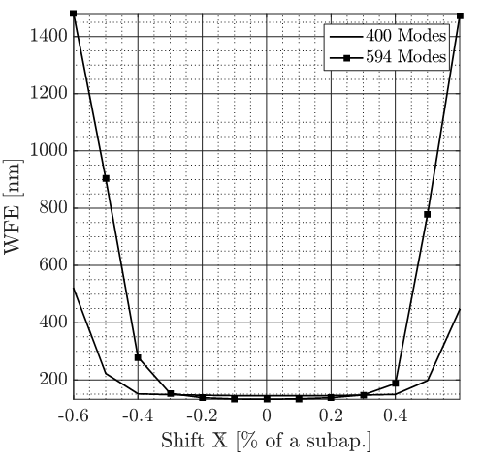
AO Calibration
Interaction Matrix
Calibrate how each WFS subaperture “sees” the DM actuators
Usually measured using external fiber.
Mis-Registrations
AO performance highly sensitive to mis-registrations
= rotation, shifts, anamorphosis of the DM actuators wrt the WFS.

Slide 4
AO Calibration
Adaptive Telescope
Large DM located inside the telescope, far from the WFS.
Frequent evolution of mis-registrations due to flexure/gravity
They have to be compensated:
Re-alignment of the system
Update of the Interaction Matrix

Slide 5
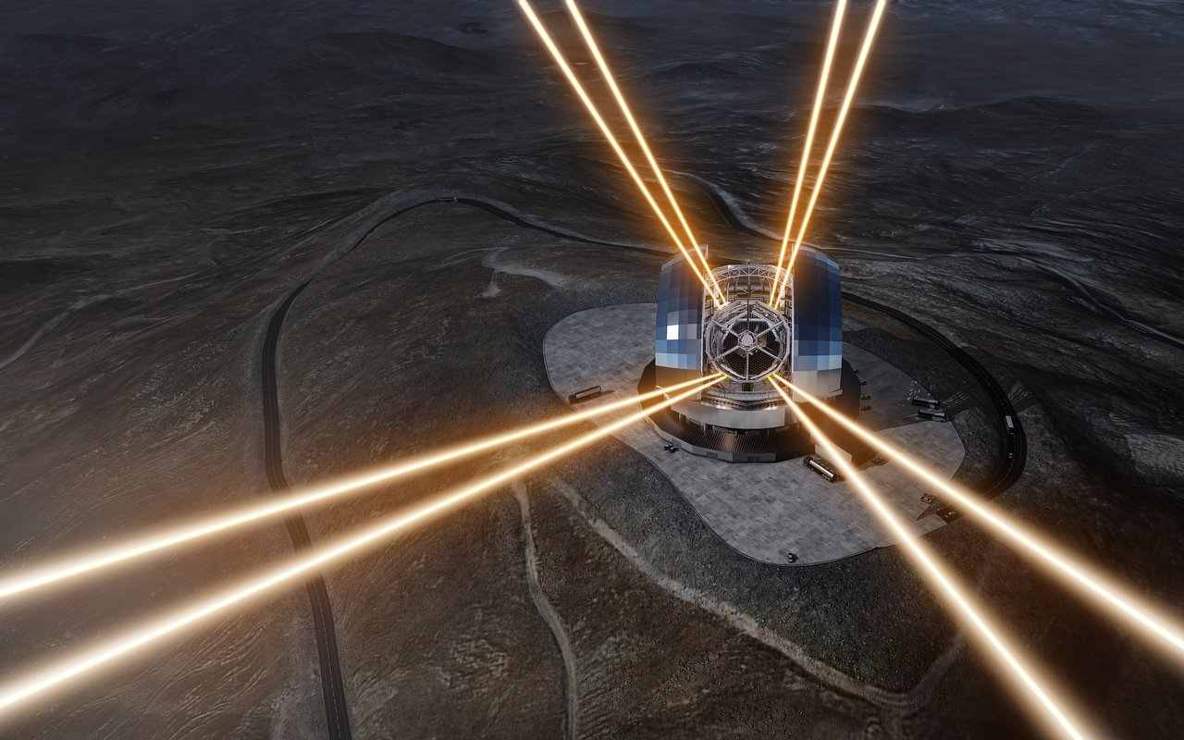
ELT Context
Adaptive Telescope with moving elements between DM and WFS
~5000 Actuators DM
Complex models of DM and WFS
No external calibration source upward M4
Credits: L. Calçada (ESO)

Slide 6
ELT Context
Adaptive Telescope with moving elements between DM and WFS
~5000 Actuators DM
Optimization of the calibration strategies required!
Complex models of DM and WFS
No external calibration source upward M4
Credits: L. Calçada (ESO)

Slide 7
AO Calibration
Pseudo - Synthetic Interaction Matrix (PSIM):
Generated from synthetic model of the AO systems injecting the correct mis-registrations parameters from experimental data.
Approach validated @AOF with SH-WFS¹ and @LBT with Pyramid-WFS²
Thank you OOMAO!
¹ Oberti et al 2006, Kolb et al 2012
² Pinna et all 2012, Heritier et al 2018

Slide 8
AO Calibration
Pseudo - Synthetic Interaction Matrix (PSIM):
Generated from synthetic model of the AO systems injecting the correct mis-registrations parameters from experimental data.
Approach validated @AOF with SH-WFS¹ and @LBT with Pyramid-WFS²
Key-Ingredient = Tracking/Identification of the mis-registrations to regularly update the calibration.
¹ Oberti et al 2006, Kolb et al 2012
² Pinna et all 2012, Heritier et al 2018

Slide 9
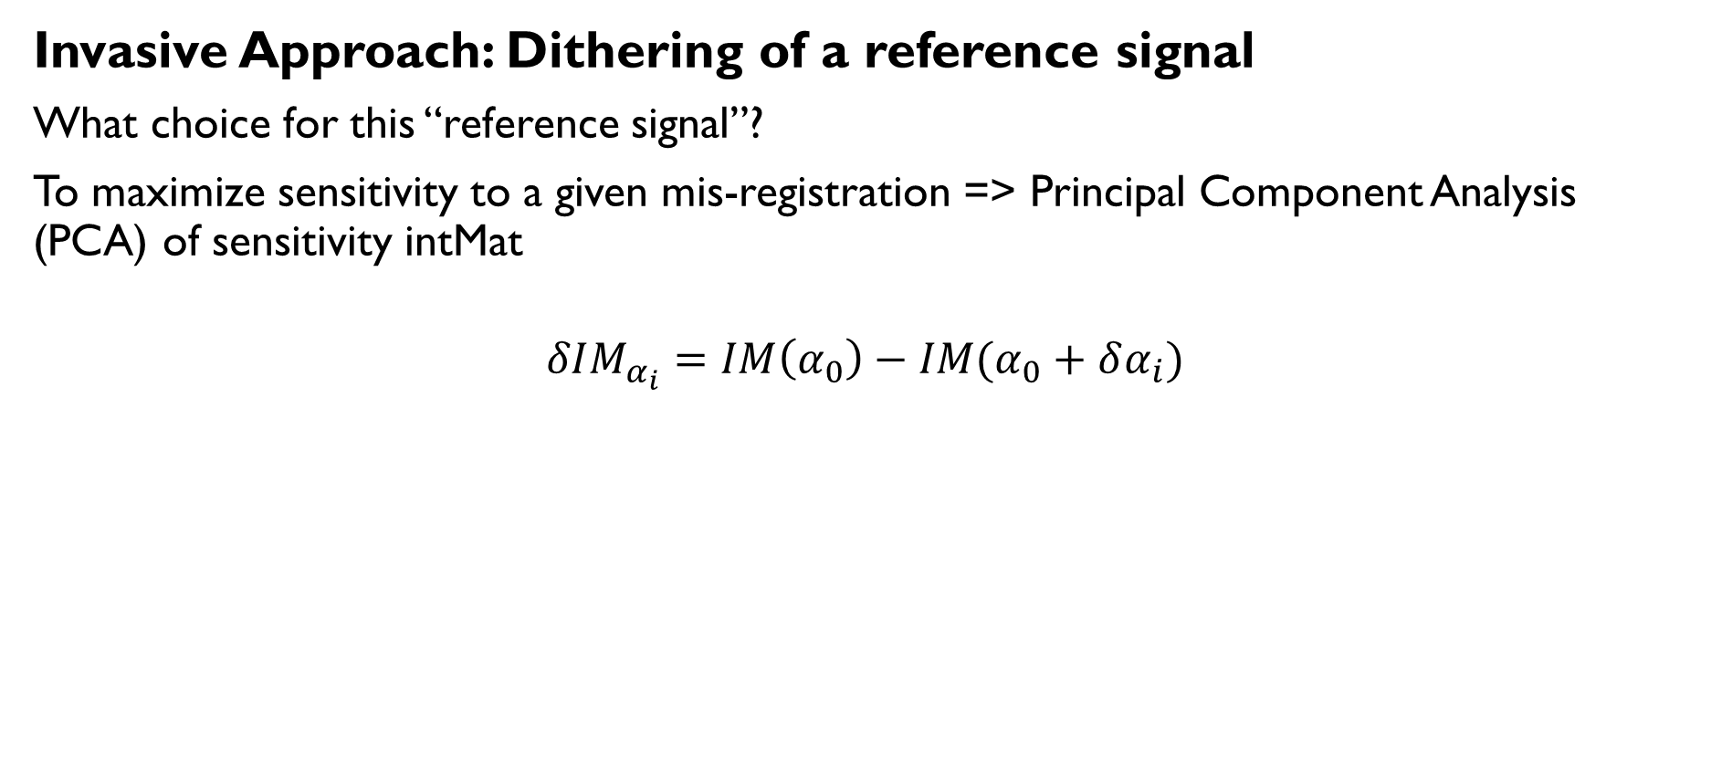
Mis-Registrations Identification
Invasive Approach: Dithering of a reference signal
What choice for this “reference signal”?
To maximize sensitivity to a given mis-registration => Principal Component Analysis (PCA) of sensitivity intMat
$$δIM_{α_{i}}=IM\left(α_{0}\right)−IM(α_{0}+δα_{i})$$

Slide 10
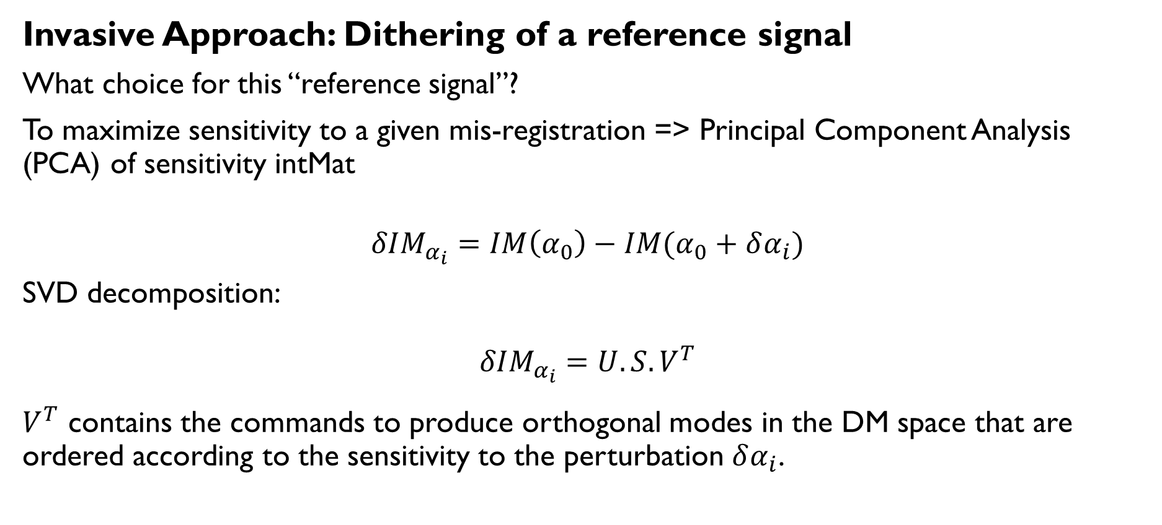
Mis-Registrations Identification
Invasive Approach: Dithering of a reference signal
What choice for this “reference signal”?
To maximize sensitivity to a given mis-registration => Principal Component Analysis (PCA) of sensitivity intMat
$$δIM_{α_{i}}=IM\left(α_{0}\right)−IM(α_{0}+δα_{i})$$
SVD decomposition:
$$δIM_{α_{i}}=U.S.V^{T}$$
$V^{T}$ contains the commands to produce orthogonal modes in the DM space that are ordered according to the sensitivity to the perturbation $δα_{i}$.

Slide 11
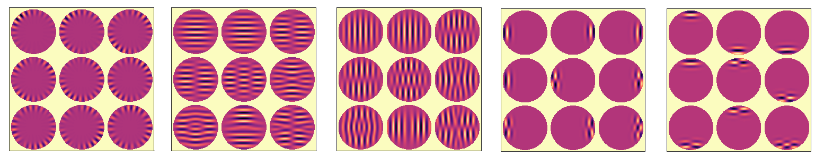
Mis-Registrations Identification
Invasive Approach: Dithering of a reference signal
“PCA Modes” example ( 32*32 Cartesian DM, 40*40 PWFS)
Rotation Shift X Shift Y Magn. Mx Magn. My
=> Includes both spatial sampling (DM and WFS).

Slide 12
Mis-Registrations Identification
Non Invasive Approach (AOF strategy)
Reconstruct the interaction matrix from closed loop data
Project this CL interaction matrix on sensitivity matrices

Slide 13
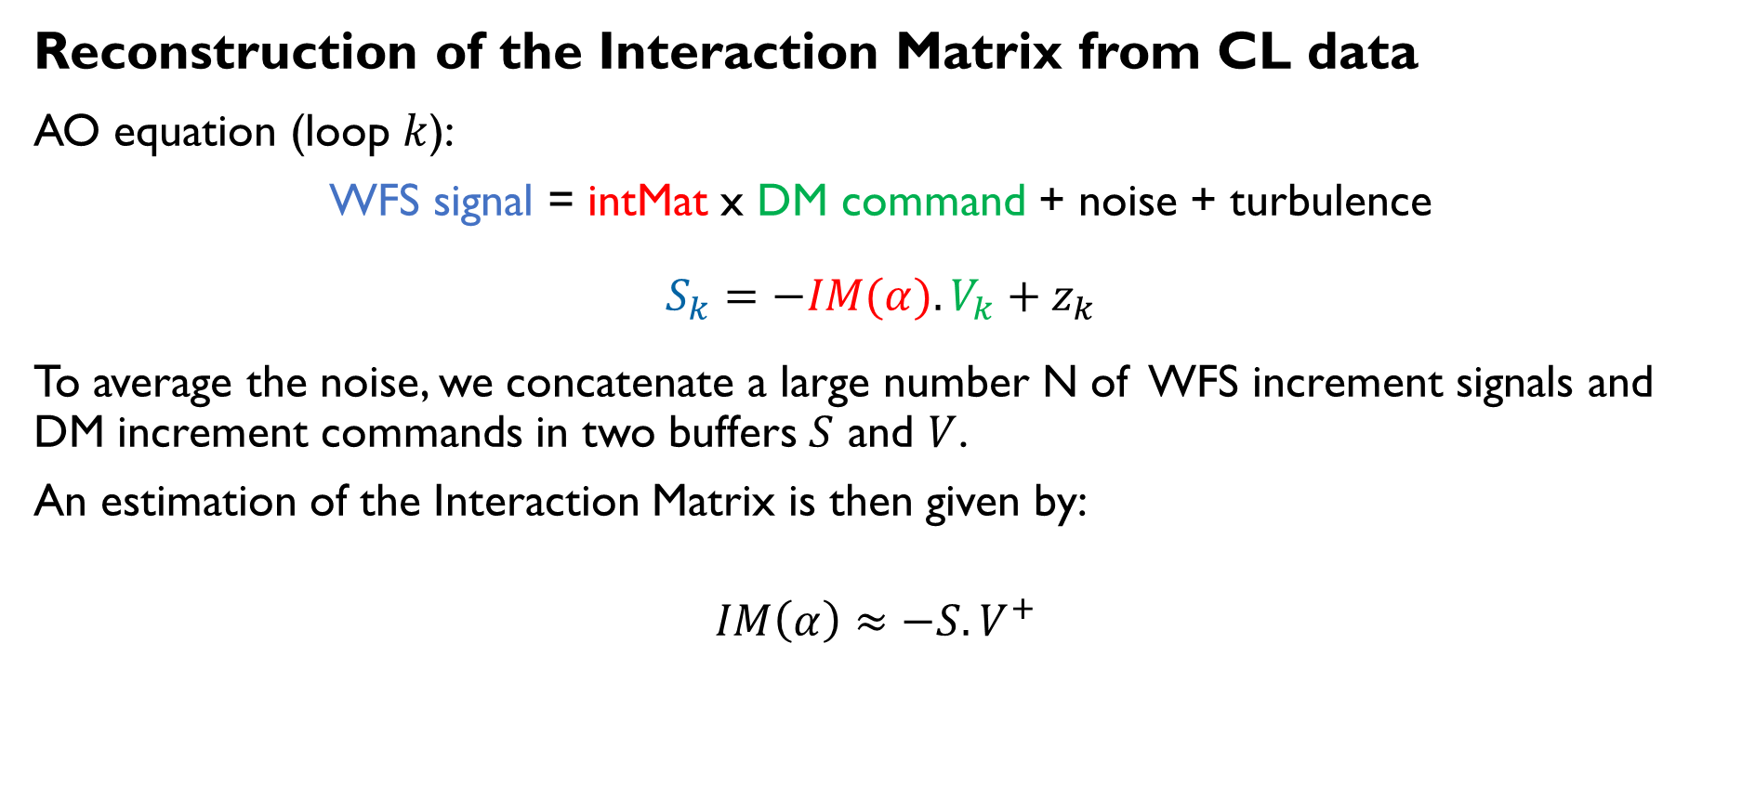
Mis-Registrations Identification
Reconstruction of the Interaction Matrix from CL data
AO equation (loop $k$):
WFS signal = intMat x DM command + noise + turbulence
$$S_{k}=−IM(α).V_{k}+z_{k}$$
To average the noise, we concatenate a large number N of WFS increment signals and DM increment commands in two buffers $S$ and $V$.
An estimation of the Interaction Matrix is then given by:
$$IM\left(α\right)≈−S.V^{+}$$

Slide 14
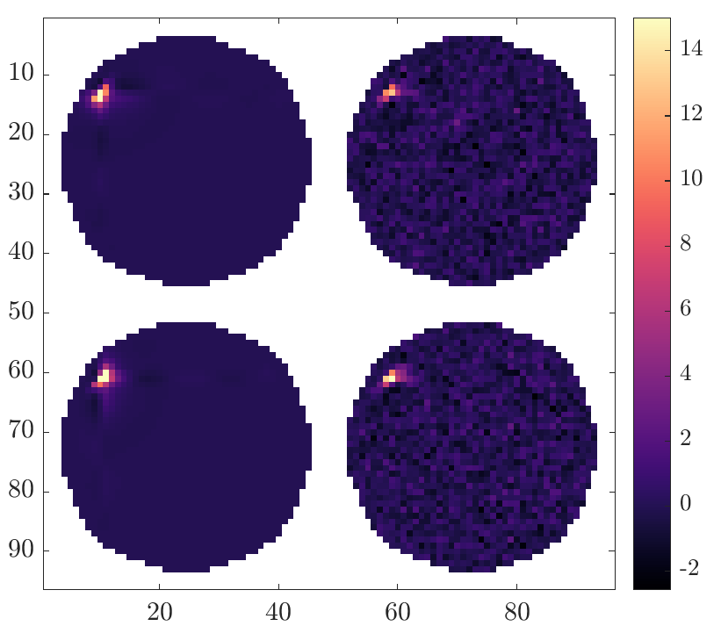
Mis-Registrations Identification
Reconstruction of the Interaction Matrix from CL data
Example (40 000 frames)
Reference IMat from CL
Slope X
Slope Y

Slide 15
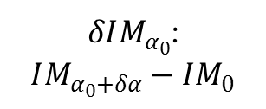
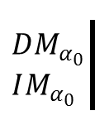

Mis-Registration Identification
Mis-Registration Identification from an Interaction Matrix
Step 0: Generation of the sensitivity matrices $δIM$ around $α_{0}$ using a step $δα$.
Computation of the Projector $P_{0}$.
$$DM_{α_{0}}$$
$$IM_{α_{0}}$$
$δIM_{α_{0}}$:
$$IM_{α_{0}+δα}−IM_{0}$$
$$P_{0}$$

Slide 16
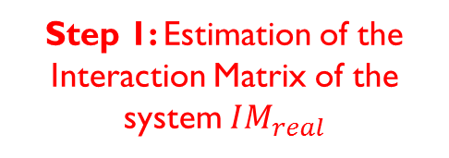
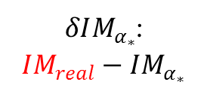
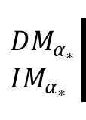
Mis-Registration Identification
Mis-Registration Identification from an Interaction Matrix
Step 0: Generation of the sensitivity matrices $δIM$ around $α_{0}$ using a step $δα$.
Computation of the Projector $P_{0}$.
$$DM_{α_{0}}$$
$$IM_{α_{0}}$$
$δIM_{α_{0}}$:
$$IM_{α_{0}+δα}−IM_{0}$$
$$P_{0}$$
$$DM_{α_{∗}}$$
$$IM_{α_{∗}}$$
$δIM_{α_{∗}}$:
$$IM_{real}−IM_{α_{∗}}$$
Step 1: Estimation of the Interaction Matrix of the system $IM_{real}$

Slide 17


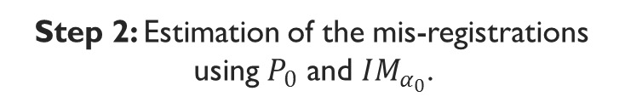
Mis-Registration Identification
Mis-Registration Identification from an Interaction Matrix
Step 0: Generation of the sensitivity matrices $δIM$ around $α_{0}$ using a step $δα$.
Computation of the Projector $P_{0}$.
$$DM_{α_{0}}$$
$$IM_{α_{0}}$$
$δIM_{α_{0}}$:
$$IM_{α_{0}+δα}−IM_{0}$$
$$P_{0}$$
$$α_{rot}^{∗}$$
$$α_{x}^{∗}$$
$$α_{y}^{∗}$$
$$α_{m_{x}}^{∗}$$
$$α_{m_{y}}^{∗}$$
$$DM_{α_{∗}}$$
$$IM_{α_{∗}}$$
$δIM_{α_{∗}}$:
$$IM_{real}−IM_{α_{∗}}$$
$$P$$
Step 1: Estimation of the Interaction Matrix of the system $IM_{real}$
Step 2: Estimation of the mis-registrations using $P_{0}$ and $IM_{α_{0}}$.

Slide 18
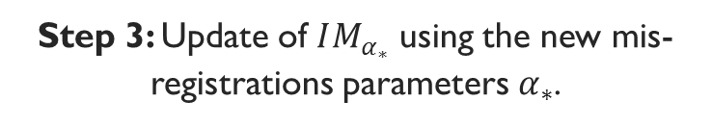
Mis-Registration Identification
Mis-Registration Identification from an Interaction Matrix
Step 0: Generation of the sensitivity matrices $δIM$ around $α_{0}$ using a step $δα$.
Computation of the Projector $P_{0}$.
$$DM_{α_{0}}$$
$$IM_{α_{0}}$$
$δIM_{α_{0}}$:
$$IM_{α_{0}+δα}−IM_{0}$$
$$P_{0}$$
$$α_{rot}^{∗}$$
$$α_{x}^{∗}$$
$$α_{y}^{∗}$$
$$α_{m_{x}}^{∗}$$
$$α_{m_{y}}^{∗}$$
$$DM_{α_{∗}}$$
$$IM_{α_{∗}}$$
$δIM_{α_{∗}}$:
$$IM_{real}−IM_{α_{∗}}$$
$$P$$
Step 3: Update of $IM_{α_{∗}}$ using the new mis-registrations parameters $α_{∗}$.
Step 1: Estimation of the Interaction Matrix of the system $IM_{real}$
Step 2: Estimation of the mis-registrations using $P_{0}$ and $IM_{α_{0}}$.

Slide 19


Mis-Registration Identification
Mis-Registration Identification from an Interaction Matrix
Step 0: Generation of the sensitivity matrices $δIM$ around $α_{0}$ using a step $δα$.
Computation of the Projector $P_{0}$.
$$DM_{α_{0}}$$
$$IM_{α_{0}}$$
$δIM_{α_{0}}$:
$$IM_{α_{0}+δα}−IM_{0}$$
$$P_{0}$$
Step 4: Update of $P$ using the new working point $α_{∗}$ if necessary.
$$P_{∗}$$
$$α_{rot}^{∗}$$
$$α_{x}^{∗}$$
$$α_{y}^{∗}$$
$$α_{m_{x}}^{∗}$$
$$α_{m_{y}}^{∗}$$
$$DM_{α_{∗}}$$
$$IM_{α_{∗}}$$
$δIM_{α_{∗}}$:
$$IM_{real}−IM_{α_{∗}}$$
$$P$$
Step 3: Update of $IM_{α_{∗}}$ using the new mis-registrations parameters $α_{∗}$.
Step 1: Estimation of the Interaction Matrix of the system $IM_{real}$
Step 2: Estimation of the mis-registrations using $P_{0}$ and $IM_{α_{0}}$.

Slide 20
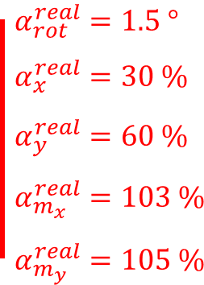
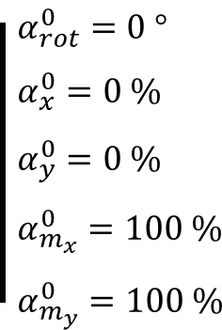
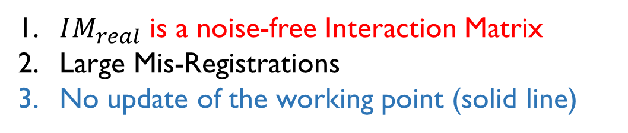
Mis-Registration Identification
Mis-Registration Identification from an Interaction Matrix
$IM_{real}$ is a noise-free Interaction Matrix
Large Mis-Registrations
No update of the working point (solid line)
$$α_{rot}^{real}=1.5 °$$
$$α_{x}^{real}=30 \%$$
$$α_{y}^{real}=60 \%$$
$$α_{m_{x}}^{real}=103 \%$$
$$α_{m_{y}}^{real}=105 \%$$
$$α_{rot}^{0}=0 °$$
$$α_{x}^{0}=0 \%$$
$$α_{y}^{0}=0 \%$$
$$α_{m_{x}}^{0}=100 \%$$
$$α_{m_{y}}^{0}=100 \%$$
23/10/2018
23/10/2018
20
20

Slide 21
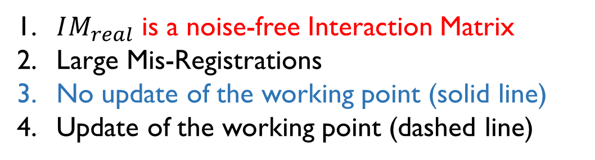
Mis-Registration Identification
Mis-Registration Identification from an Interaction Matrix
$IM_{real}$ is a noise-free Interaction Matrix
Large Mis-Registrations
No update of the working point (solid line)
Update of the working point (dashed line)
$$α_{rot}^{real}=1.5 °$$
$$α_{x}^{real}=30 \%$$
$$α_{y}^{real}=60 \%$$
$$α_{m_{x}}^{real}=103 \%$$
$$α_{m_{y}}^{real}=105 \%$$
$$α_{rot}^{0}=0 °$$
$$α_{x}^{0}=0 \%$$
$$α_{y}^{0}=0 \%$$
$$α_{m_{x}}^{0}=100 \%$$
$$α_{m_{y}}^{0}=100 \%$$
23/10/2018
23/10/2018
21
21

Slide 22
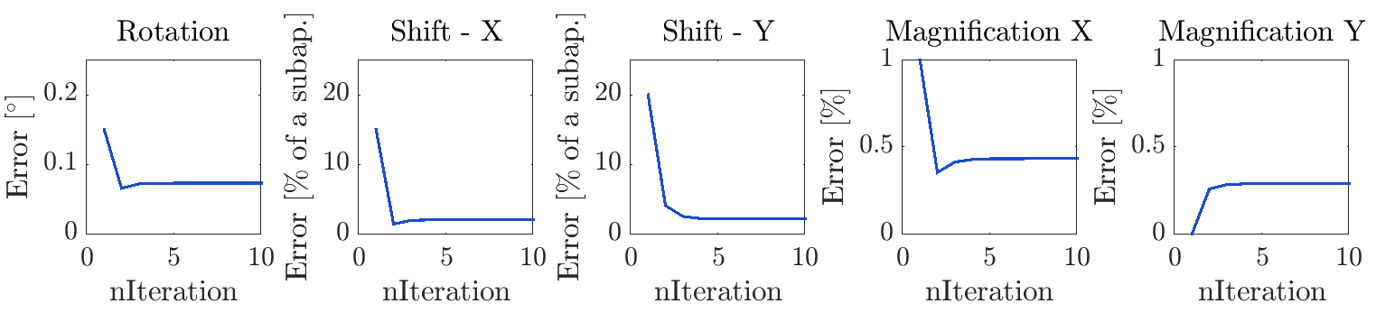
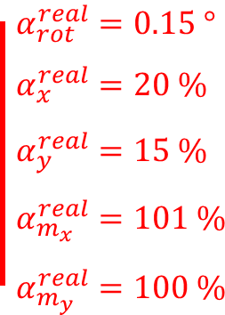
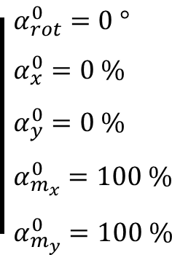
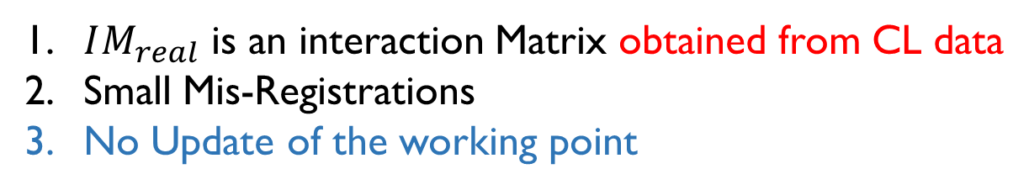
Mis-Registrations Identification
Mis-Registration Identification from an Interaction Matrix
$IM_{real}$ is an interaction Matrix obtained from CL data
Small Mis-Registrations
No Update of the working point
$$α_{rot}^{real}=0.15 °$$
$$α_{x}^{real}=20 \%$$
$$α_{y}^{real}=15 \%$$
$$α_{m_{x}}^{real}=101 \%$$
$$α_{m_{y}}^{real}=100 \%$$
$$α_{rot}^{0}=0 °$$
$$α_{x}^{0}=0 \%$$
$$α_{y}^{0}=0 \%$$
$$α_{m_{x}}^{0}=100 \%$$
$$α_{m_{y}}^{0}=100 \%$$

Slide 23
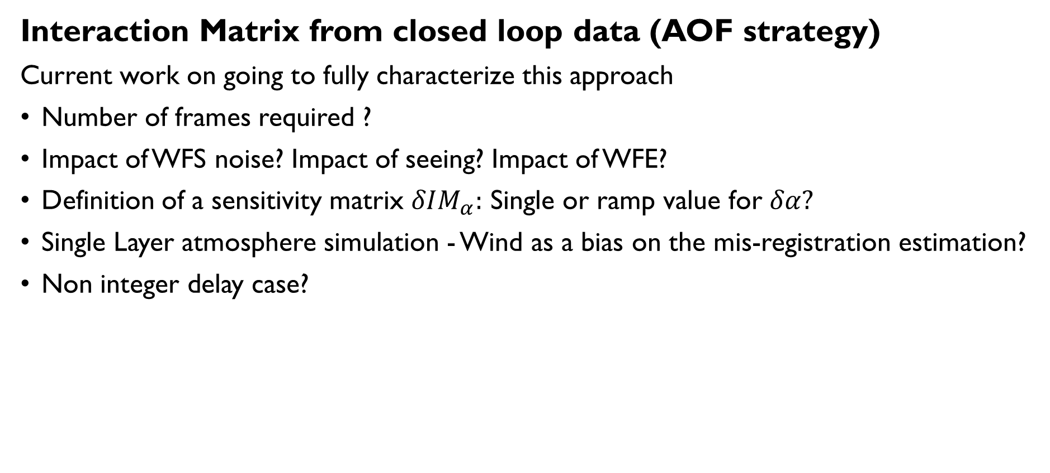
Mis-Registrations Identification
Interaction Matrix from closed loop data (AOF strategy)
Current work on going to fully characterize this approach
Number of frames required ?
Impact of WFS noise? Impact of seeing? Impact of WFE?
Definition of a sensitivity matrix $δIM_{α}:$ Single or ramp value for $δα?$
Single Layer atmosphere simulation - Wind as a bias on the mis-registration estimation?
Non integer delay case?
23/10/2018
23/10/2018
23
23

Slide 24
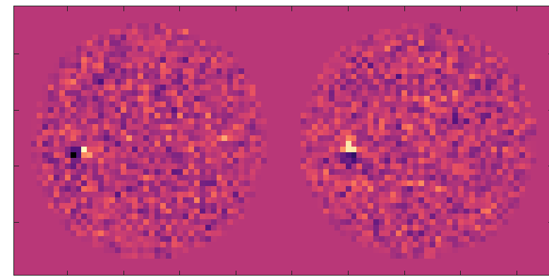
Mis-Registrations Identification
Interaction Matrix from closed loop data (AOF strategy)
Current work on going to fully characterize this approach
Optimizations on going:
Windowing of the WFS signals: x
Modal space reduction: consider optimal modal basis for identification algorithm. Projection on PCA modes? First promising results
23/10/2018
23/10/2018
24
24

Slide 25
Lab Activity: High Order Test Bench @ESO
HOT Test-Bench
New set-up fot the High Order Test-Bench @ ESO
new calibrations on-going.
Synthetic Calibration – On-Going
Experimental validation of Mis-Registration identification strategies studied in simulator.
See M. Kasper talk on Wednesday

Slide 26
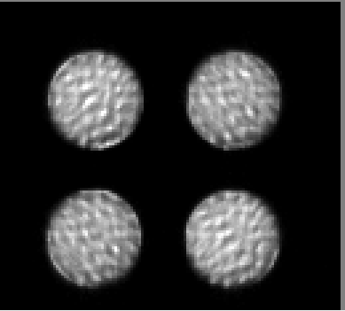
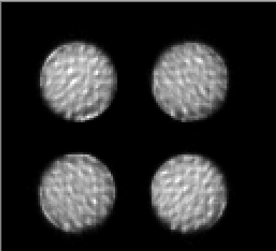
Lab Activity
HOT Test-Bench
New set-up fot the High Order Test-Bench @ ESO
new calibrations on-going.
Synthetic Calibration – On-Going
First promising results – controlling 100 modes
Synthetic Experimental

Slide 27
Conclusion
There are plenty of things to look at!
The AO calibration for the future ELT instrument will require optimized strategies that will most likely be based on synthetic models of the AO systems.
One of the key element will be the update of the Interaction Matrix by monitoring and tracking the mis-registrations parameters.
I still have ~ 1 year to look at this thoroughly, working with OOMAO & the HOT Test Bench!
Thank you for your attention!

Slide 28
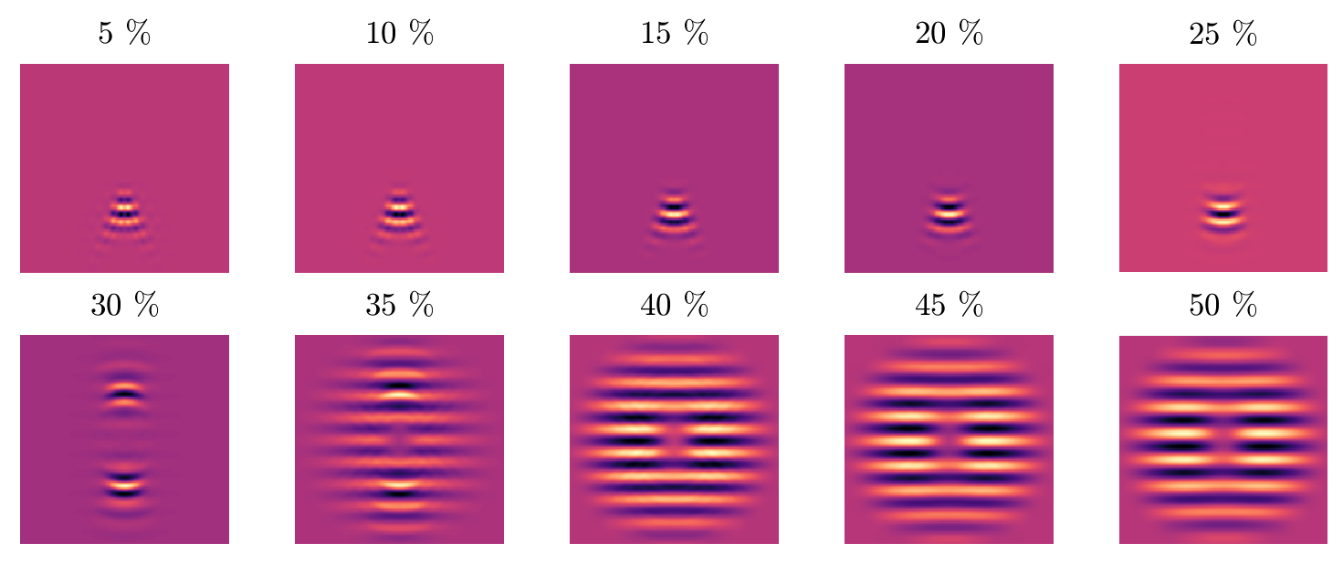
Mis-Registrations sensitivity analysis
Influence Function Mechanical Coupling (LBT-like system)

Slide 29
Mis-Registrations sensitivity analysis
WFS sampling vs DM (fixed) Geometry

Slide 30
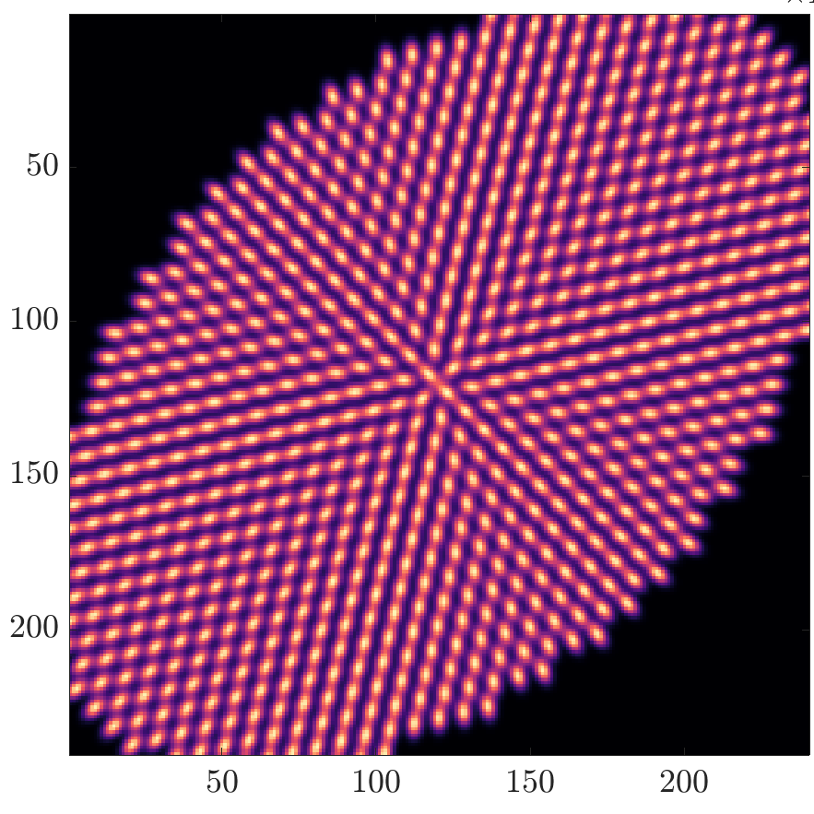



Anamorphosis
$$m_{r}$$
$$m_{n}$$
$$θ$$

