Slide 1




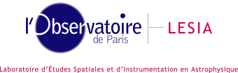

A status of coronagraphic phase diversity:
COFFEE
Olivier Herscovici-Schiller
L. Mugnier, J.-F. Sauvage, P. Baudoz, R. Galicher, A. Vigan, K. Dohlen, L. Leboulleux, F. Patru, T. Fusco, L. Pueyo, R. Soummer, J.-M. Le Duigou
1

Slide 2
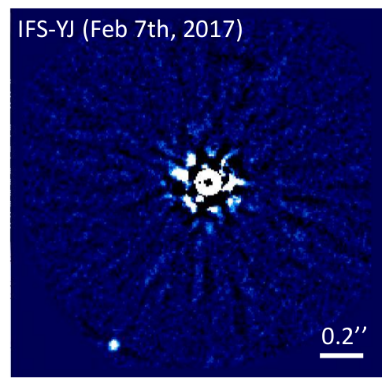
Limitations to direct imaging of exoplanets
Separation < 1″
⇒ Very large telescopes
+ AO (from ground)
Contrast < 10⁻⁴
⇒ Coronagraph
⇒ Post-processing
Ultimate limitation: speckles due to
quasi-static aberrations
HIP 65426b, SPHERE, ESO [Chauvin et al. 2017]
1

Slide 3
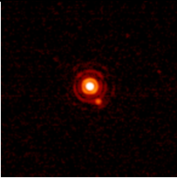
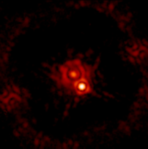
Coronagraph
α Eri. (SPHERE), no coronagraph
α Eri. (SPHERE), with coronagraph
1

Slide 4
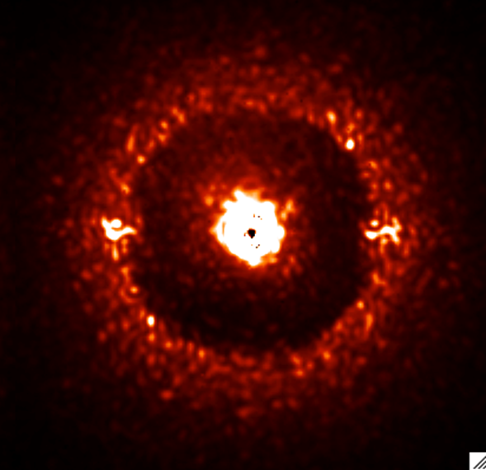
Structure of high-contrast images
Diffraction residual
AO correction limit
(20 λ/D on SPHERE)
Speckle
SPHERE/IRDIS image
1

Slide 5
Quasi-static speckles: how to make them disappear?
Quasi-static speckles: where do they come from?
Goal: NCPA correction
AO-corrected aberrations
Telescope
AO
Non-common path aberrations
(NCPA)
Coronagraph
corrected
Camera
Focal-plane WFS
1

Slide 6
Better contrast for ground-based instruments
  Ground-based instruments
    Issue : aberrations change during the night
    [Martinez et al 12−13, Milli et al 16, Gœbel et al 18]
    Issue : calibration source ≠ on-sky measurement [Vigan
Telescope
⇒ On-sky post-coronagraphic WFS
AO
Coronagraph
Camera
Focal-plane WFS

Slide 7
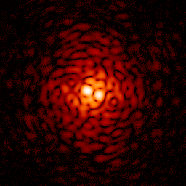
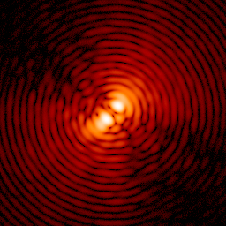
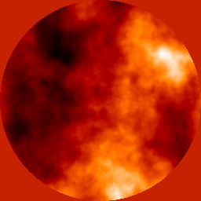
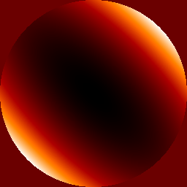
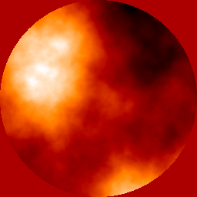
COFFEE, the coronagraphic phase diversity
Coronagraphic Focal-plane wave-Front Estimation for Exoplanet detection
coronagraphic imaging
upstream pupil
Downstream pupil
(Lyot Stop)
Detector
i(ϕ_{u}, ϕ_{d})
i(ϕ_{u}+ϕ_{div,} ϕ_{d})
Étoile
Focal-plane coronographic mask
+
ϕ_{u}
ϕ_{div}
ϕ_{d}
[Sauvage et al., Opt. Lett. 2012], [Paul et al., A&A 2013], [Paul et al., Opt. Expr. 2013]
1
1
Notes:
<numéro>
Phase diversity does exactly this: it’s a WF sensor that uses the scientific detector for its measurements and thus suffers no NCPA.
Until recently it only worked with conventional imaging systems
We’ve extended phase diversity to coronagraphic imaging and nicknamed this extension COFFEE, for…
<numéro>

Slide 8
Imaging models used for inversion
non coronagraphic coronographic
non
turbulent
turbulent
stationary
ergodic
phase diversity : [Gonsalves 82]
COFFEE : [Paul 13]
[Roddier 81]
?
on-line phase diversity : [Mugnier 08]

Slide 9
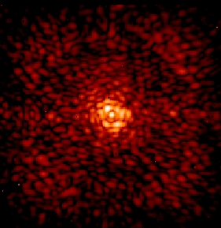
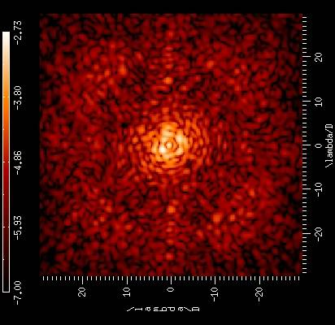
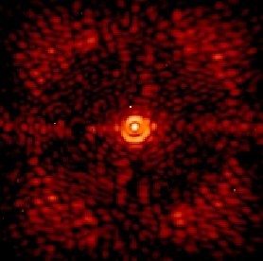
COFFEE: SPHERE NCPA measurement & correction using
Internal calibration source [B. Paul et al., A&A 2014]
Images expérimentales (IRDIS)
10⁻²
10⁻⁴
Before compensation
10⁻⁵
Contraste
10⁻⁶
After compensation
10^{-6.3}
Contrast gain x2 – x5
[B. Paul et al., A&A 2014]
1
1
Notes:
Note Jeff : Faire apparaître deux choses :
- Gain of COFFEE is visible in whole focal plane
- Gain is around a factor of 2 (TBC)
- Profile of coronagraphic image with experimental APO1 + ALC2 + amplitude effects only, for comparison and ultimate performance of phase conjugation
<numéro>

Slide 10
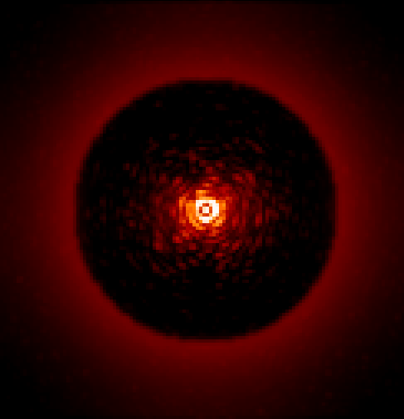
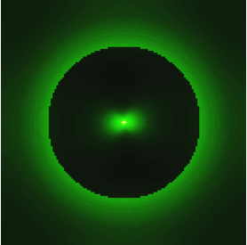
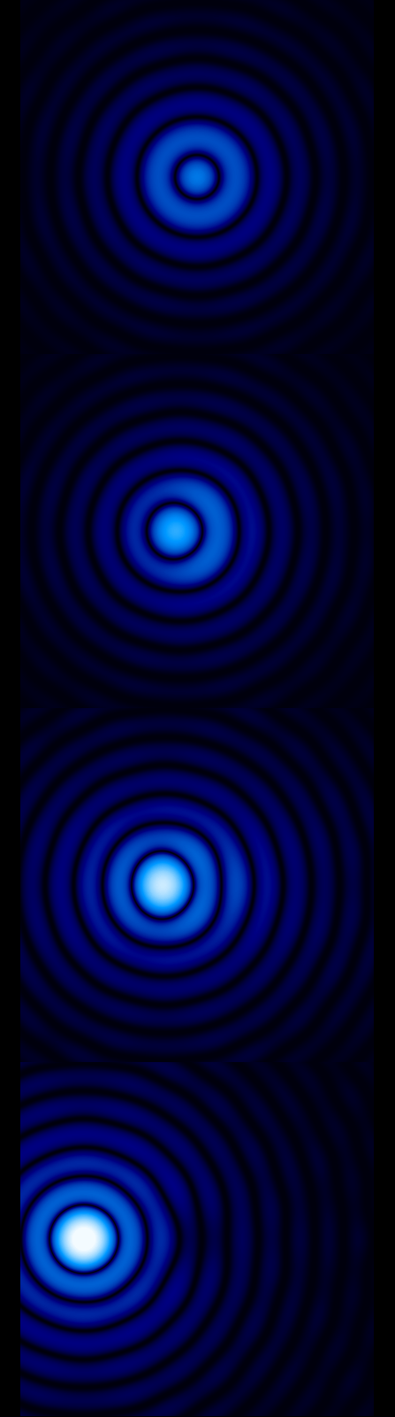
Coronagraphic imaging through turbulence: analytic expression
[Herscovici-Schiller et al 2017]
α’=0.λ/D
α’=1.λ/D
α’=2.λ/D
α’=6.λ/D
= x
Long-exposure image
Atmospheric IR
Coronagraphic IR
⇒ Extends Roddier’s formula to the coronagraphic case
Uses :
— simulation,
— detection of exoplanet in data through post-processing,
— wavefront sensing
1

Slide 11
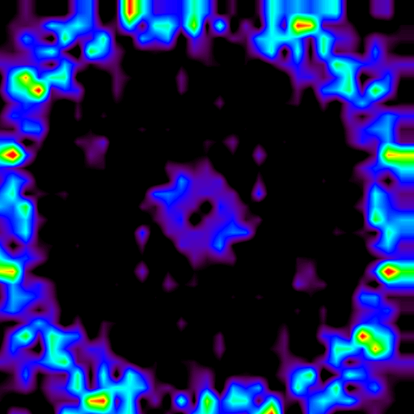
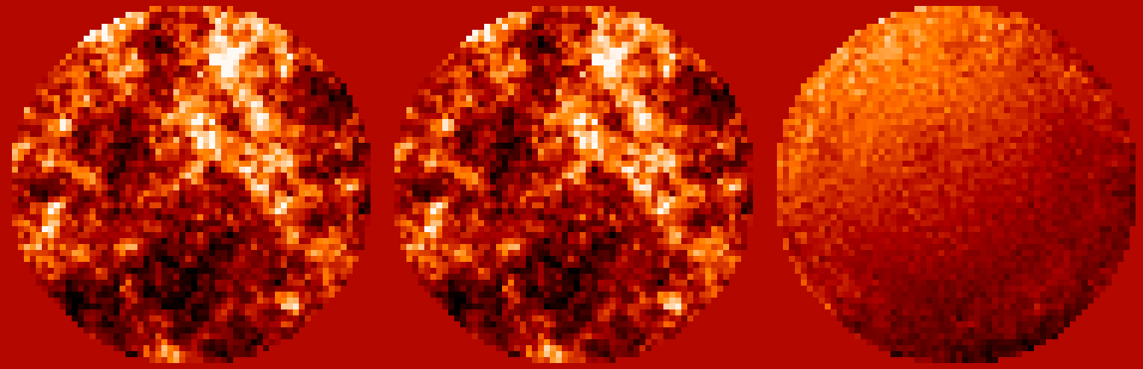
Application to post-coronagraphic WFS: realistic simulation
— 10% error on
— Planet with contrast 10⁻⁵ in data
— Flux :10⁶ photons
— Upstream aberration : 50 nm
50 nm RMS 4 (1,5) nm RMS ;
1

Slide 12
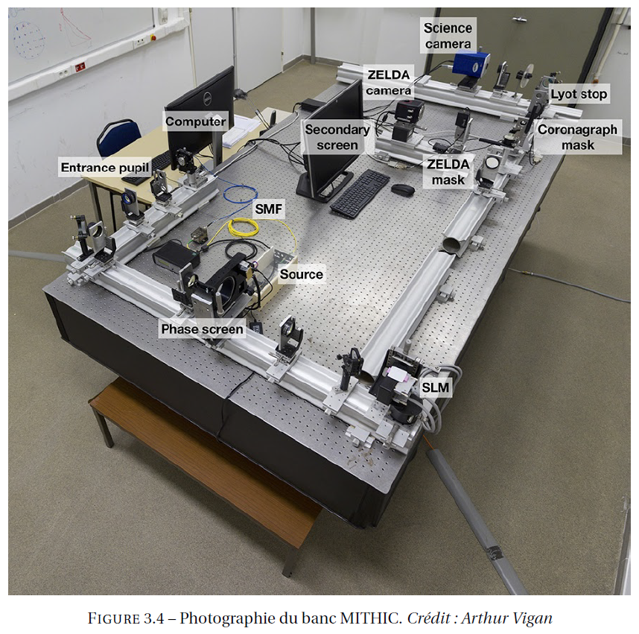
Experimental validation on MITHiC
MITHiC :
LAM high-contrast testbed for groundbased imaging
1

Slide 13
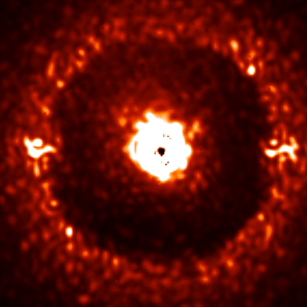
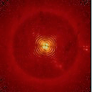
MITHiC images structure
λ = 1600 nm
ALC
50 nm NCPA (λ/30)
SAXO
λ = 677 nm
corono R&R
20 nm NCPA (λ/30)
Phase screens
ghosts
Image SPHERE/IRDIS Image MITHiC
MITHiC images represent SPHERE data
1

Slide 14

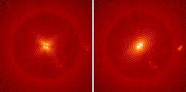
Static aberrations retrieval
COFFEE
24 nm RMS
1

Slide 15

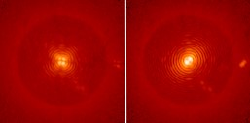
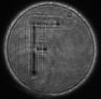
High-frequency calibration retrieval
COFFEE
11 nm RMS
28 nm RMS
1

Slide 16
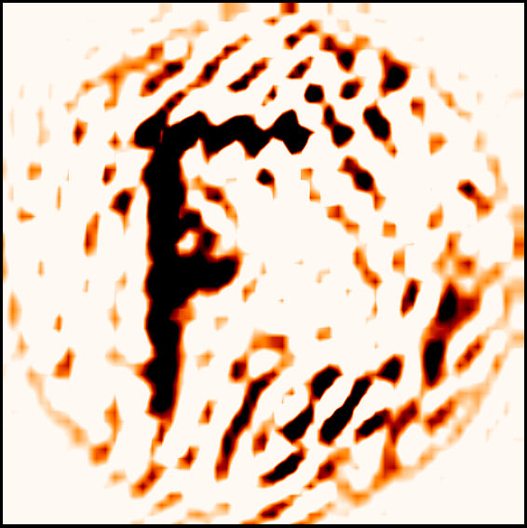
Differential reconstruction
- =
28 nm RMS 24 nm RMS
13 nm RMS
(vs 11 nm introduits)
⇒ COFFEE with turbulence validated
On-going : Retrieval of SPHERE aberrations (with Zelda team) (collaboration Zelda en cours)
1

Slide 17
Better contrast for space-based instruments
Space-based instruments: 10⁻¹¹ contrast objective
Issue: amplitude aberrations impact focal-plane images
⇒ complex field measurement (amplitude + phase)
+ dark hole : to cancel the electric field in a specific region
Telescope
Active optics
dark hole control
Coronagraph
Camera
Focal-plane WFS

Slide 18
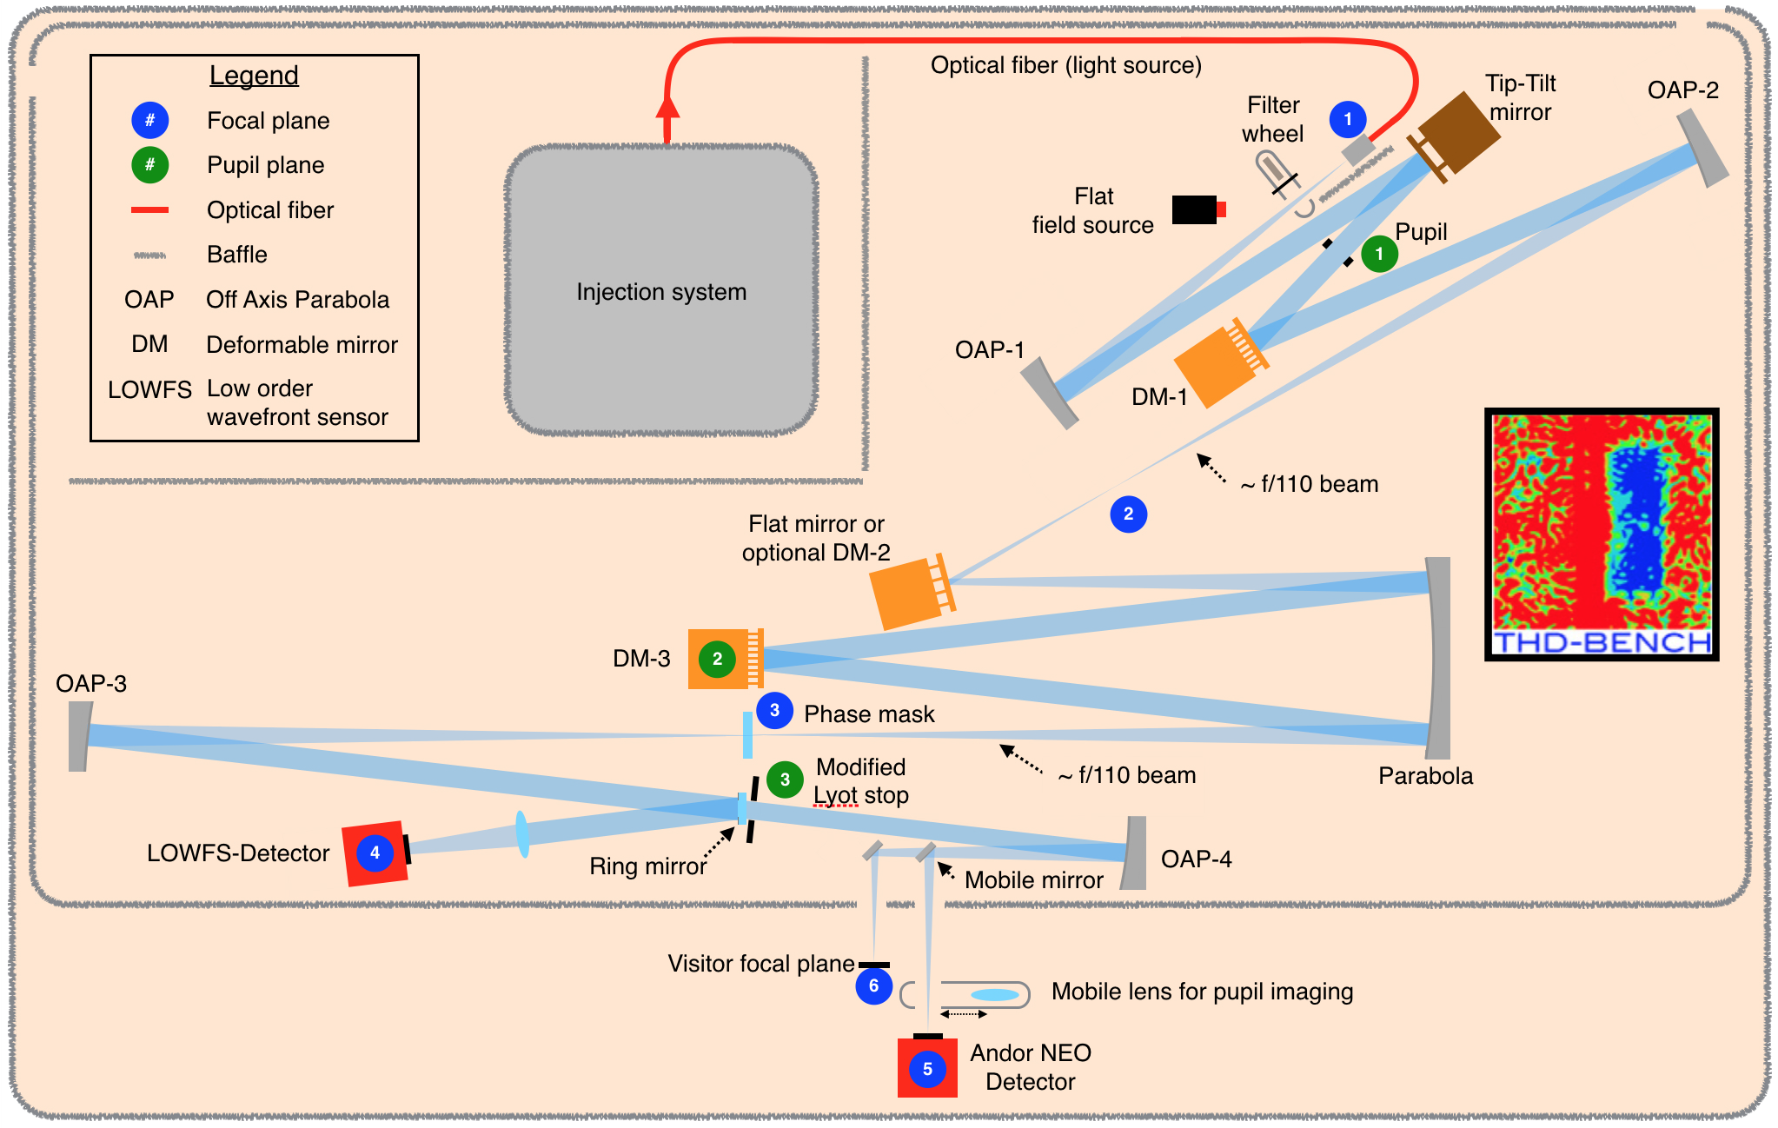
Le banc THD
Miroir phase + ampl
Miroir phase
Pupille de Lyot SCC
THD : banc très haute dynamique du LESIA : 10⁻⁸ à 6 λ/ D [Baudoz et al 18]
1

Slide 19
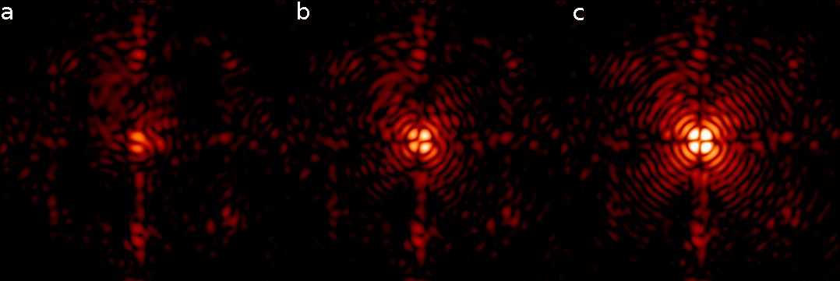
Reference images
focal image diversity 1 : 20 nm RMS diversity 2 : 30 nm RMS
4QPM signature
Limit of corrected zone
1

Slide 20
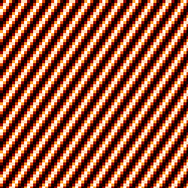
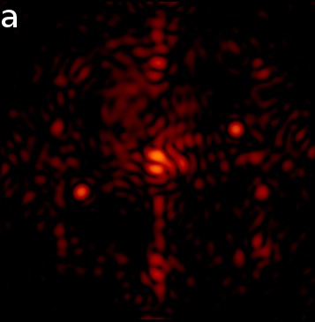
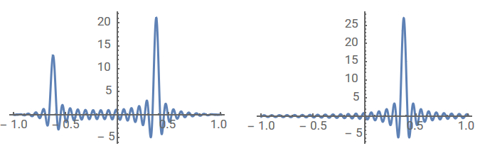
Introduced aberration
Talbot propagation:
amplitude sinus
?
1,6 nm RMS
Focal image
BostonMM DM harmonics
[Herscovici-Schiller et al 2018]
1

Slide 21
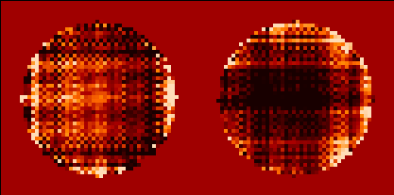
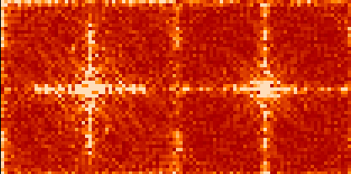
First reconstruction
THD
COFFEE
: 1,6 nm RMS
50 nm RMS 35 nm RMS
4QPM filtres some modes
⇒ unseen modes COFFEE 4Q
⇒ uncontroled amplification in reconstruction
⇒ need for regularisation
⇒ dedicated regularisation
TF
[Herscovici-Schiller et al 2018]
1

Slide 22
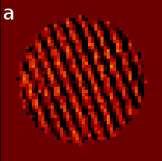
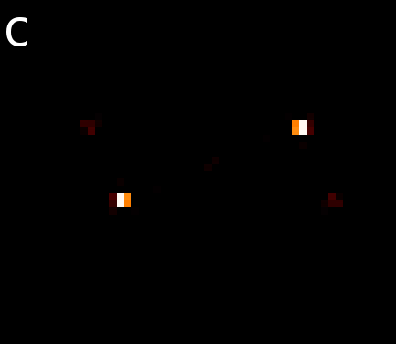
Reconstruction with adapted filtering
THD
COFFEE
: 1,6 nm RMS
: 1,5 nm RMS
TF
⇒ Validation of amplitude reconstruction [Herscovici-Schiller et al 2018]
1

Slide 23

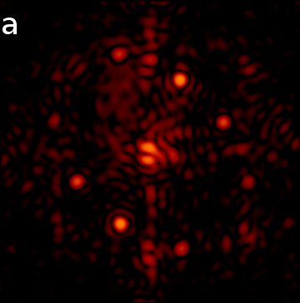
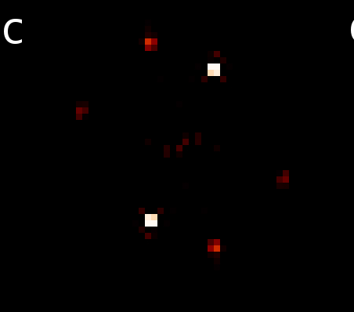
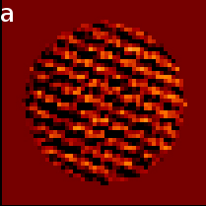
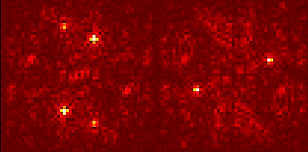
Reconstruction of phase + amplitude aberration
THD
: 2,9 nm RMS
: 1,6 nm RMS
⇒ Phase-amplitude separation OK
[Herscovici-Schiller et al 2018]
COFFEE
argsinh scale
TF
: 3,0 nm RMS
: 1,7 nm RMS
: 3,0 nm RMS
: 1,7 nm RMS
1

Slide 24
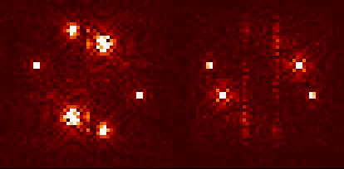
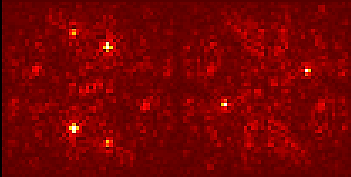
SCC / COFFEE: a comparison [Herscovici-Schiller et al 2018]
: 2,9 nm RMS
: 1,6 nm RMS
: 3,0 nm RMS
: 1,7 nm RMS
corrélation
SCC
COFFEE
: 86%
: 89 %
Low-pass filter
model error : 4QPM
pupil sampled on 52 × 52 pixels
FT
⇒ complex COFFEE & SCC in good agreement
1

Slide 25
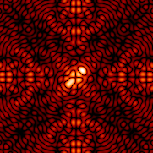
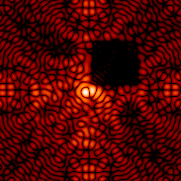
Dark hole techniques
Exoearth spectroscopy ⇒ contrasts ~ 10⁻¹¹
⇒ Need for suppression of diffractive residuals
Classical methods:
  linar: hypothesis that field aberrations
  Iterative
1

Slide 26
Non-linear dark hole (NLDH)
Space telescopes need to avoid iterations
⇒ Non-Linear Dark Hole
Numerical minimisation of
[Malbet, Yu & Shao 95], [Paul 2014]
1

Slide 27
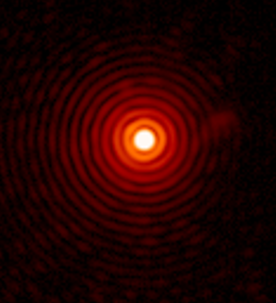
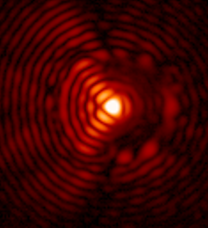
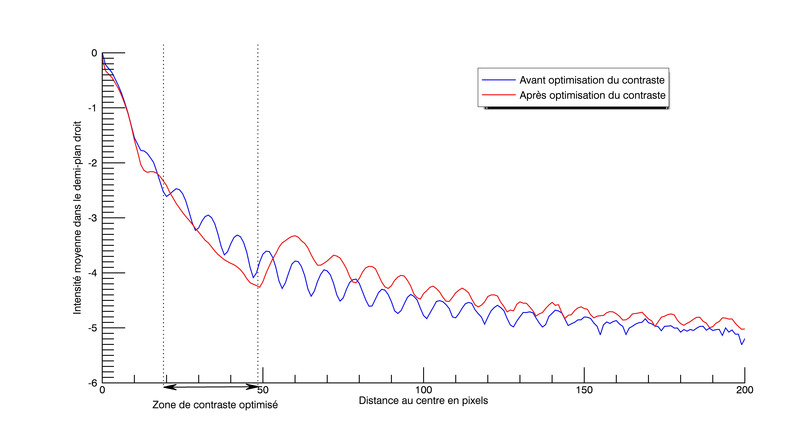
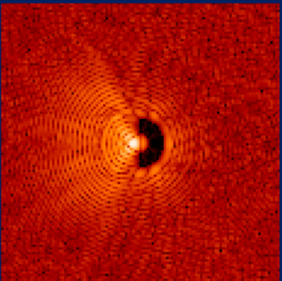
Back on MITHiC for a test of principle
L. Leboulleux & OHS
PSF MITHiC
Dark Hole MITHiC
Expected dark hole (simulation)
1

Slide 28
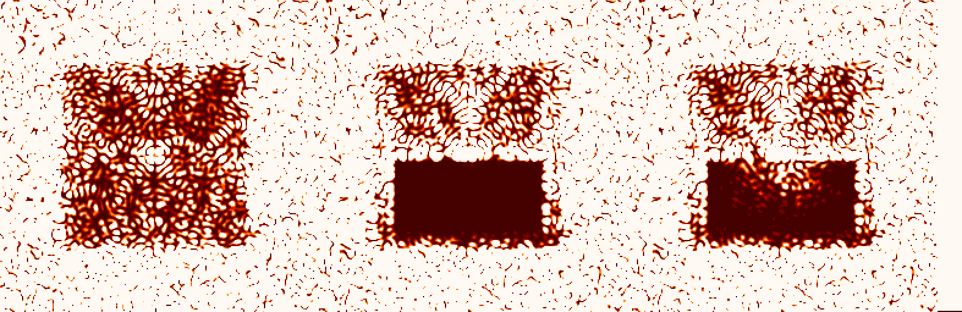
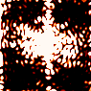
Back on THD for a high-contrast test
SCC
NLDH
contrast 4×10⁻⁷
contraste 2,6×10⁻⁷
Contrast 2×10⁻⁷
2 itérations
Non-Linear Dark Hole OK in principle
Few iterations
Contrast limitation
1

Slide 29
Interpretation in simulation
Start No model mismatch
5% RMS mismatch
on actuators
Contraste 24×10⁻⁸ 1×10⁻⁸
7×10⁻⁸
⇒ DM model is a key performance limitation
⇒ Need for fine DM calibration
1

Slide 30
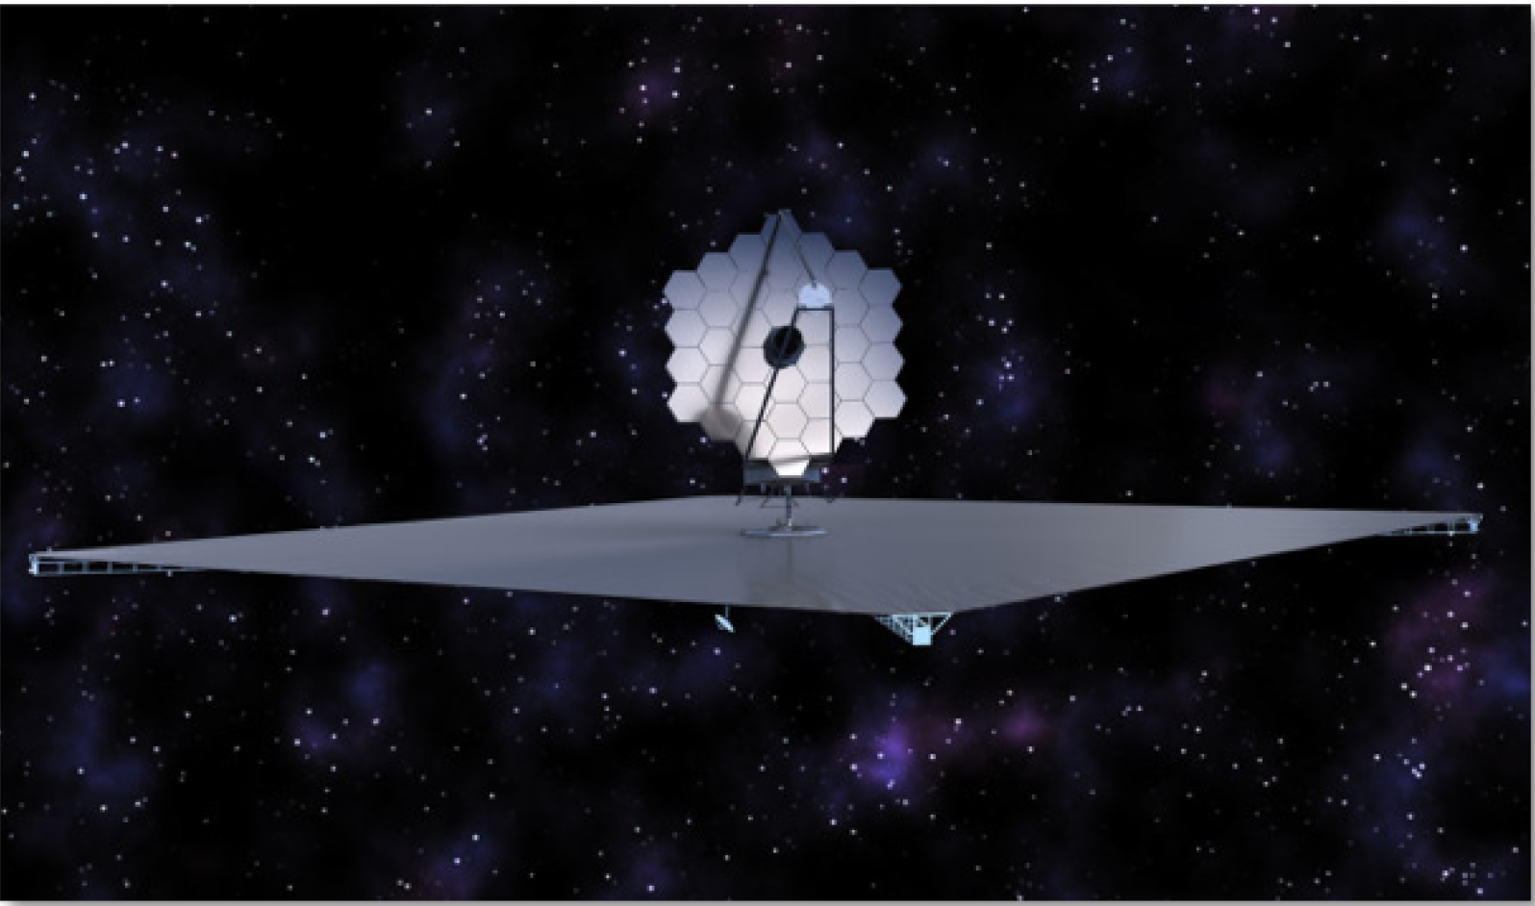
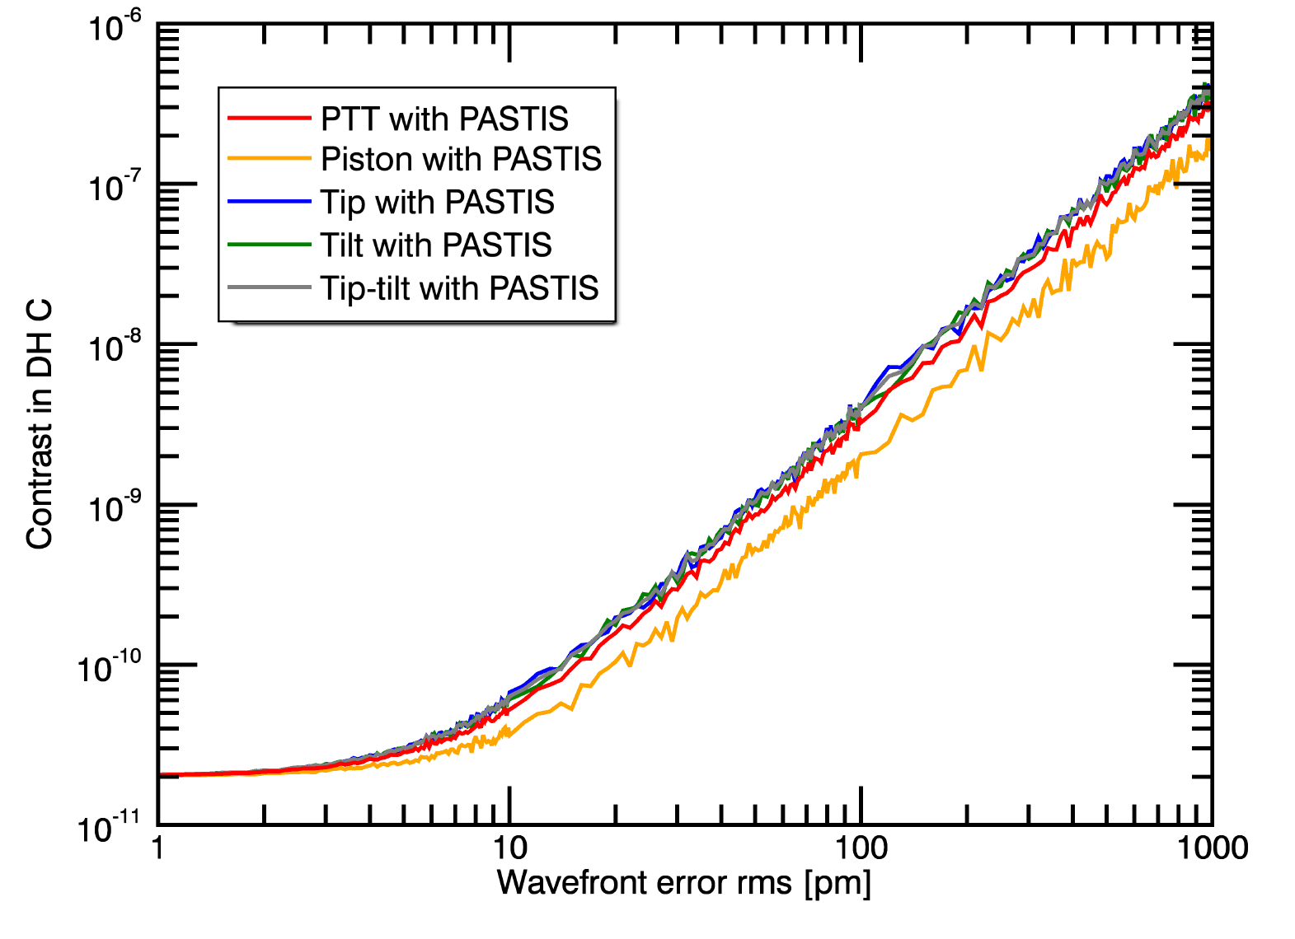
Wave-front sensing on Segmented aperture on STScI
LUVOIR science case :
exo-Earth direct imaging from space
Contrast of 10⁻¹⁰

Slide 31

Wave-front sensing on Segmented aperture on STScI
Future space telescopes : segmented (JWST, LUVOIR)
Need for wave-front sensing …
…able to deal with coronagraph…
…and with segmented apertures!
L. Leboulleux (ONERA – STScI), demonstration on HiCat (2018)
…To be continued by Iva Laginja
Iris-AO phase map
COFFEE estimation

Slide 32
Conclusions & perspectives
Ground-based COFFEE
  Coronagraphic imaging in the presence of residual turbulence
  Coronagraphic WFS
  Experimental validation on MITHiC
⇒ Collaboration with A. Vigan & M. N’Diaye : application to SPHERE
⇒ Use for NCPA compensation on SPHERE
Space-based COFFEE: complex WFS
  Experimental measurement
  Première comparaison entre ASO coronographiques (COFFEE/SCC)
⇒ Optimisation diversité
⇒ Extension aux télescopes segmentés (R&T CNES, collab. STScI, thèse I.L.)
Optimisation non linéaire du contraste (cas spatial)
  Démonstration de principe
  Analyse de sensibilité
⇒ Calibration fine du DM (collaboration CNES WFIRST)
1

Slide 33

Influence of error on

Slide 34

Influence of a planet on COFFEE reconstruction
Flux de la planète
0 10⁻⁵ 10⁻⁴ 10⁻³
0,3 nm
0,3 nm
0,5 nm
6 nm
Écart-type de l’erreur
⇒ Pas d’influence si flux ≤ 10⁻⁵

Slide 35
Formalisme de COFFEE
⇒ Nécessité d’un modèle d’imagerie coronographique en présence de turbulence

