Slide 1
EINSTEIN TELESCOPE probing the extreme through gravitational waves
G Losurdo – INFN Pisa
on behalf of the ET Collaboration
Slide credits: S Hild, F Linde, H Lück, M Punturo, B Sathyaprakash, M Vasuth, …

Slide 2
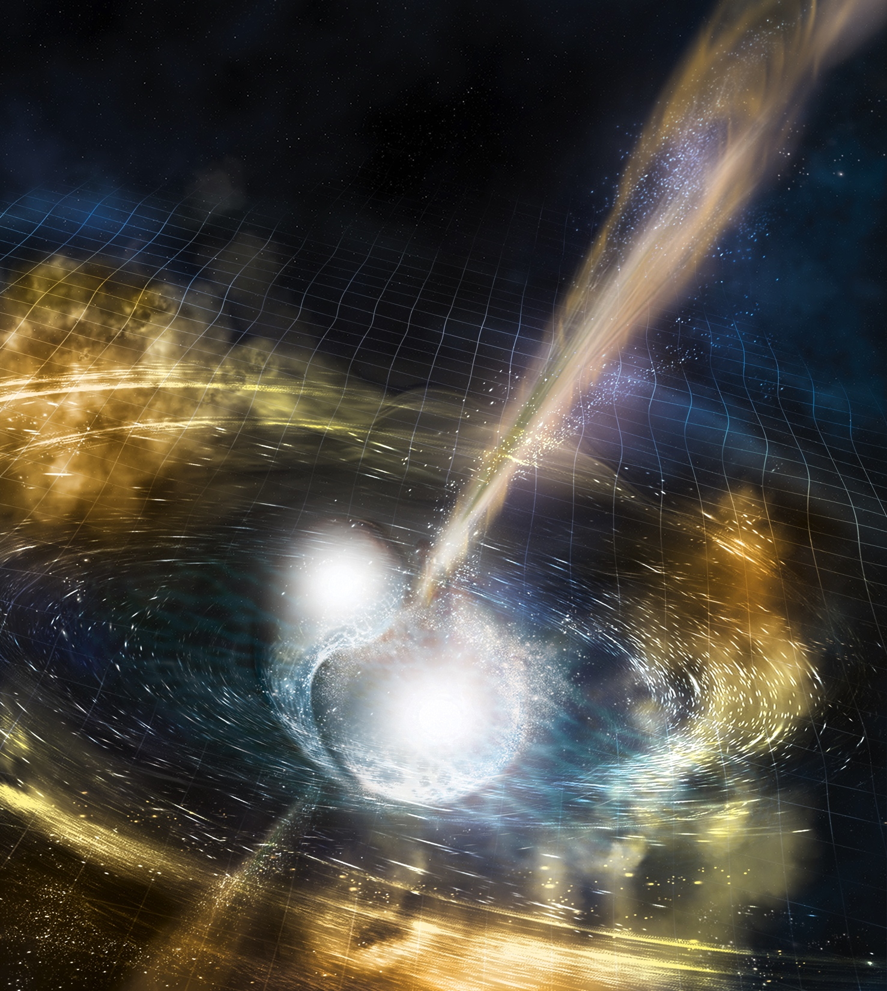
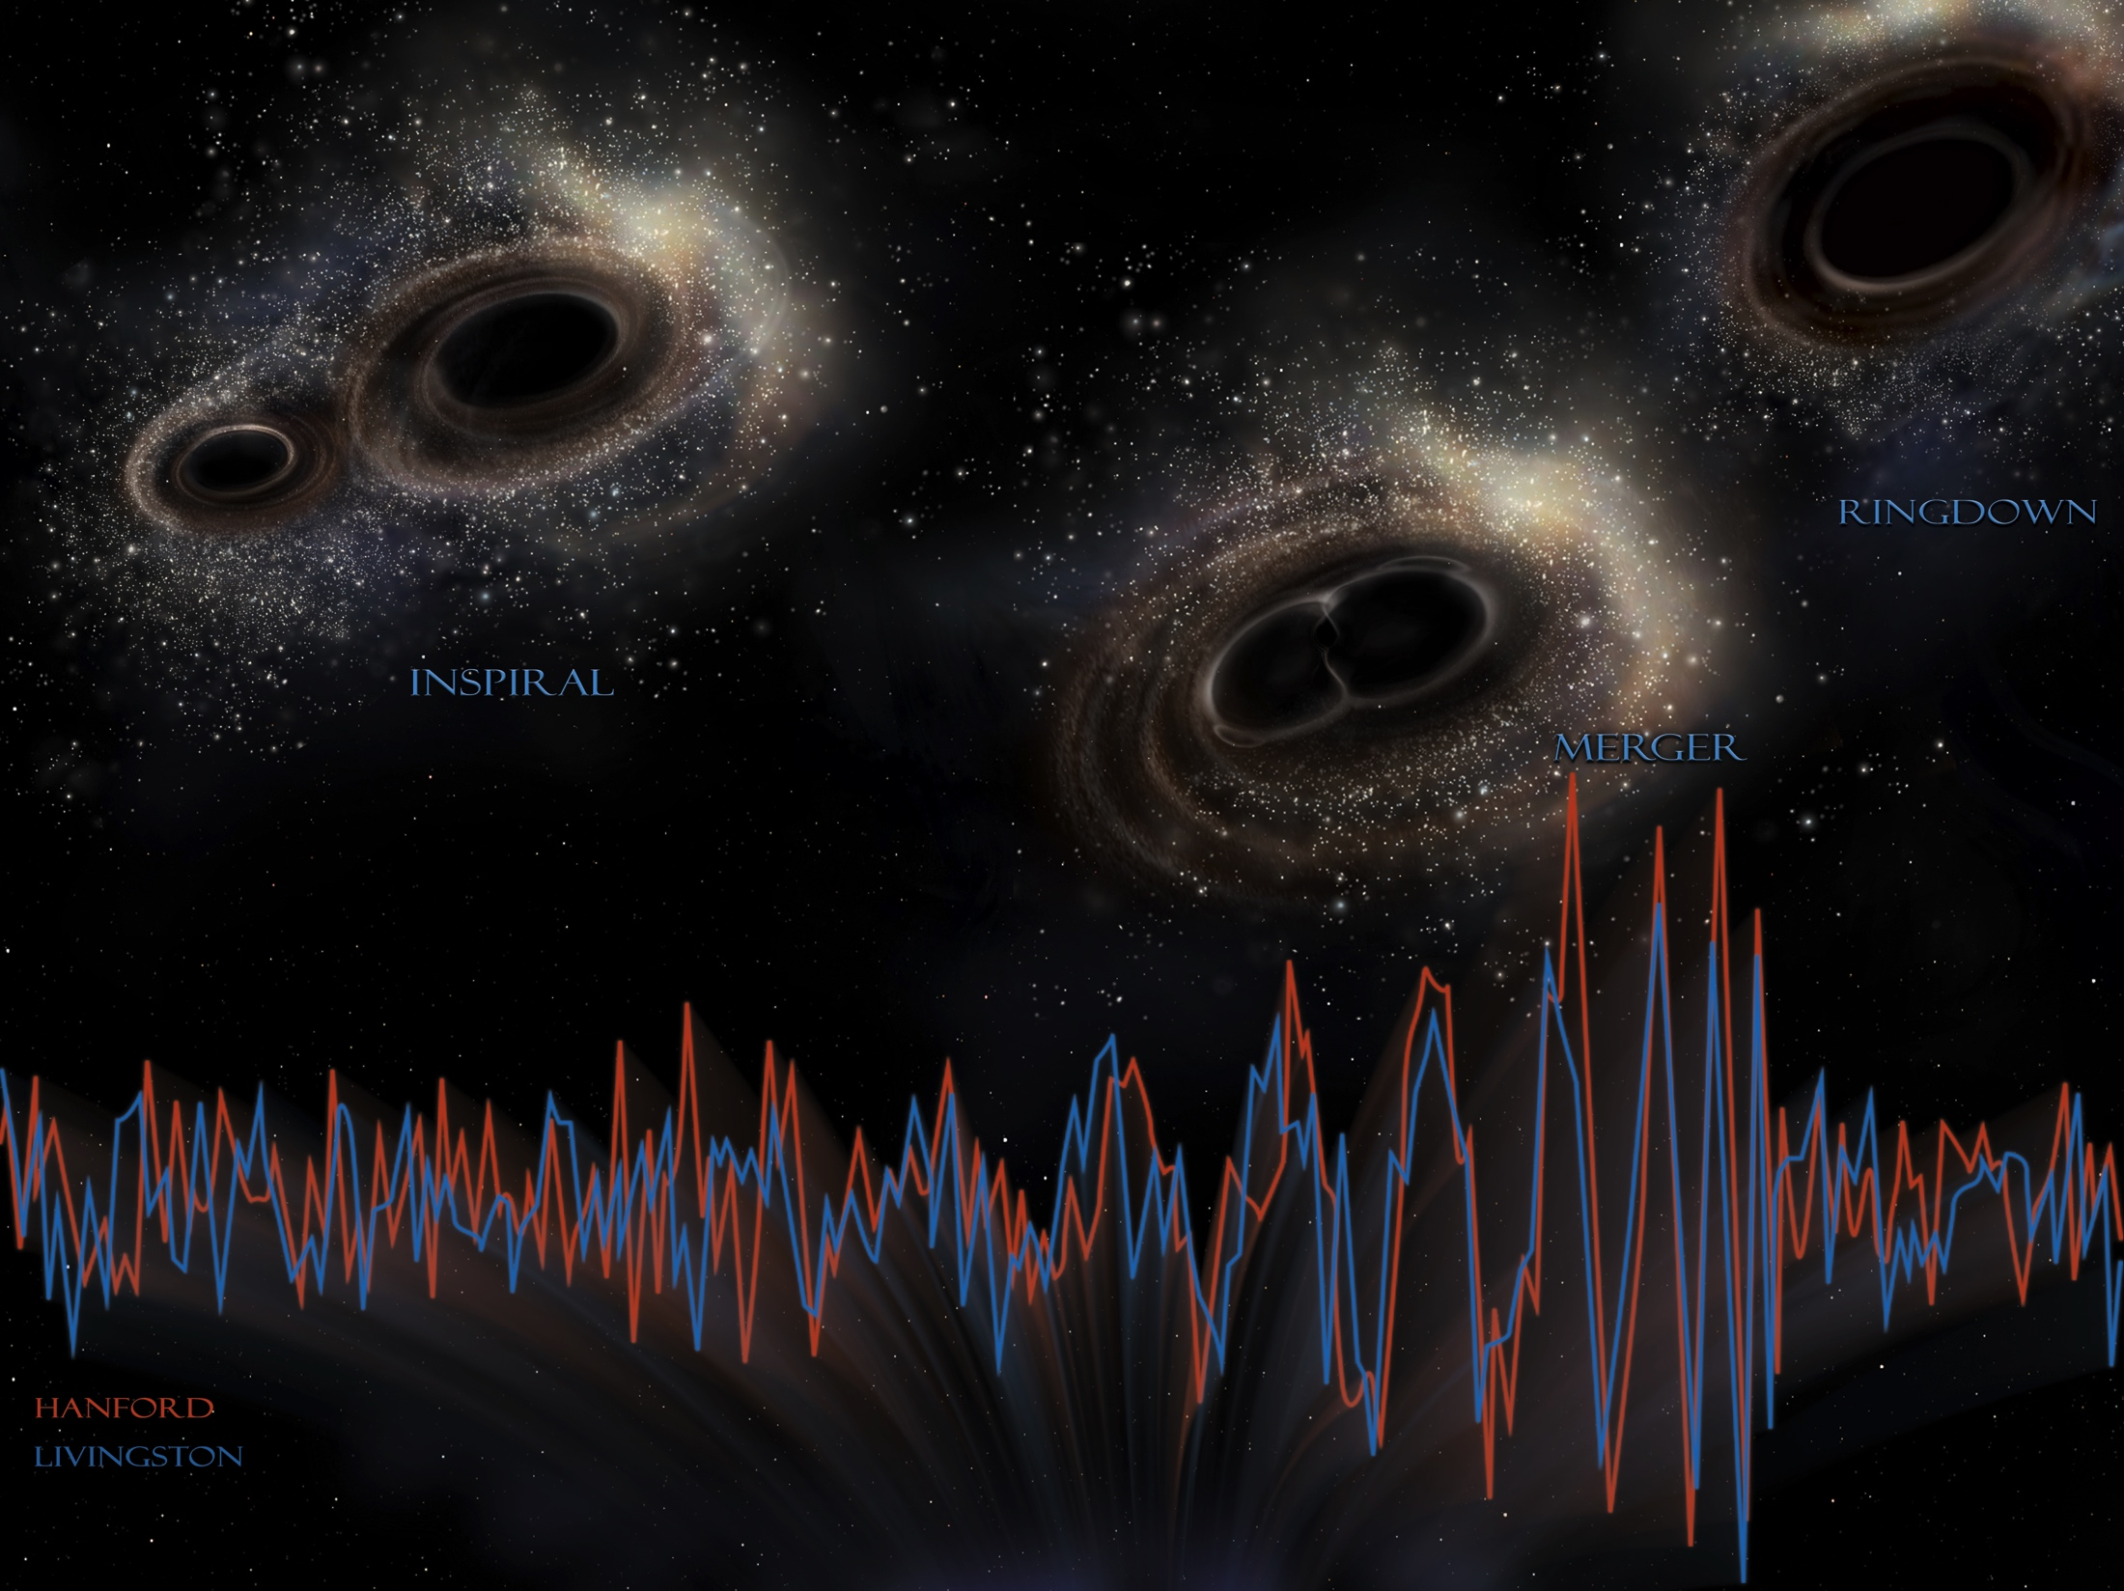
TWO GROUND-BREAKING DISCOVERIES
A NEW ERA IN THE OBSERVATION OF THE UNIVERSE
GW170817
GW150914
Notes:
In just 2 years: first observation of GW, start of multi-messenger astronomy

Slide 3
WHY 3G? WHY NOW?
LIGO and Virgo both have facility-imposed limits on sensitivity
  length, on surface site, obsolescence
  At best a factor 3 in sensitivity can be gained wrt to the “advanced” LIGO/Virgo
We are ready to realize an infrastructure compatible with the development of the interferometric detectors for decades
3G detector:
  extend by ~10x the distance of sight wrt to the “advanced detectors”
  entend the bandwidth towards lower frequencies (1 Hz target)
The first and second generations have required ~15 years between the concept and the operation
EINSTEIN TELESCOPE: concept developed in a FP7 Design Study, involving France, Germany, Italy, the Netherlands, UK
  today the ET community also involves Belgium, Hungary, Poland, Spain, …

Slide 4
Science case
Extreme matter
Extreme gravity
Extreme universe

Slide 5
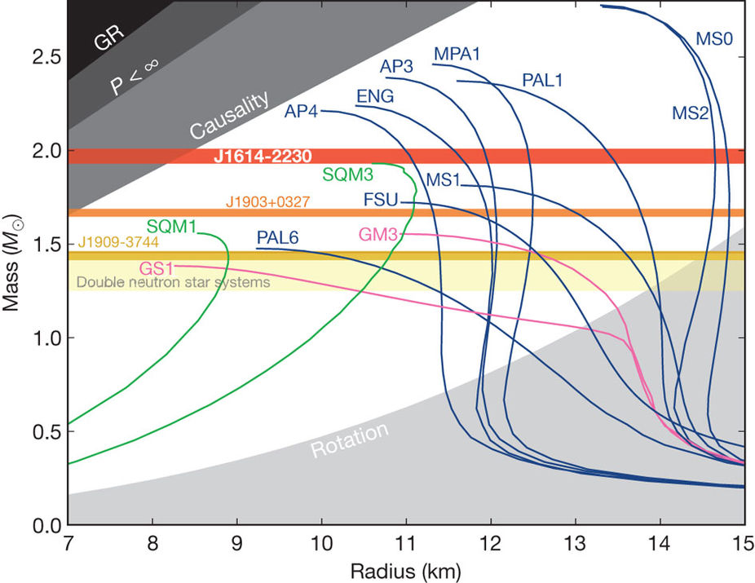
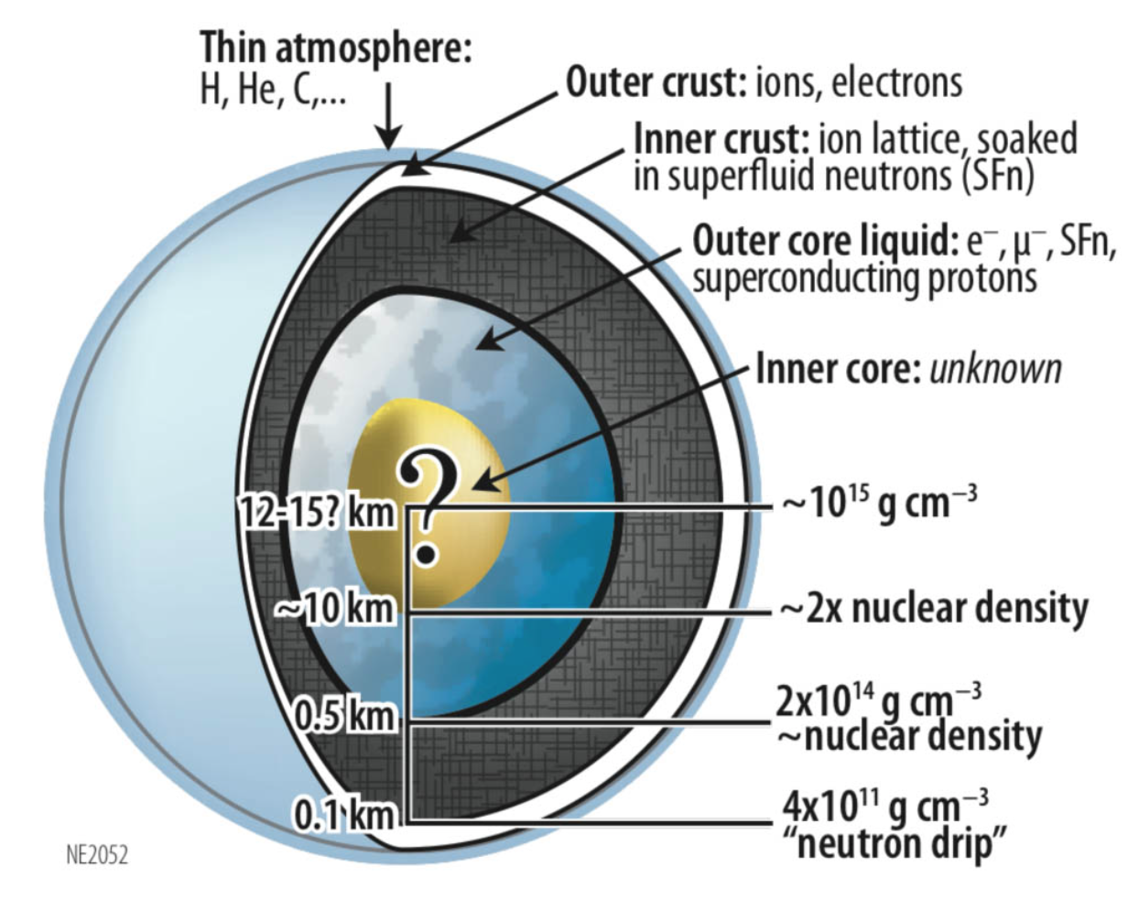
EXTREME MATTER
Nucleons +
exotic matter
Quark
Nucleons
DEMOREST+, 2010
INTERNAL STRUCTURE AND COMPOSITION OF NS (LARGELY UNKNOWN) ENCODED IN THE EQUATION OF STATE

Slide 6
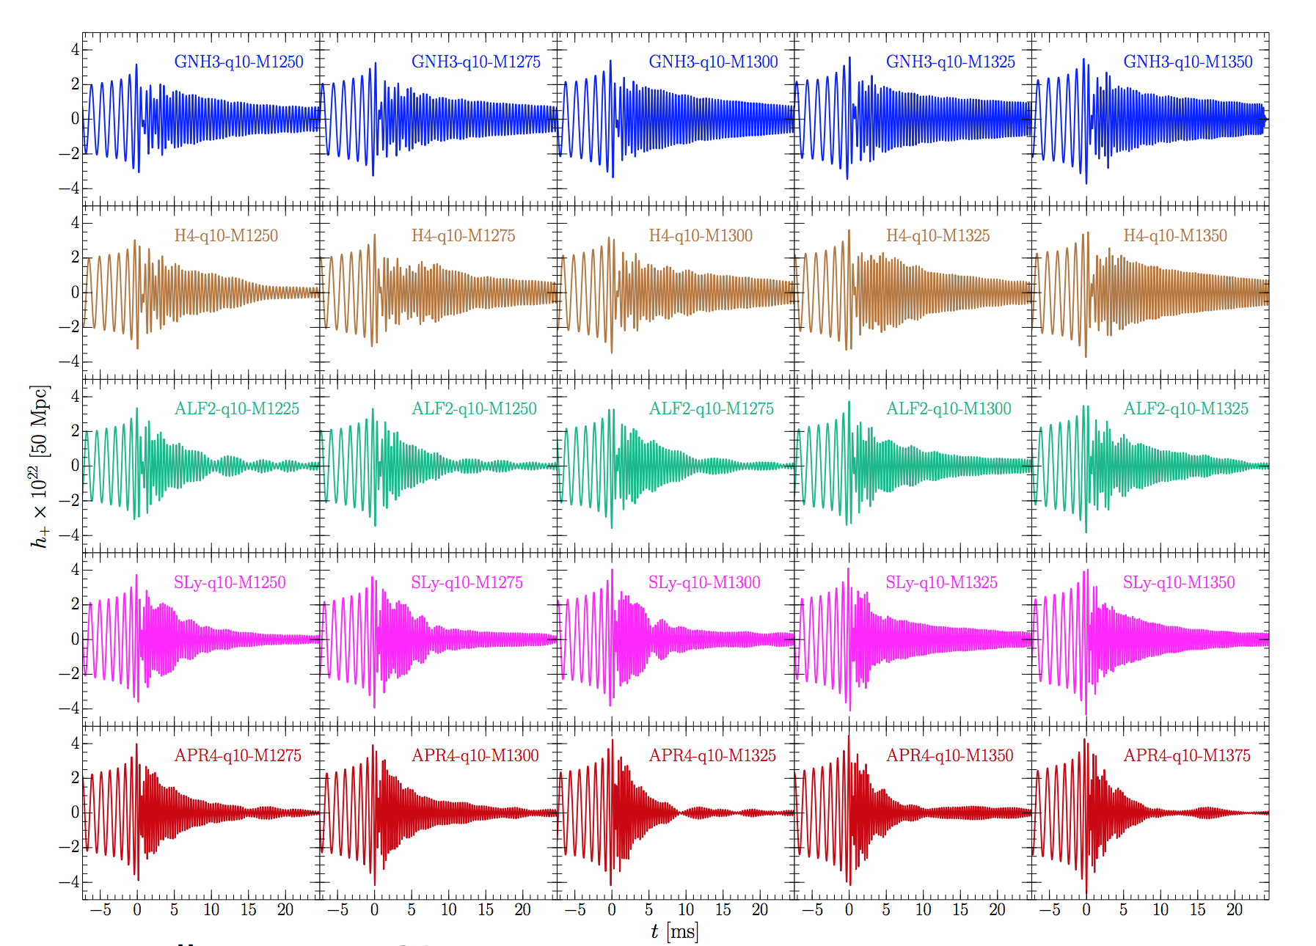
EXTREME MATTER
WE ARE ABLE TO COMPUTE THE WAVEFORMS FOR THE VARIOUS EOS
Takami, Rezzolla, Baiotti (2014)

Slide 7
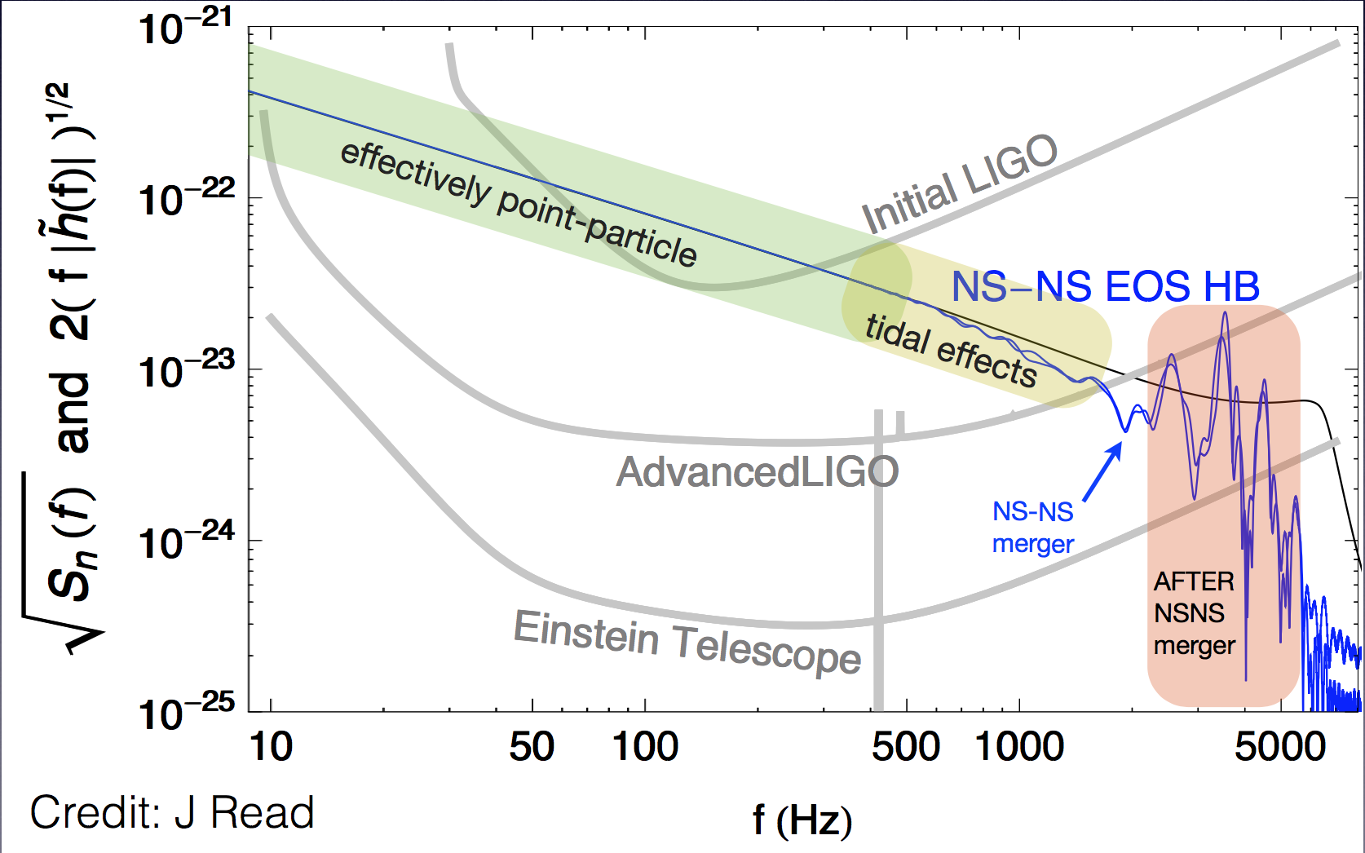
EXTREME MATTER
A 3G DETECTOR IS NEEDED TO MEASURE WHICH EOS IS THE RIGHT ONE

Slide 8
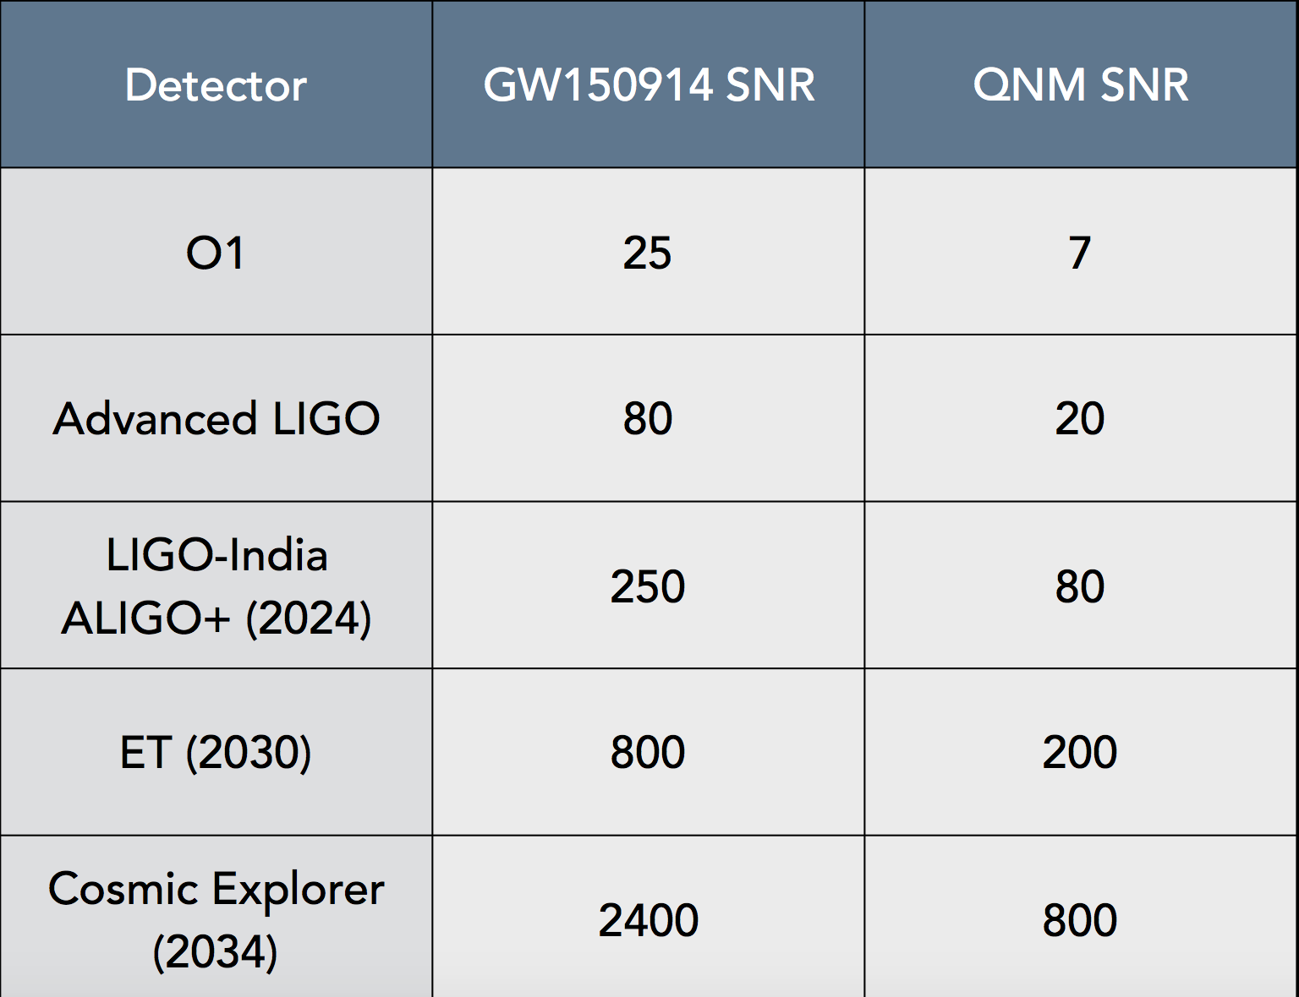
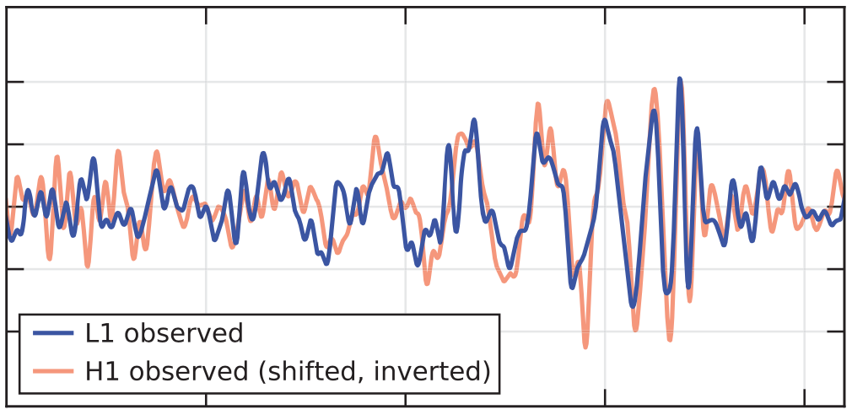
EXTREME GRAVITY
Precision tests of alternative theories
  polarizations
  graviton mass
  Lorentz invariance
Exotic compact objects
BH QNM

Slide 9
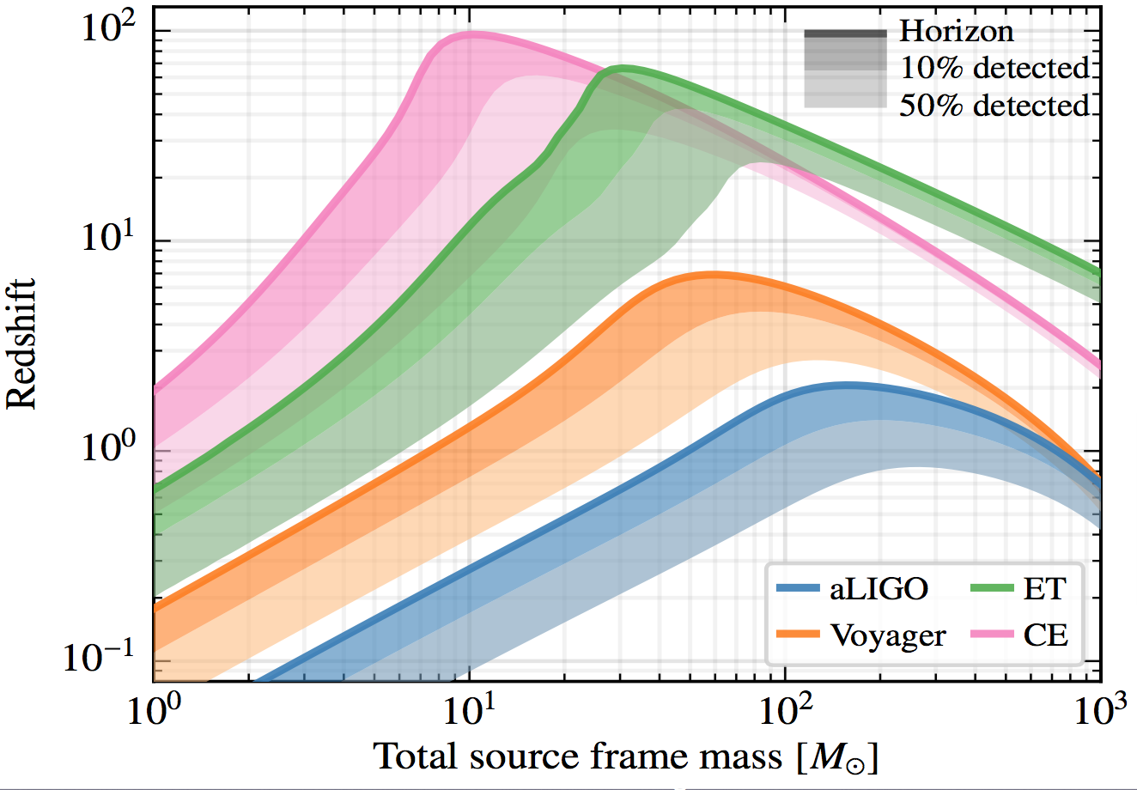
EXTREME UNIVERSE
Hubble parameter
Stochastic background

Slide 10
DETECTOR CONCEPT

Slide 11
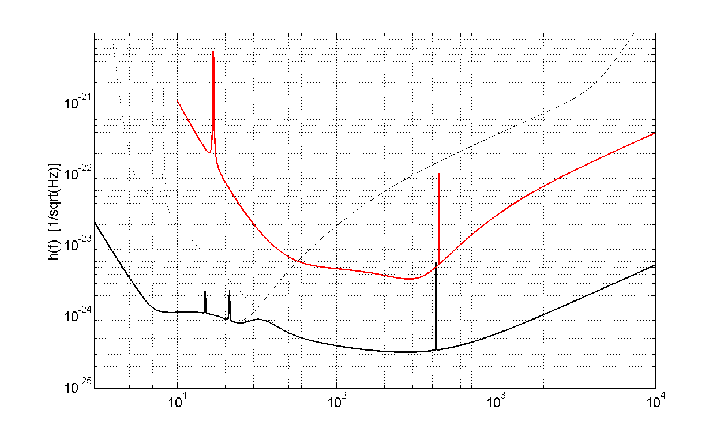
SENSITIVITY GOAL
Advanced Virgo
MASS ACCURACY
HIGH MASS/HIGH Z
MERGER PHYSICS
LOCALIZATION
NUMBER of SOURCES
ET

Slide 12
WIDEN THE BAND: UNDERGROUND
Limitations to LF sensitivity
  rejection of seismic noise
  newtonian noise
Both can be eased by going underground
noise at 2 Hz reduced by
~2 orders of magnitude

Slide 13
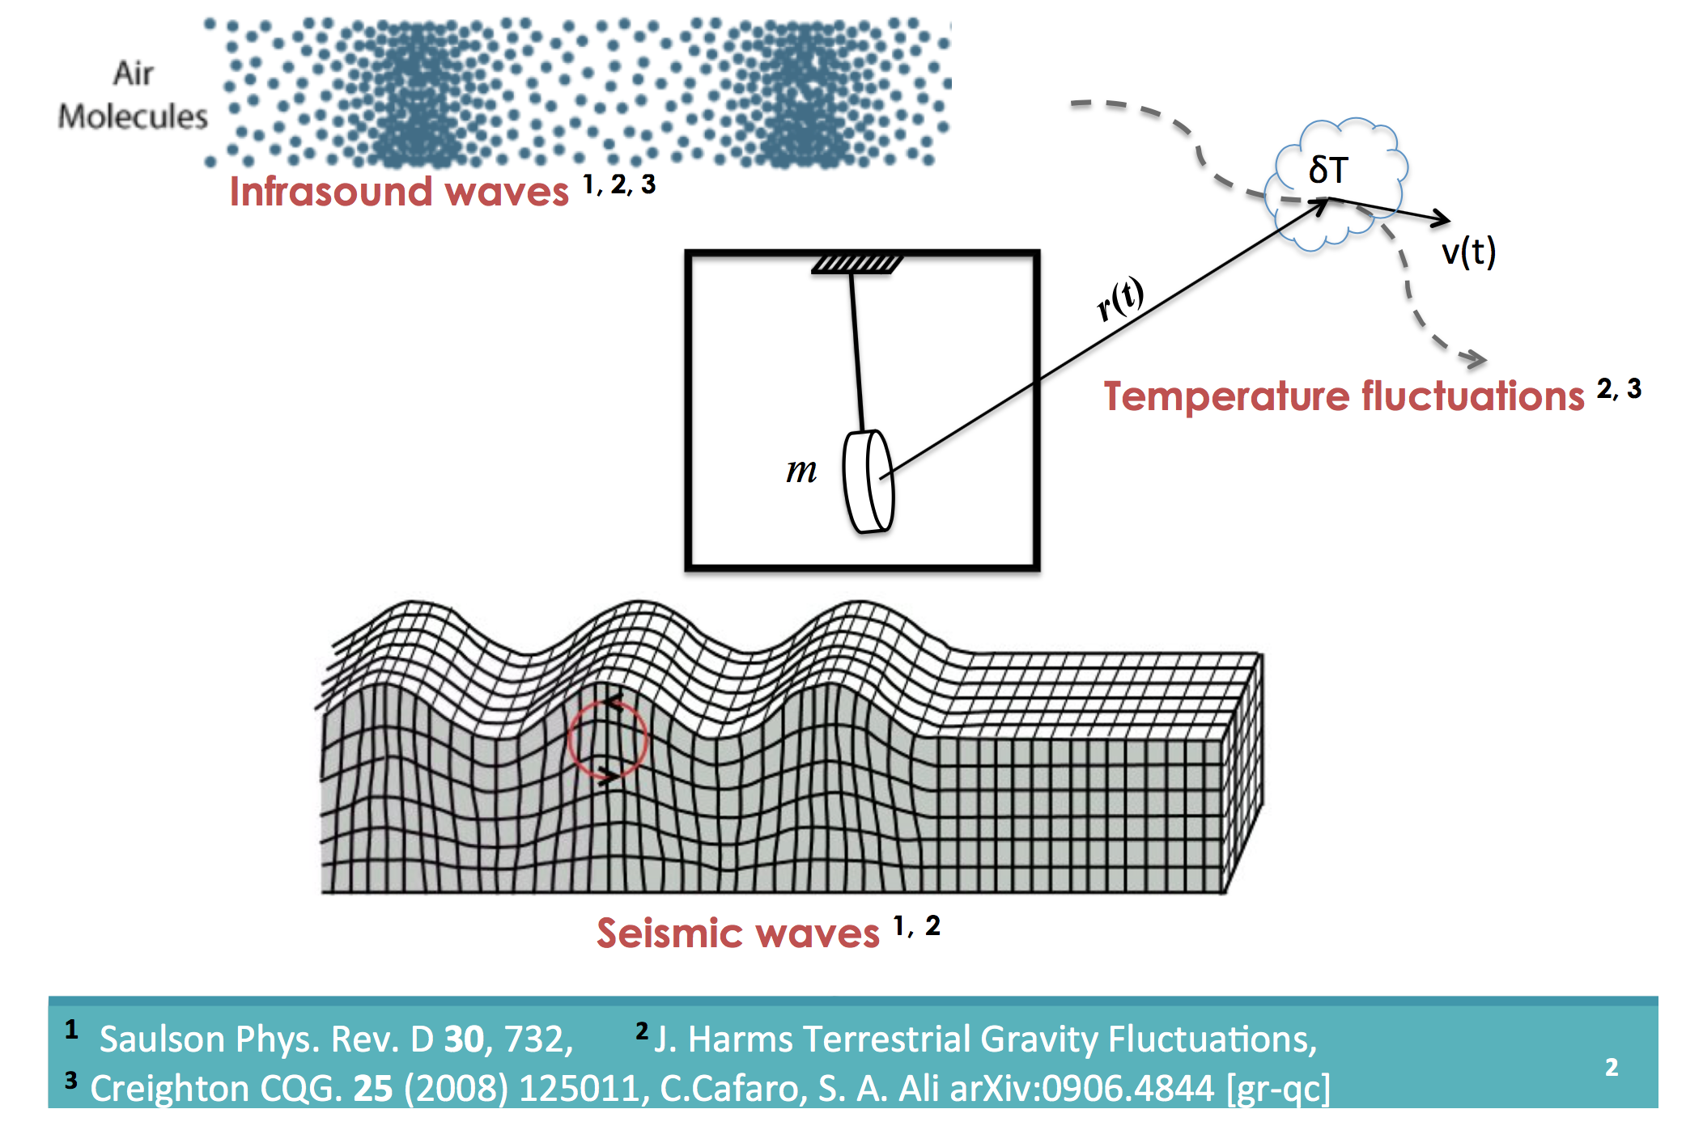
NEWTONIAN NOISE
CREDIT: D Fiorucci

Slide 14
WIDEN THE BAND: XYLOPHONE
Improving al low and high frequency with a single detector is very challenging
  HF requires more laser power
  LF requires cold mirrors
Idea: split the detection band over 3 “specialized” instruments

Slide 15
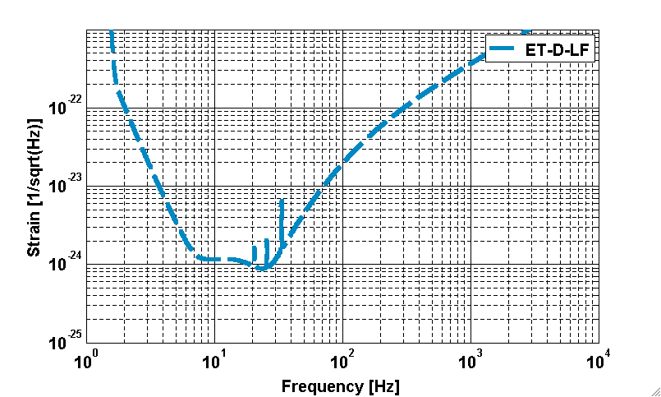
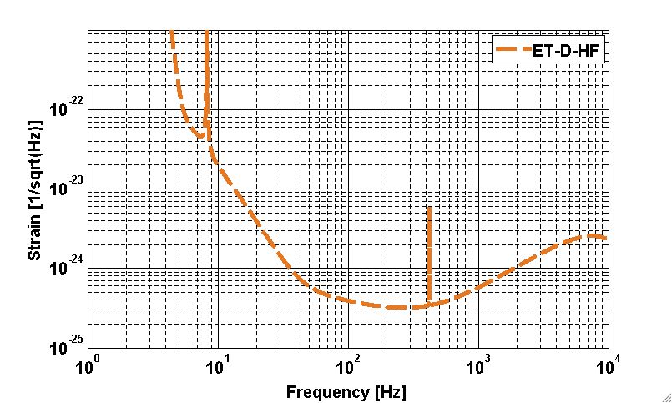
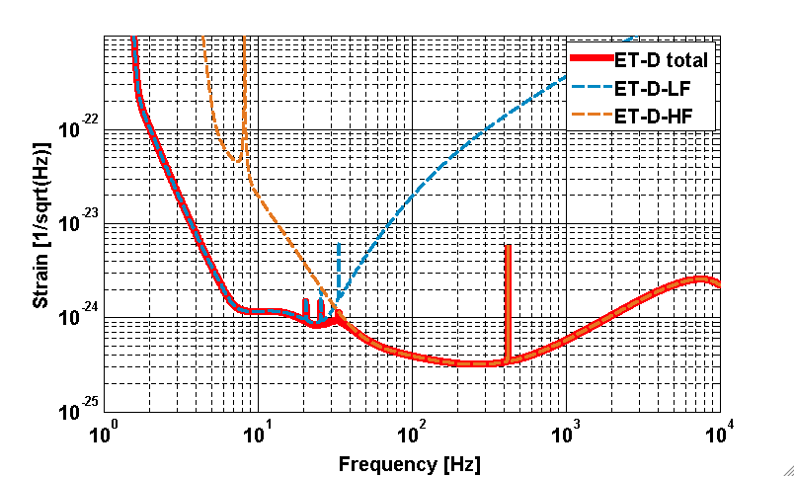

Slide 16
TECHNOLOGIES
ET-LF
Underground
Cryogenics
Silicon (Sapphire) test masses
Large test masses
New coatings
New laser wavelength
Seismic isolation
Frequency dependent squeezing
ET-LF
High power laser
Large test masses
New coatings
Thermal compensation
Frequency dependent squeezing

Slide 17
STAND-ALONE OBSERVATORY
Start with a single (xylophone) detector

Slide 18
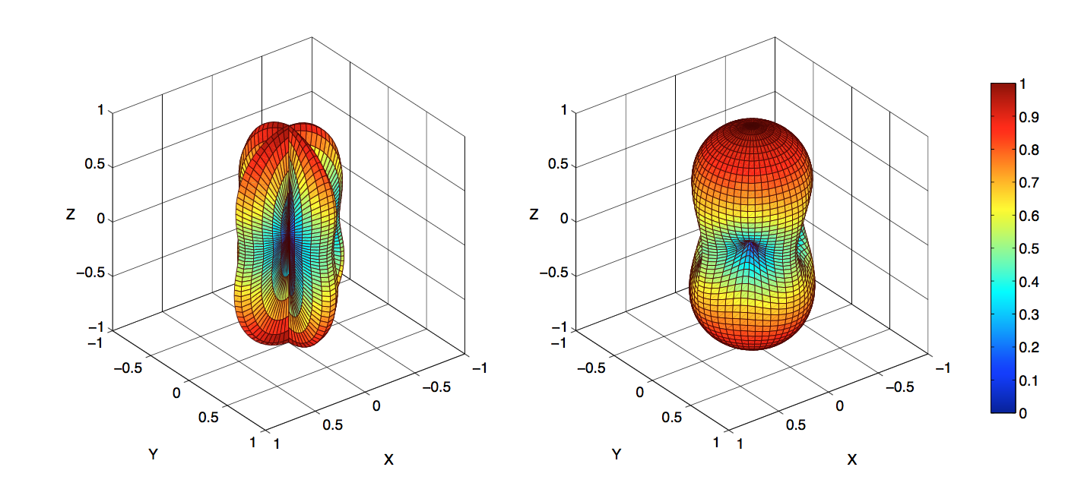
STAND-ALONE OBSERVATORY
Start with a single (xylophone) detector
Add a second one to fully resolve polarization
Antenna pattern for a polarized GW:
simple “L” (left) vs Triangle (right)

Slide 19
STAND-ALONE OBSERVATORY
Start with a single (xylophone) detector
Add a 2nd one to fully resolve polarization
Add a 3rd one for null stream and redundancy

Slide 20
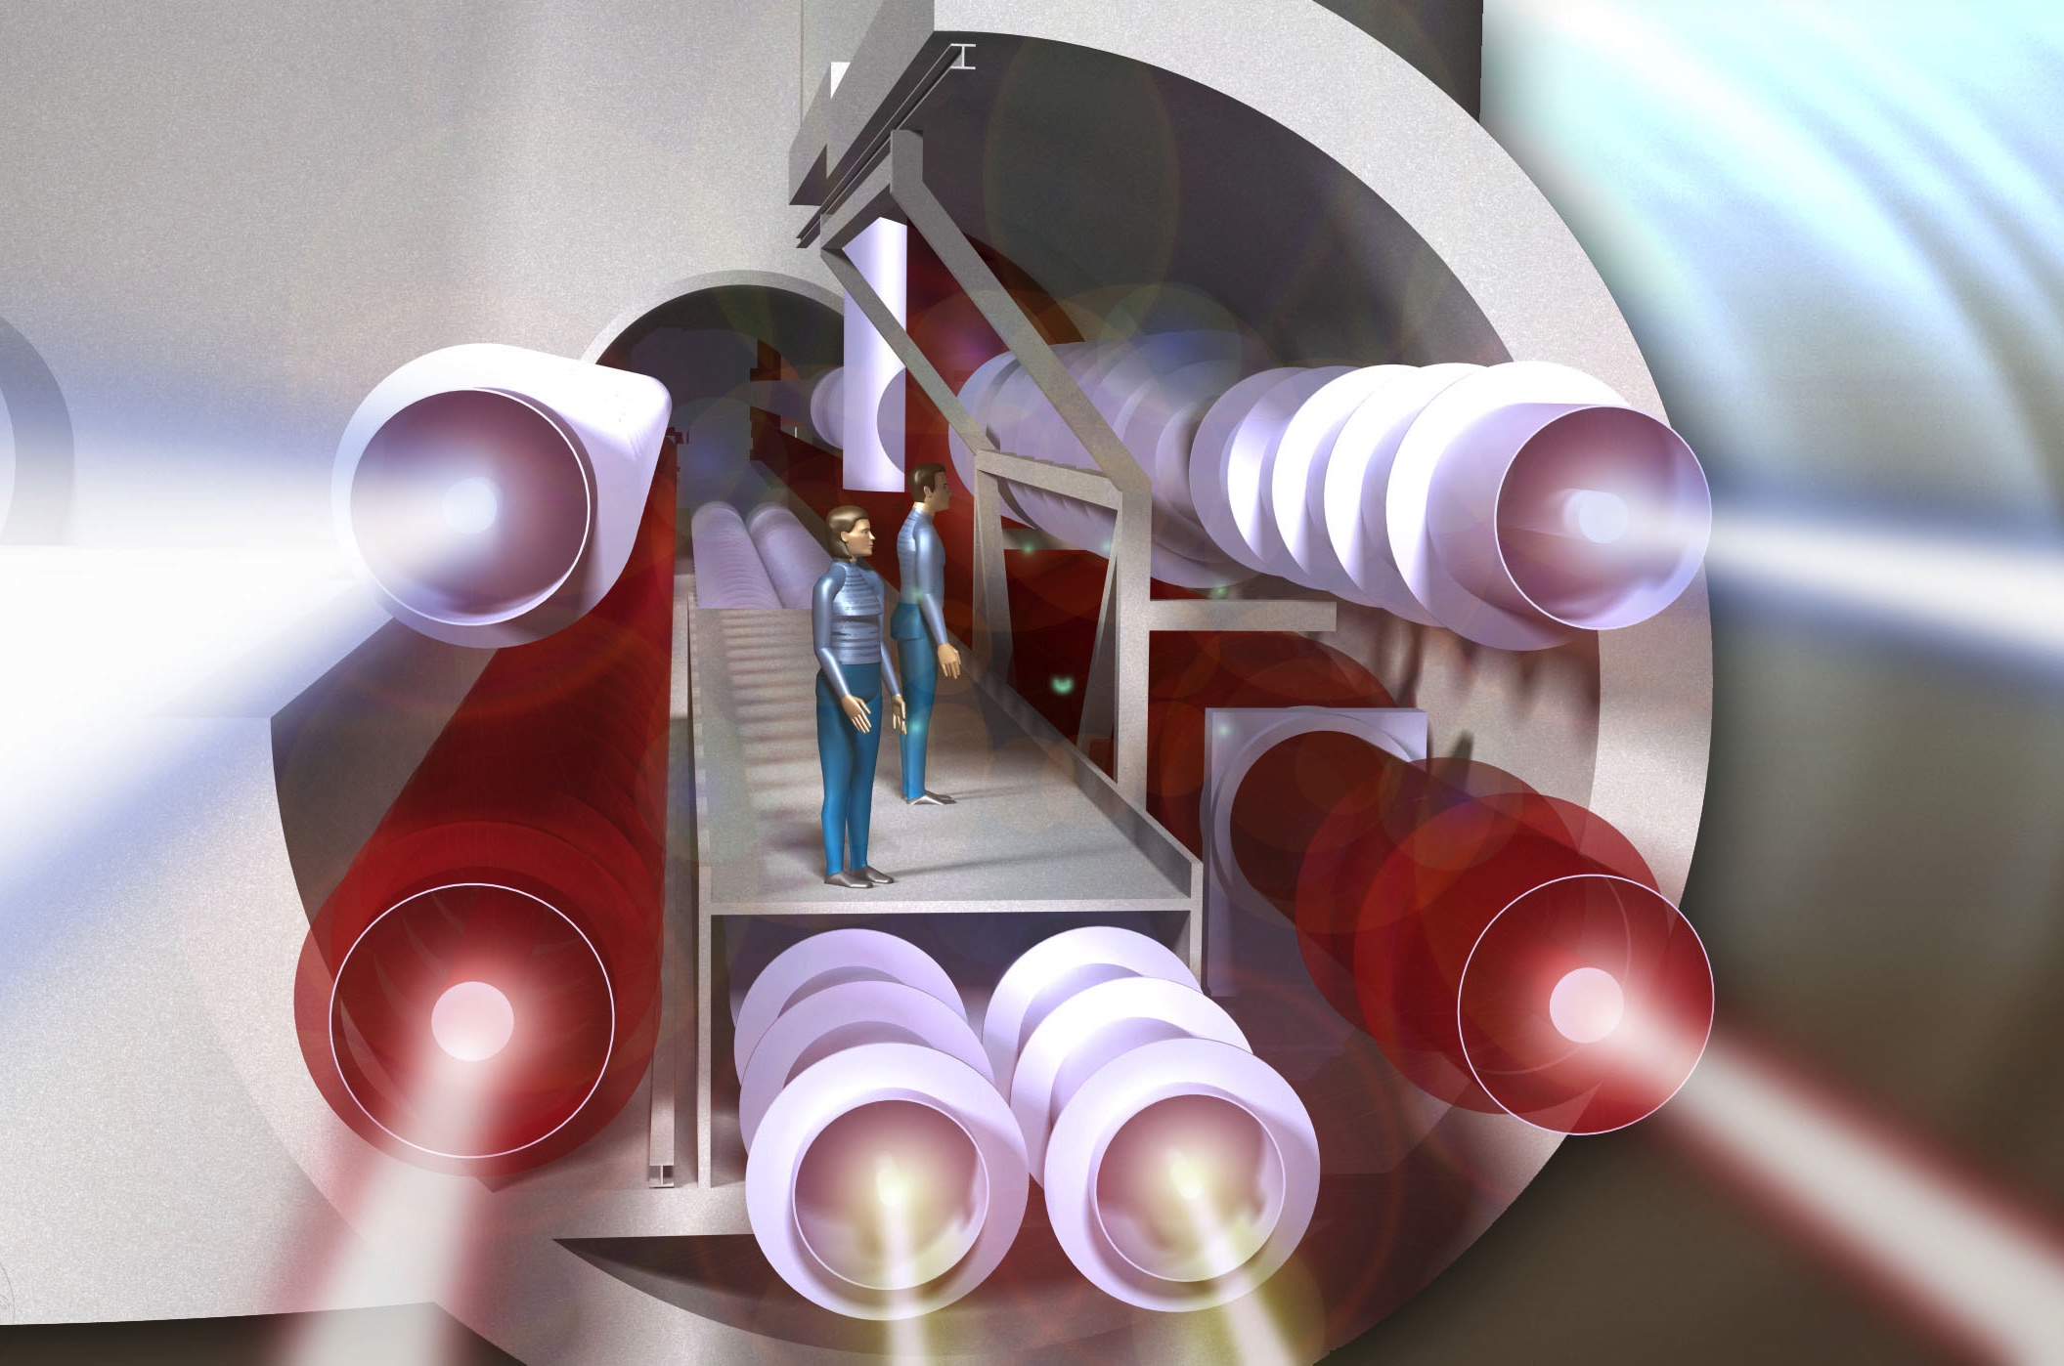
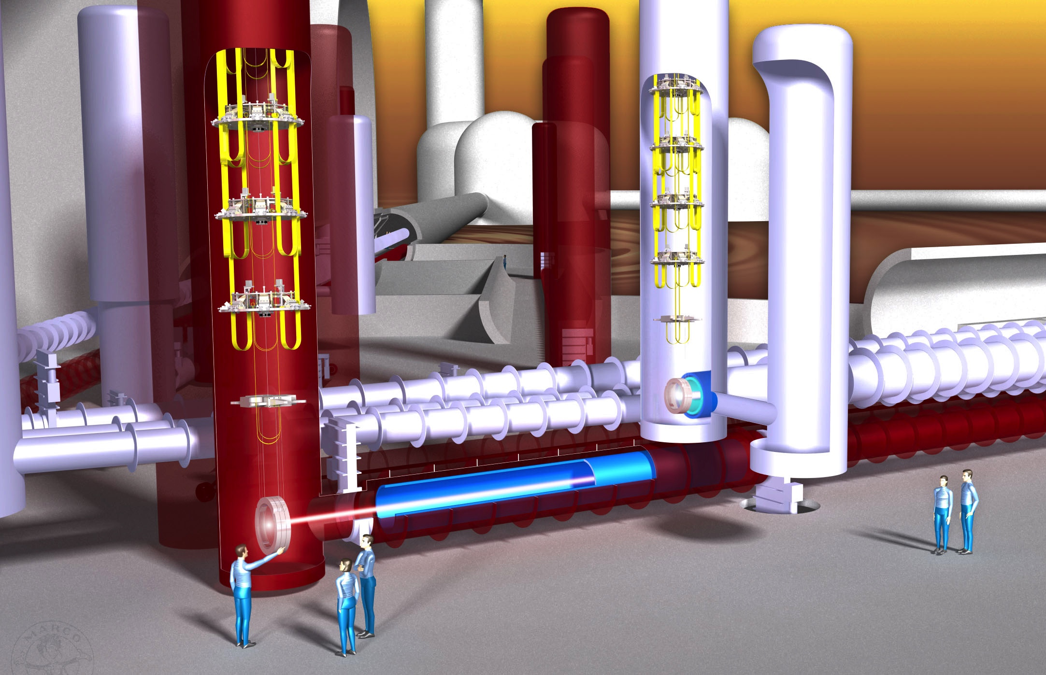
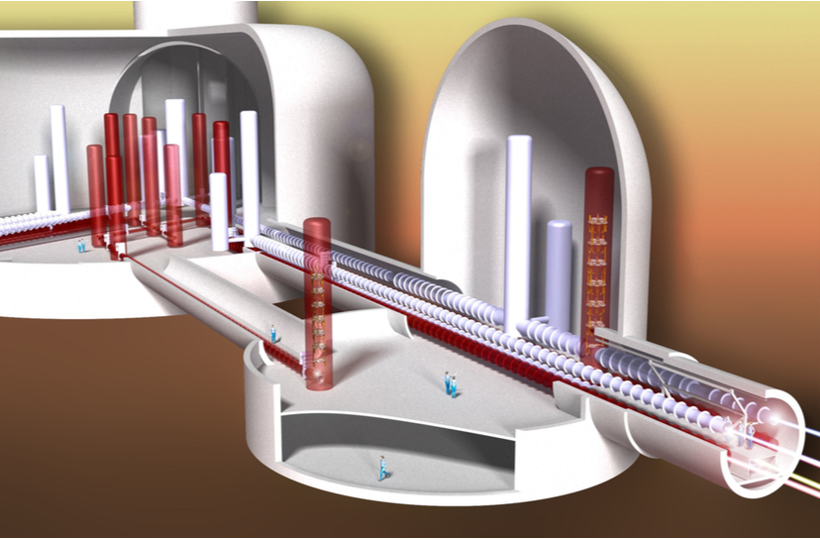
ET INFRASTRUCTURE CONCEPT
ET DESIGN STUDY, 2011

Slide 21
ET AND THE international framework

Slide 22
PROJECT ROADMAP
2018-2019 Form the ET collaboration
2019-2020 ESFRI roadmap
  Light TDR to be realised, refine CDR cost evaluation, key options to be selected, ESFRI proposal
2022 Site Selection
  Technical/political activity
  Requirements need to be compared with the site characteristics through an intense experimental activity in the next 3 years
2023 Full Technical Design Report
  Cost definition
2025 Infrastructure realization start (excavation, ….)
2030 -2031 end of infrastructure construction, start of installation
2032+: installation / commissioning / operation

Slide 23
ET COLLABORATION
Call for interest launched at the ET Symposium (May 19-20)
Subscriptions by individual scientists (>700 so far)
10th ET symposium: decision to start the procedure to approve the collaboration statute and to transform the ET community to a collaboration
http://www.et-gw.eu/index.php/letter-of-intent

Slide 24
ESFRI Roadmap Proposal
ET lTDR writing team
Name | Country
Marie Anne Bizouard | FR
Raffaele Flaminio | FR
Andreas Freise | UK
Gianluca Gemme | IT
Jan Harms | IT
Stefan Hild | UK→NL
Giovanni Losurdo | IT
Harald Lück | DE
Ettore Majorana | IT
Michele Maggiore | CH
Cristiano Palomba | IT
Michele Punturo | IT
Jo van den Brand | NL
Chris van den Broeck | NL
The procedure for the update of the ESFRI roadmap should open in June 2019 and close in April 2020
  The proposal should be ready in advance to be submitted to the national government
  Preparation based on 2018 questionnaire:
  ET CDR has been delivered in 2011
    We need a Light TDR for the technical part of the ESFRI proposal
    We need to refine our cost evaluation
Cost re-evaluation in progress, need of additional expert support (CERN?)

Slide 25
TOWARDS A 3G NETWORK
ET-3G idea is spreading in the world
  A similar scale GW observatory concept (Cosmic Explorer) is currently under consideration in the US
  Or other designs that may emerge
A global approach to coordinate the efforts toward a Global Research Infrastructure vision is underway
  Bottom-Up approach: GWIC-3G
    Through the “Gravitational Wave International Committee”, scientists have established a coordination team named GWIC-3G (see next slide) that is investigating the future network of 3G observatory from several points of view: addressing its scientific potential, the technological development needed, the opening and growing of the scientific community, the relationship with the funding agencies and the governance model to be adopted.
  Top-Down approach: GWAC
    Funding agencies supporting or interested in GW research activities have established the “Gravitational Wave Agencies Correspondents”, an information exchange forum to develop higher-level coordination

Slide 26
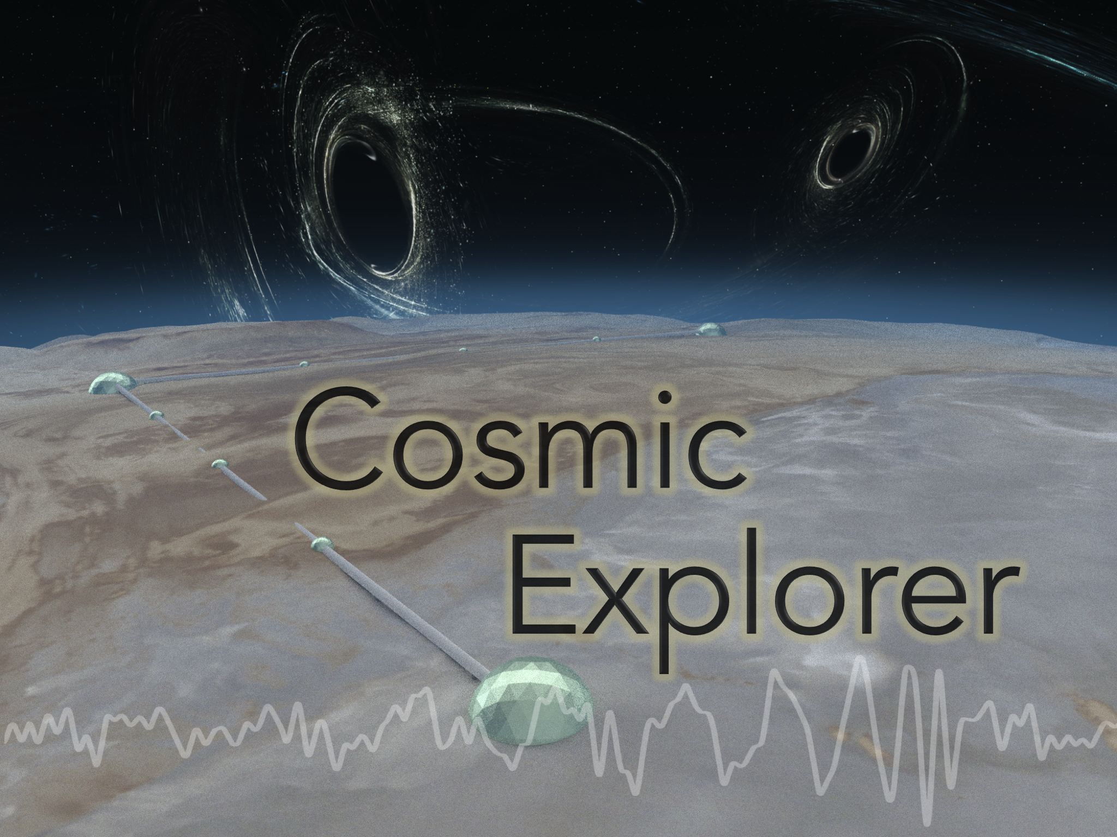
PLANS IN THE US
40 km ON-SURFACE DETECTOR, DESIGN STUDY FUNDED BY NSF

Slide 27
SITE optionS
Limburg (NL)
Matra (HU)
Sos Enattos (I)

Slide 28
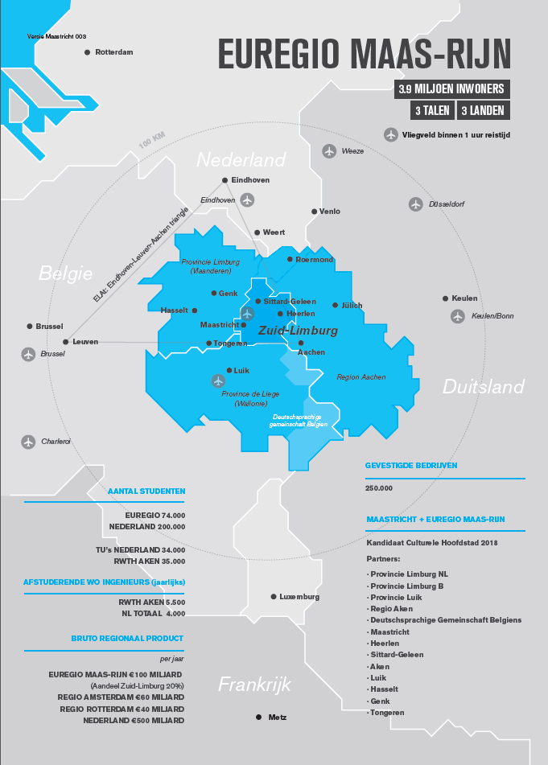
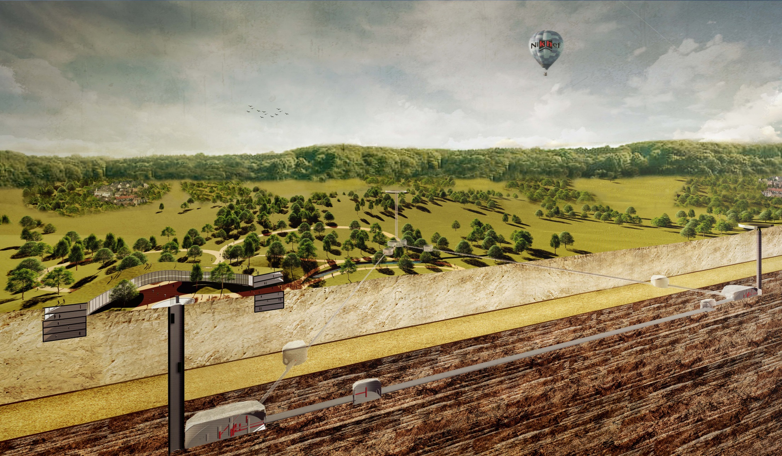
EUREGIO MEUSE-RHINE
A proposal to realize ET in the Limburg area
A strong asset: a detector hosted by 3 countries (B-D-NL)

Slide 29
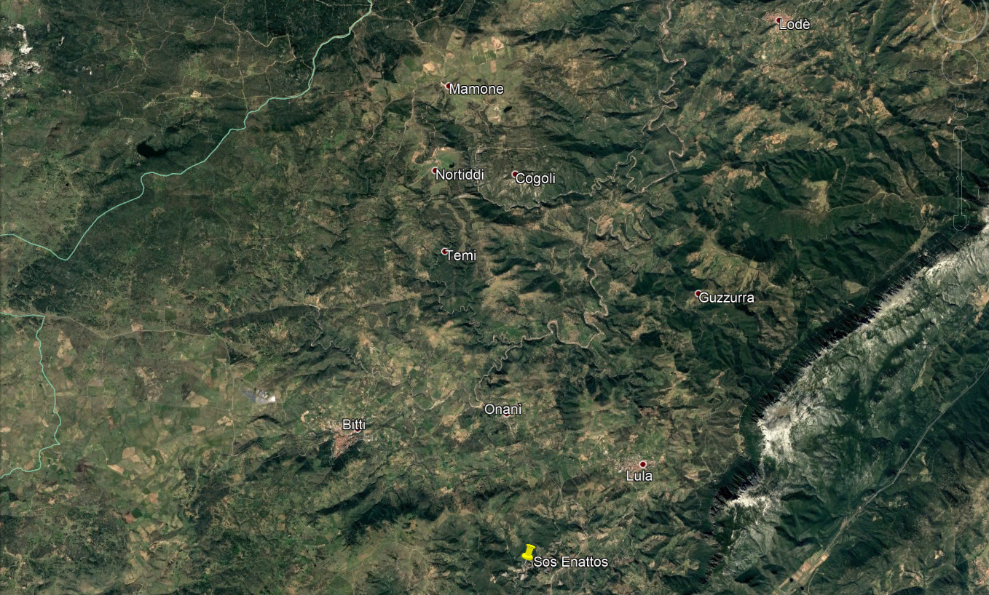
SARDINIA - SOS ENATTOS

Slide 30
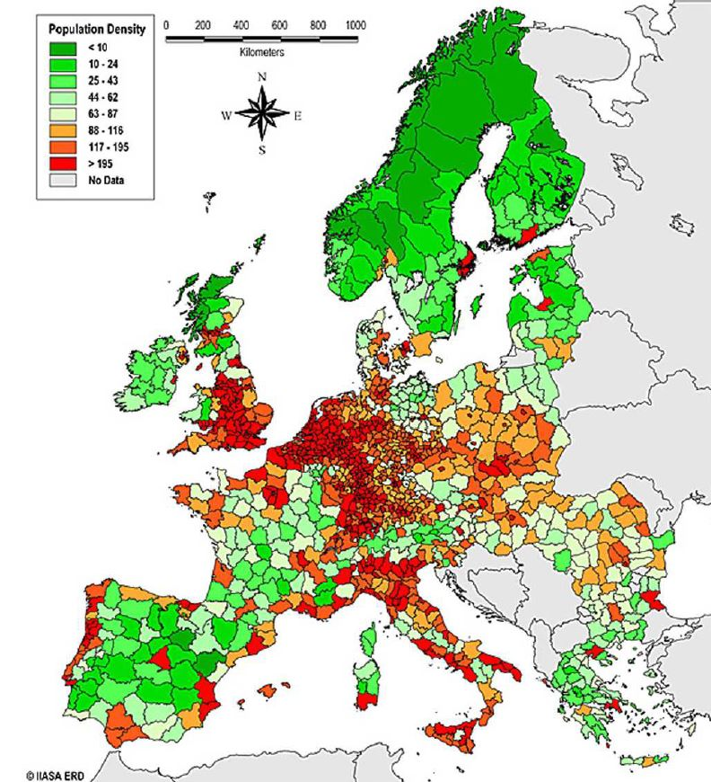
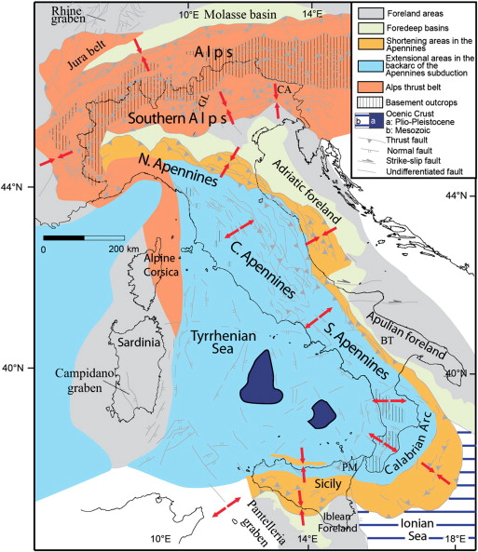
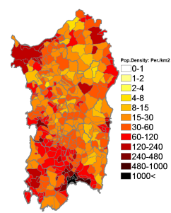
One of the least populated areas in EU
Ancient rocks, European continental landmass:
seismically quiet

Slide 31
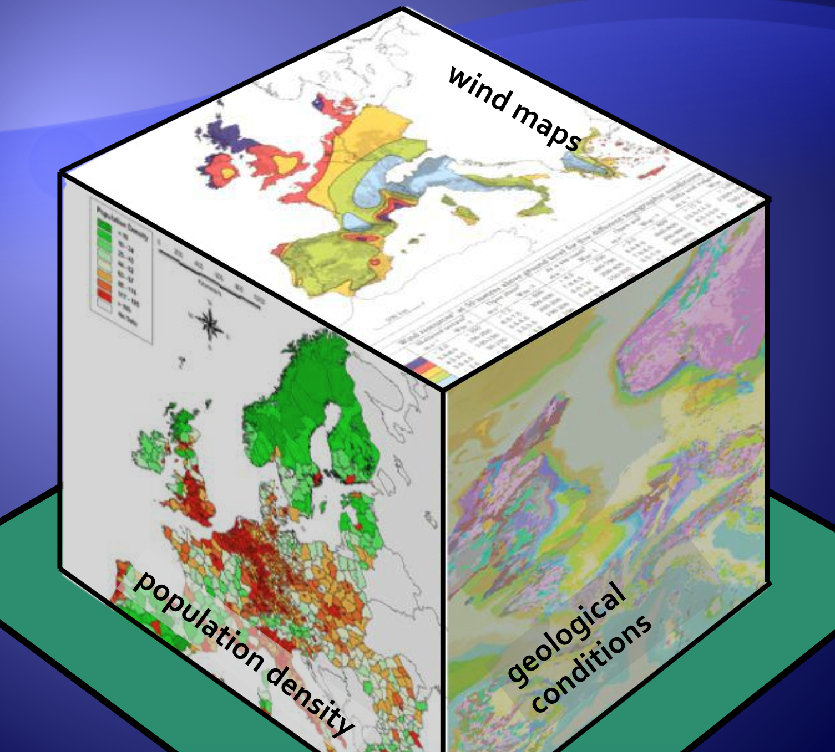
SITE SELECTION
POLITICAL
SUPPORT
LOGISTICS
FUNDING
AGENCIES
PRIORITIES
…

